Slide 1
Introduction to the Kwame Nkrumah University of Science and Technology, Kumasi Ghana

Slide 2
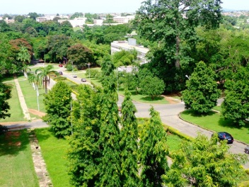
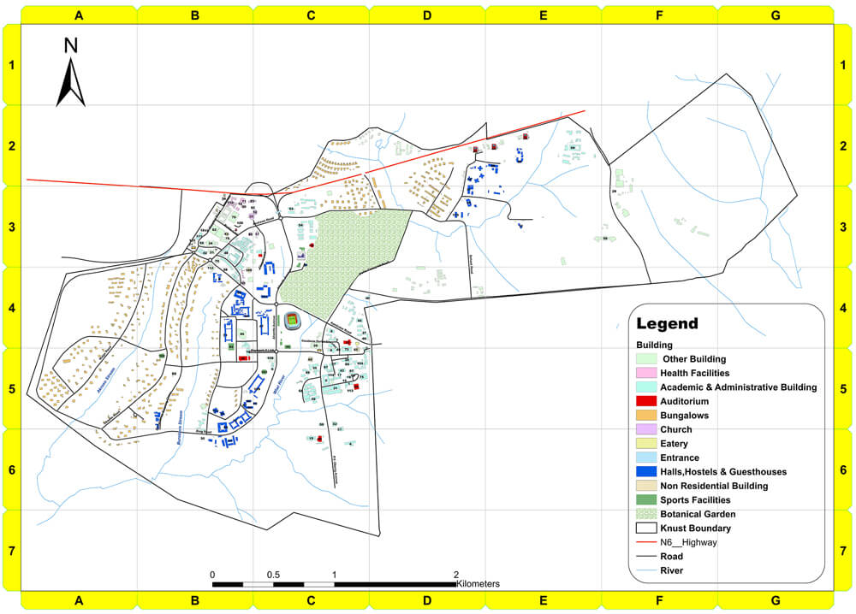
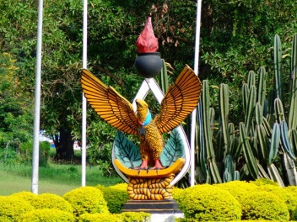
Kwame Nkrumah University of Science and Technology
Beautiful campus of 17 km²

Slide 3
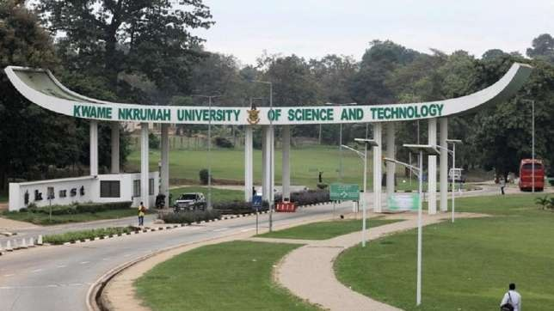
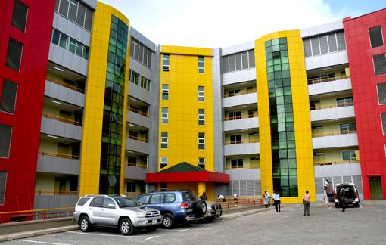
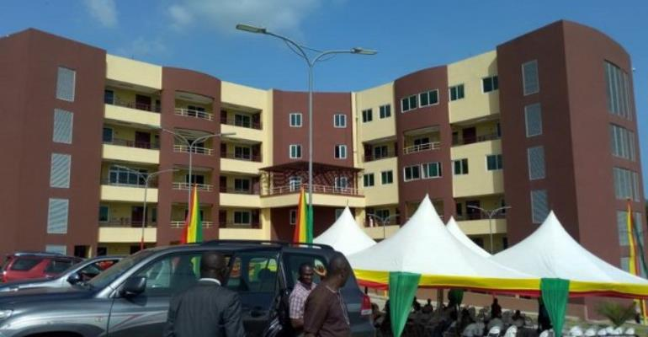
Kwame Nkrumah University of Science and Technology
Kumasi: Main Campus
Accra
Takoradi

Slide 4
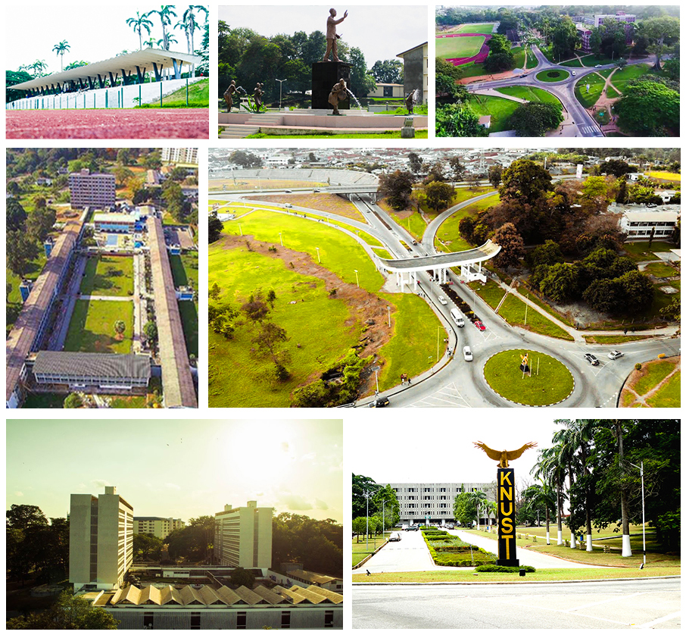
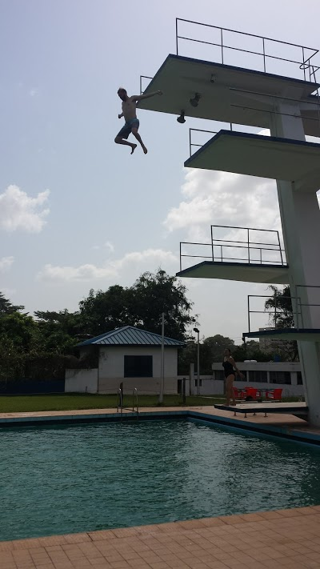
Kwame Nkrumah University of Science and Technology

Slide 5
KNUST Colleges
Six colleges
  AGRICULTURE AND NATURAL RESOURCES
  ART AND BUILT ENVIRONMENT
  ENGINEERING
  HEALTH SCIENCES
  HUMANITIES AND SOCIAL SCIENCES
  SCIENCE
  INSTITUTE OF DISTANCE LEARNING

Slide 6
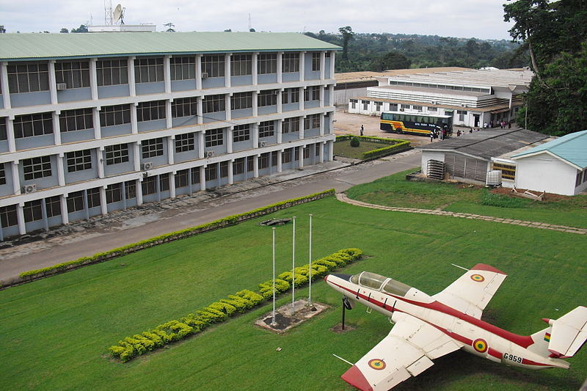
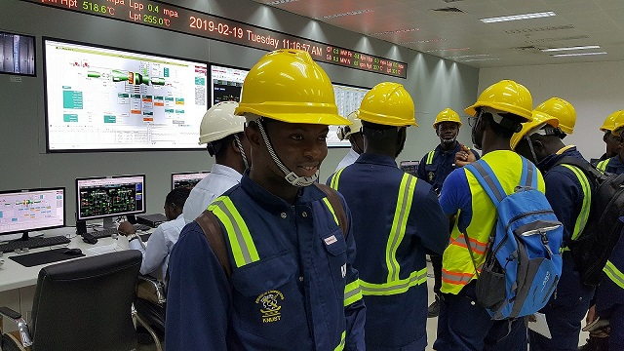
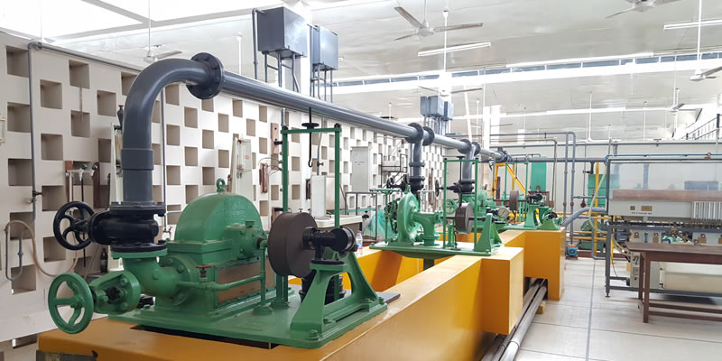
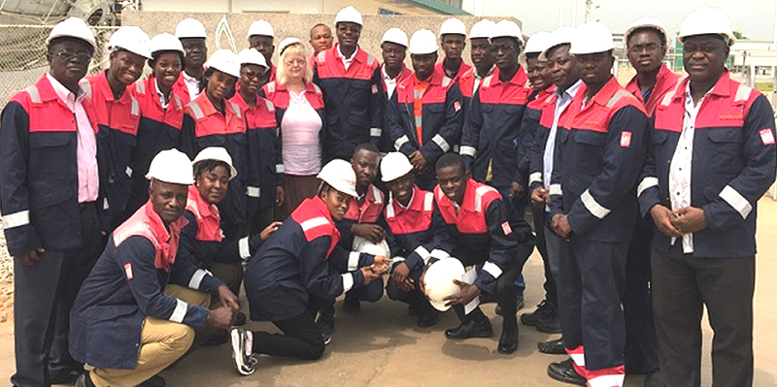
Kwame Nkrumah University of Science and Technology

Slide 7
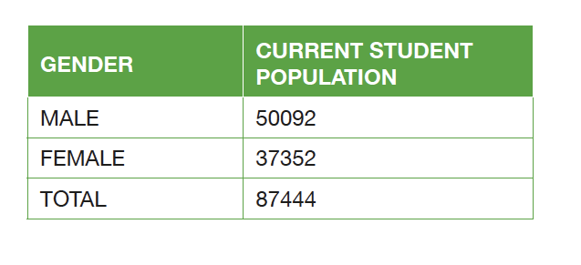


Statistics at KNUST

Slide 8
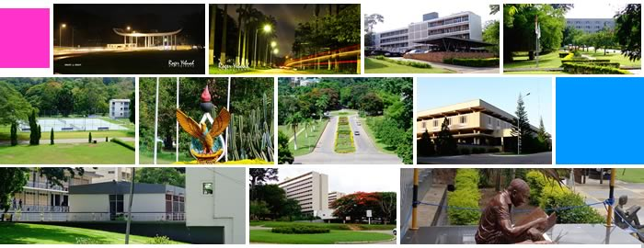
Statistics at KNUST
1,120 Academic staff
3,237 Total work force

Slide 9

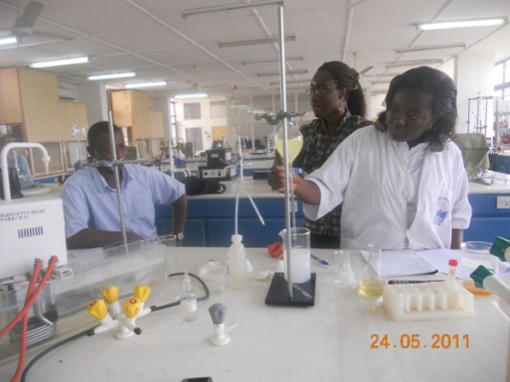
The Brew-Hammond Energy Centre
Created in 2009
Multidisciplinary research
In the area of Energy (Conventional and Non-conventional)
National and international relevance

Slide 10
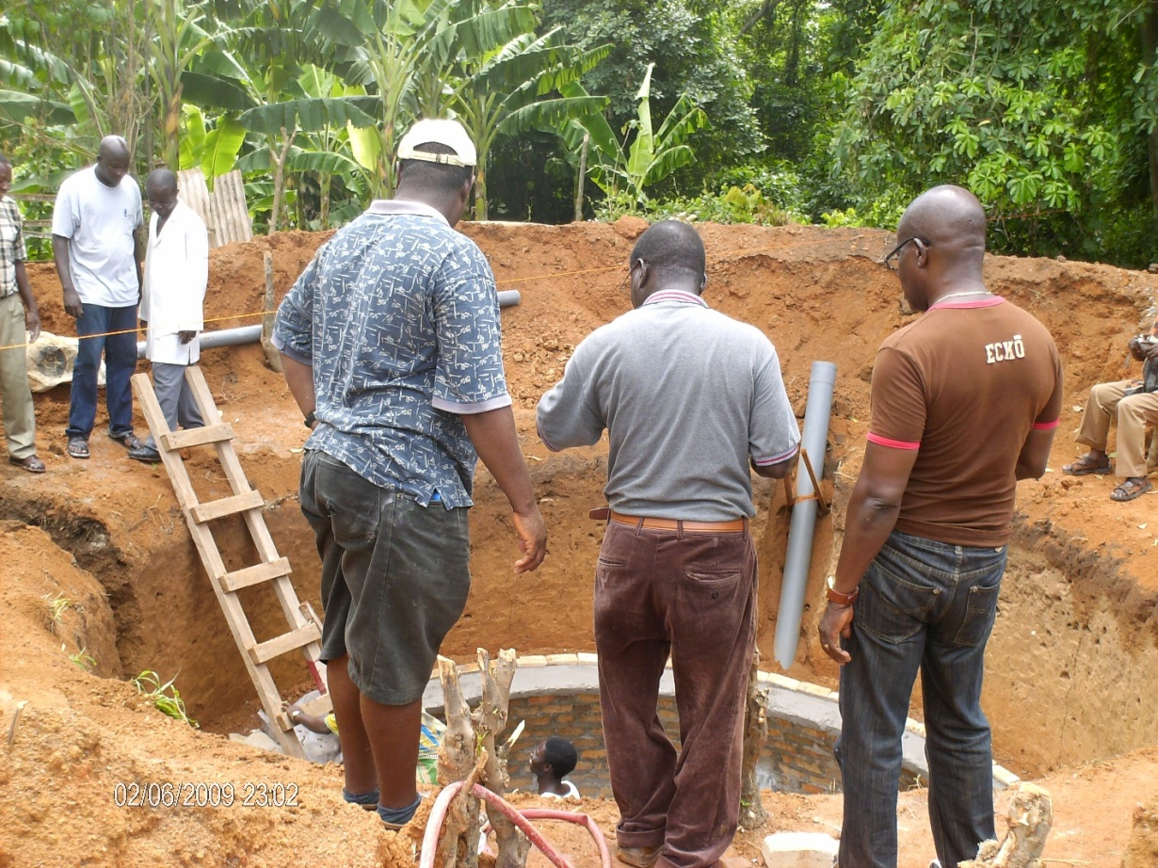
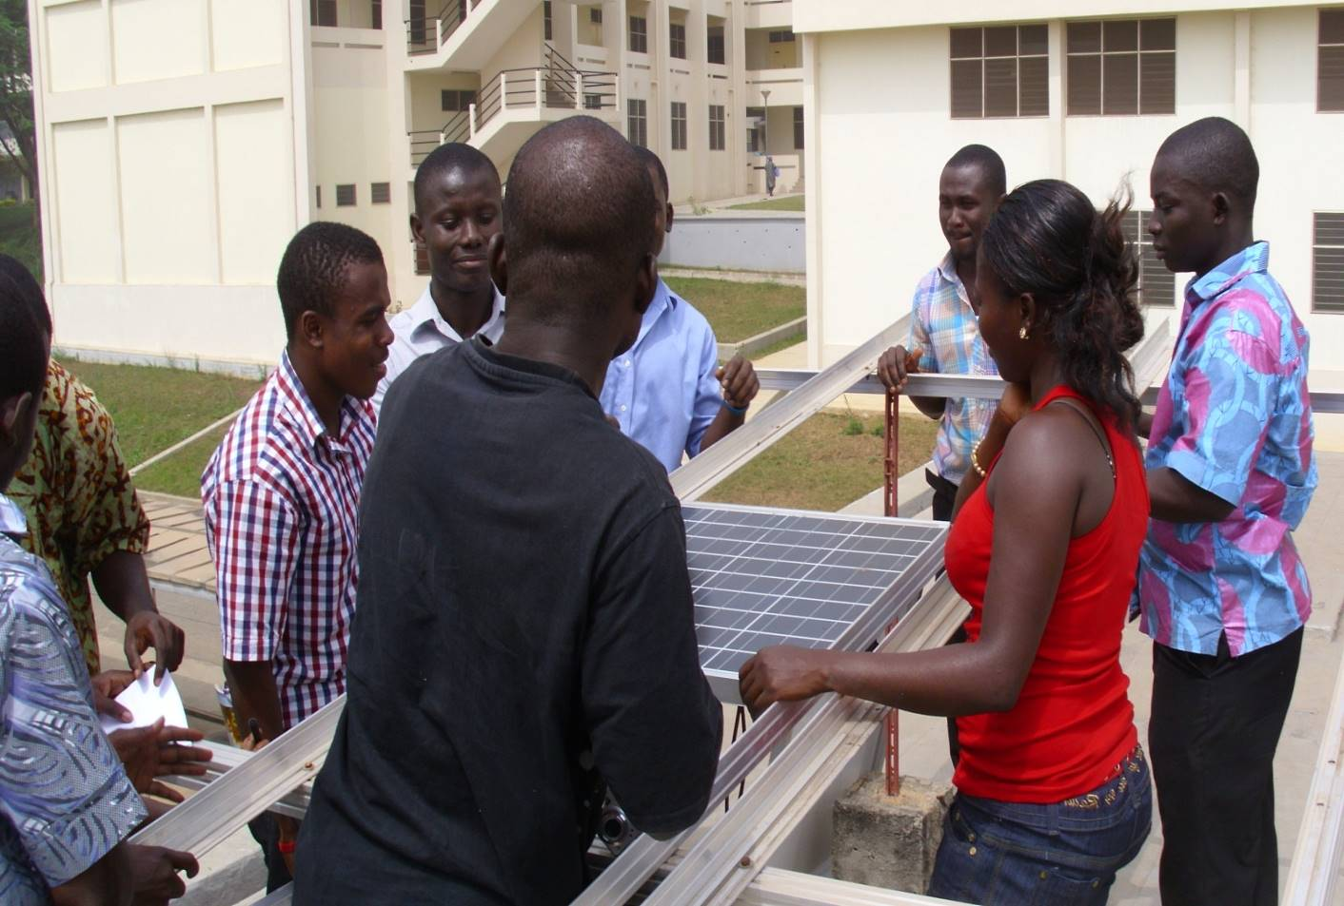
The Brew-Hammond Energy Centre
Training
Research
Advisory services to public and private actors
Harvesting and dissemination of knowledge and best-practices
Enhance capabilities of selected/ interested academic staff
Create an effective organizational framework for collaborative, interdisciplinary R&D within KNUST
In energy technology, policy and management

Slide 11
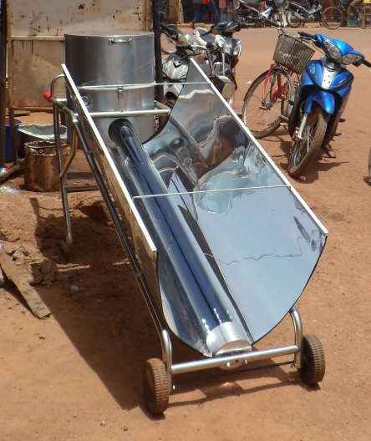
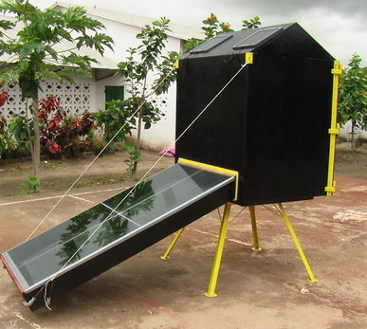
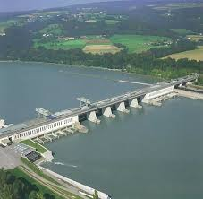


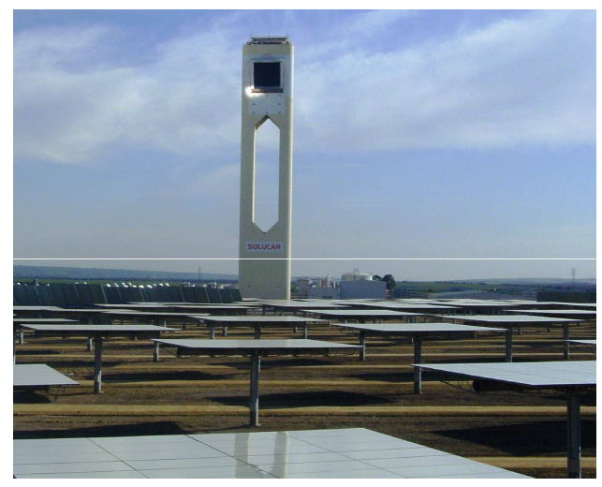
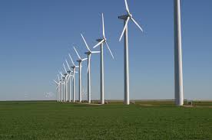
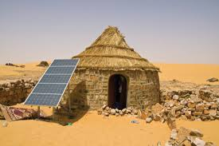
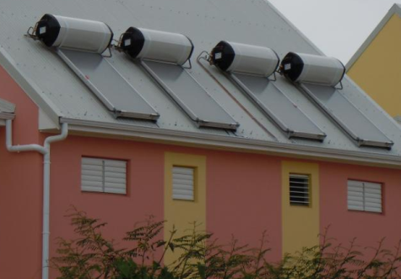
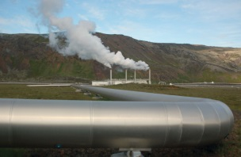
The Brew-Hammond Energy Centre – Focus areas
Some of the focus areas are: Wind, Solar PV, Solar Thermal, Biomass, Biogas, Biofuels, Waste to Energy, Hydropower, Energy Economics and Financial Modeling, Energy Efficiency, Energy Policy, Smart Grid Systems, Conventional Sources of energy, Climate Change, etc.
11

Slide 12
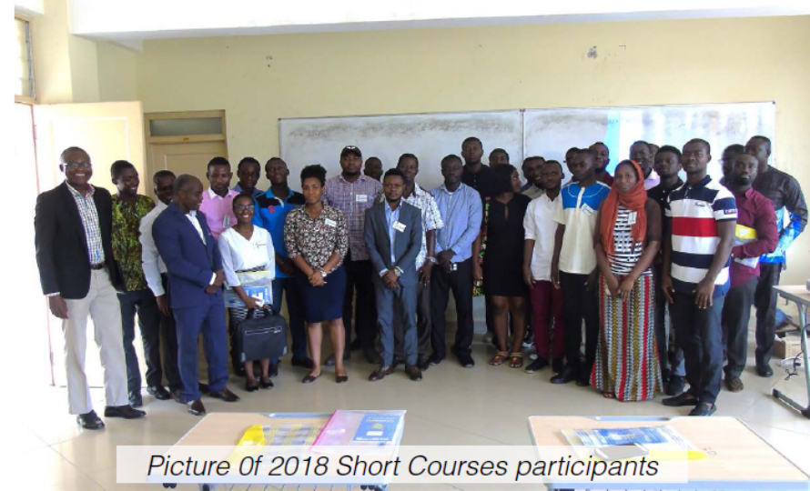
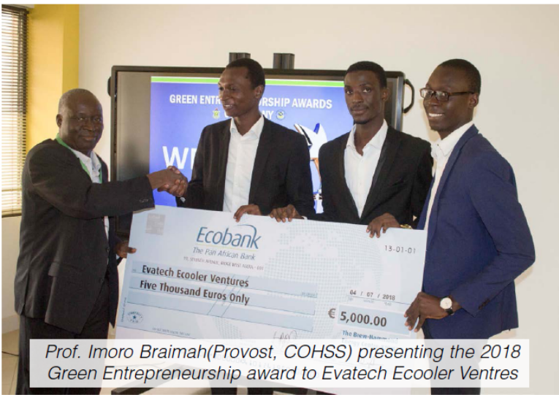
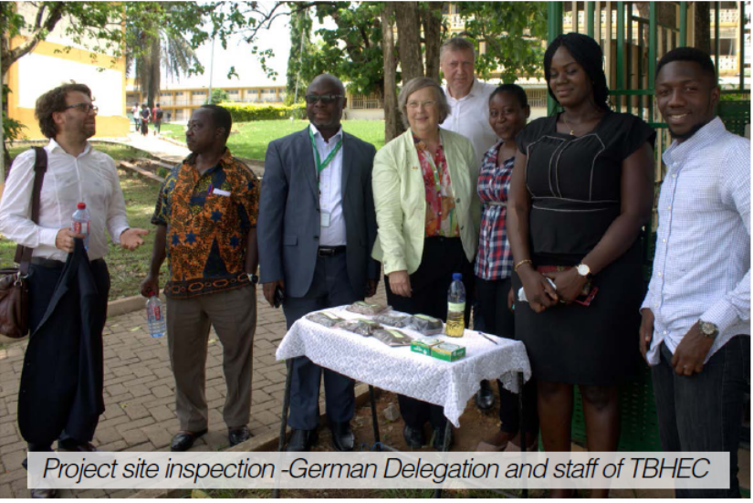
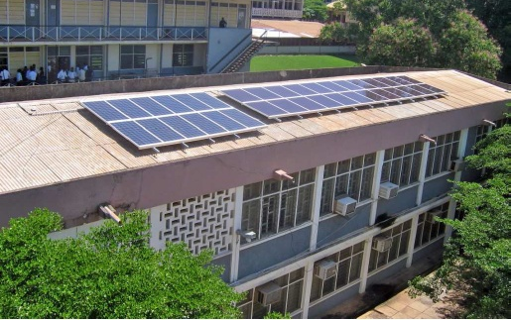
The Brew-Hammond Energy Centre – Projects
Since its Creation, TBHEC has actively implemented more than 70 projects funded by various partners.
12

Slide 13
The Brew-Hammond Energy Centre – Some projects
 | Project Title and Sponsor | Project Budget
 | AU GRID SOLAR – African Union | € 934,056.60
2. | CSP4Africa –African Union | €81,686.00
3. | ECOWREX -ECREEE | € 1,090,878.71
4. | Edulink REEP – ACP-EU | € 575.928,57
5. | EREF Project – ECREEE | € 8,283.00
6. | GEDAP – Ghana Govt | GH¢ 136,887.50
7. | RE4Food - University of Newcastle | € 824,069.00
8. | UNIDO Biogas–UNIDO and Korea | € 1,280,000.00
9. | REEEP – Energy Commission, Ghana | € 90,923.00
10. | Africa LEDS – UNEP-EU | US$1,793,000.00
11. | EBAFOSA – UNEP | $ 70,000.00
12. | AFREC - African Energy Commission | US$ 28,000.00
13. | TARIFF – Ghana Government | $126,200

Slide 14
The Brew-Hammond Energy Centre – Academics
Under the Edulink REEP – ACP-EU project, MSc Renewable Energy Technologies programme was designed
Under the UPERCRETs project, MPhil Renewable Energy Technologies and PhD Sustainable Energy Technologies programmes were designed
The masters (MSc and MPhil) programmes are targeted for the ProREG project
First semester core courses
GIS for Sustainable Energy Applications
Research Methods
Energy Policy, Gender and Planning
Energy and Environment
Second semester core courses
Entrepreneurship and Small Business Management
Project Analysis and Management
Renewable Energy Laboratory
First semester elective courses
Liquid Biofuel Production Systems
Biogas Technology
Solar Thermal Technology
Small Hydropower Technology
Second semester elective courses
Solar PV Technology
Wind Power Technology
Bio-energy Technology
Hybrid Energy Systems

Slide 15























The Brew-Hammond Energy Centre – Partners
15

Slide 16
THANK YOU

