Slide 1
climate finance programs and initiatives BY SECO IN GHANA
01.10,2024.

Slide 2

Macroeconomic policies
Trade and private sector
Financial sector
Infrastructure financing

Slide 3
Seco SUPPORT AREAS (Energy Infrastructure)
Promoting the use of Renewable Energy. GEDAP III: Ghana Electricity Sector Support Project. Scaling Up Renewable Energy Program (SREP) - Component II: The Net-metering PV Project.

Slide 4
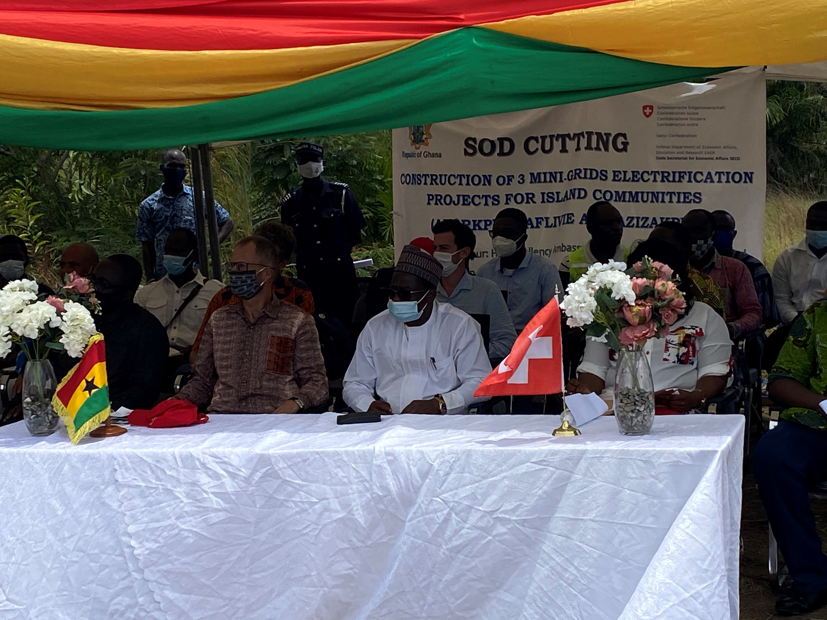
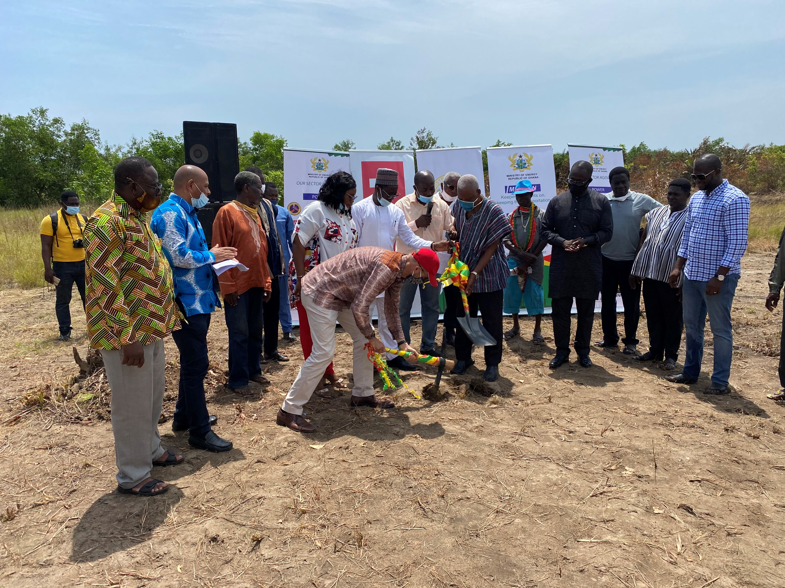
GEDAP III: Ghana Electricity Sector Support Project.
Construction of three (3) Solar-powered Minigrids with Lithium ion batteries on three (3) islands in Ada.

Slide 5
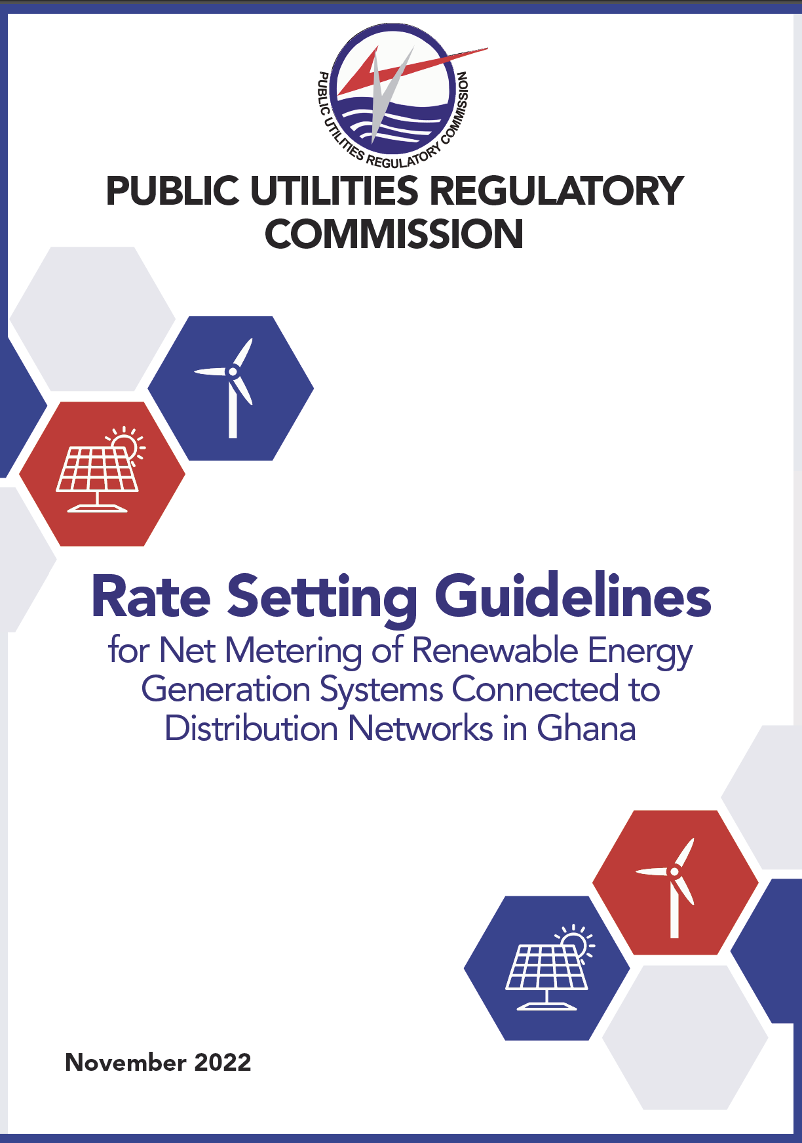
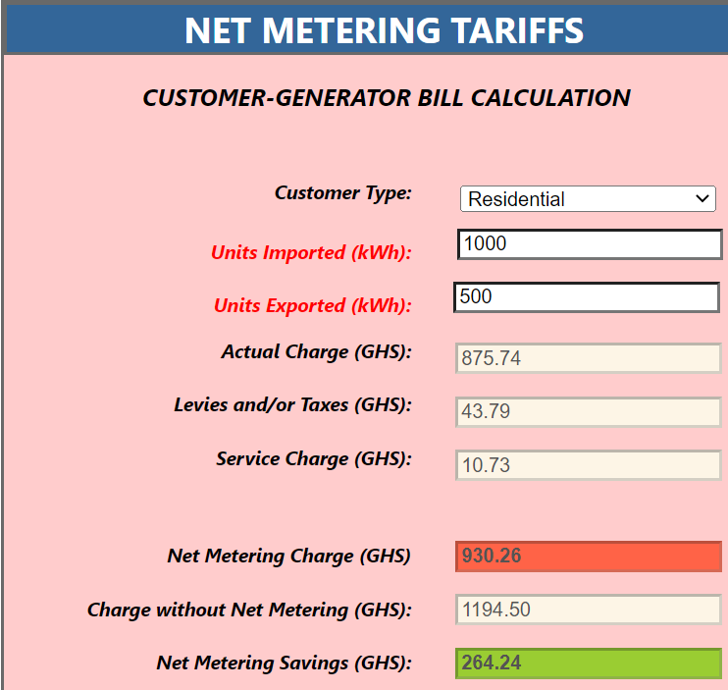
Net metering

Slide 6
Net-Metering PV project (NMPV) and its Opportunities
The NMPV project is aimed at creating an enabling and sustaining environment for renewable energy scaleup and leveraging additional private and public financial resources to the renewable energy sector.
Project Targets: 12,000 NMPV systems (62.5MW) , 4 Utility Scale Battery Energy Storage System(BESS)
GoG Implementing Ministry: Ministry of Energy
Implementing agency: Energy Commission
Funding sources: SECO($14m), AfDB($11m), CIF($11.9m), GoG($8m), Private sector ($66m)
Overall estimated project cost: $110.9m

Slide 7
Net-Metering PV project (NMPV) and its Opportunities
Beneficiaries under the Project:
Energy Commission
Public Utility Regulatory Commission (PURC)
Electricity Company of Ghana (ECG)
Northern Electricity Distribution Company (NEDCo)
Local Solar Installation Companies
Private Businesses and Households

Slide 8
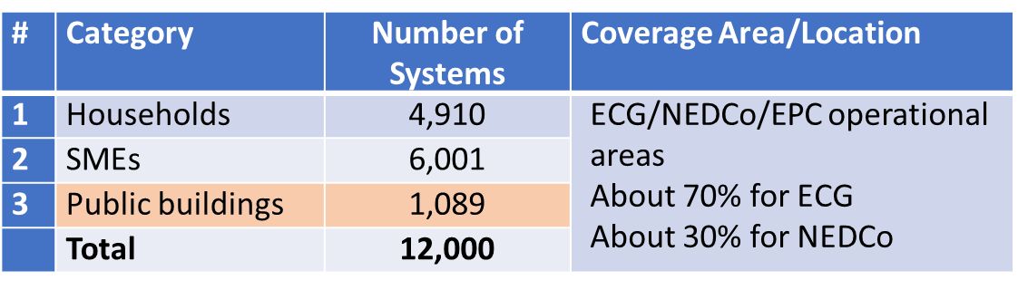
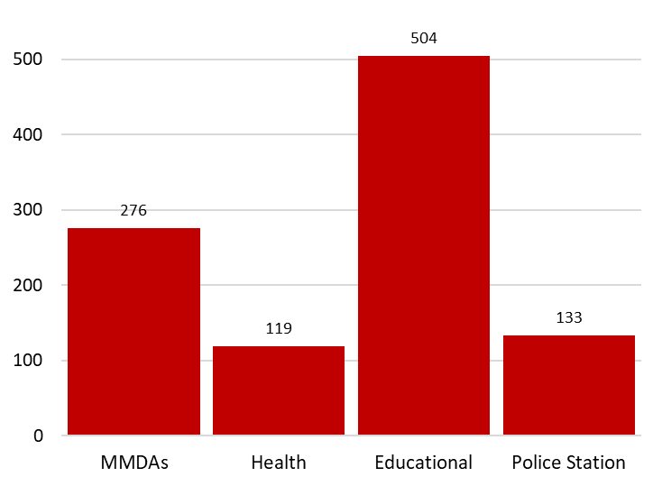
Project Targets:
12,000 NMPV systems

Slide 9
Private sector incentives under the NMPV project
Approx. 11,000 PV systems will be installed by private sector.
Free net-meters for grid-connected PV systems.
Free installation of net-meters by staff of ECG & NEDCo.
Up to 24% subsidy on all systems installed under the project.

Slide 10
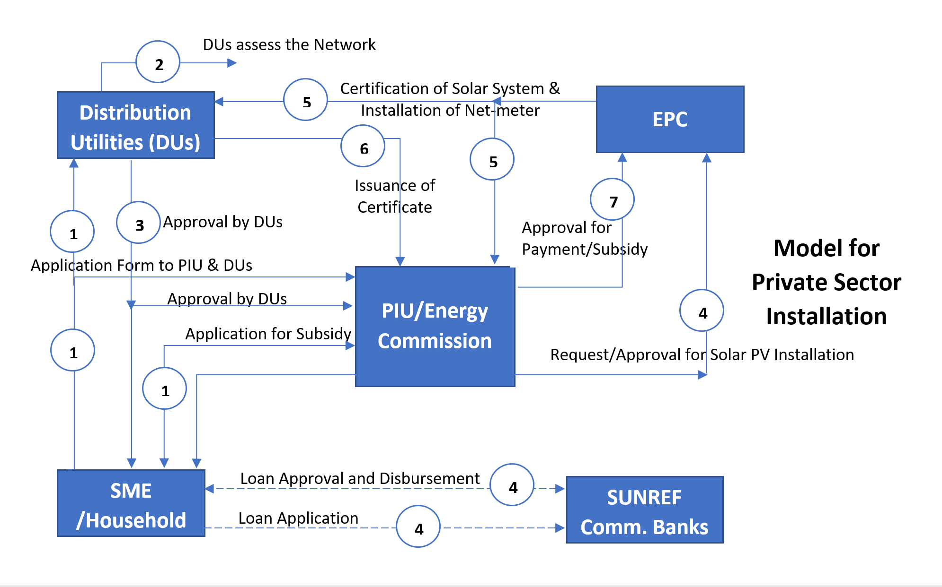
Process flow Households and SMEs

Slide 11
Solar PV based net metering with battery storage: installation of 12,000(62.5MW)
solar PV net metering systems.
Next steps under the Project:
Completion of Tender process for the procurement of Net Meters.
Completion of Tender process for the procurement Solar PV Systems for Public Buildings.
Completion of Tender process for the procurement for web application platform.
Development of NMPV communication materials (FAQ) to market the Project.
Trainings for Distribution Utilities and Solar Installation Companies.
Commencement and Official Launch of Project in Q3 2024.

Slide 12
The NMPV GOVERNANCE COUNCIL
Members of the GC:
Ministry of Energy (SREP PIU)
SECO
AfDB
Energy Commission
ECG
NEDCO
PURC
EPA
Solar Assc. Groups
Academia

Slide 13
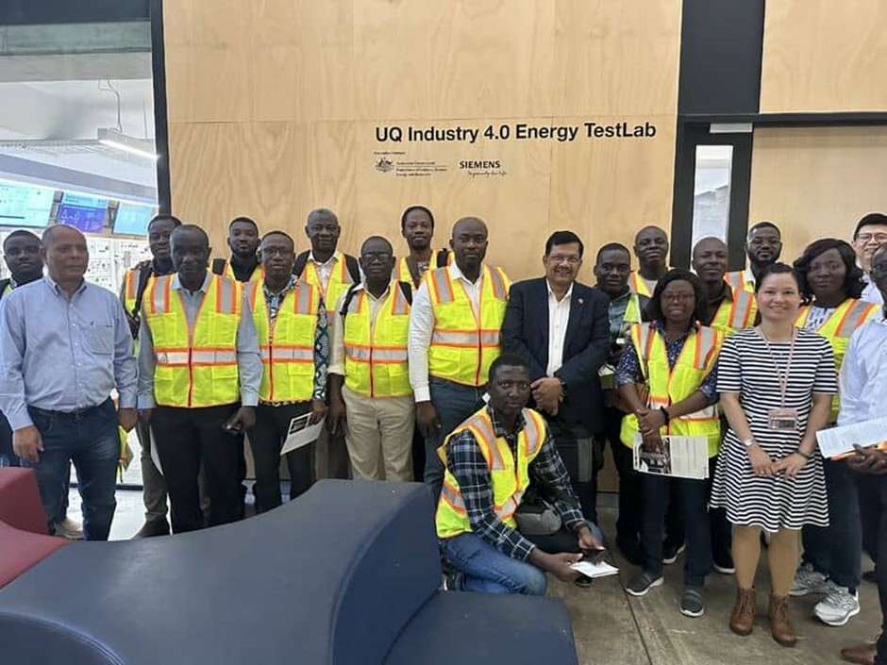
Net – metering PV Study Tour to Queensland, Australia (10.11 –
20.11.2023)

Slide 14
Key FINDINGS
Collaboration with Industry explored win-win scenarios(e.g. UQ industry 4.0 Energy Test lab was built with funding support from SIEMENS).
The Lab is used to perform power system simulations for utilities and Renewable energy grid – tied solar systems. It can also be used for forecasting and simulating faults and fault management.
The University has a strong collaboration with the power utilities and energy companies and has recently simulated and produced a report that shows how Queensland’s grid network will look like by 2025 – Basically serving as the Technical Assistance arm, research arm of the Power Utilities.

Slide 15
THANK YOU
Andrew Boamah Asare
National Programme Officer, Infrastructure
Embassy of Switzerland
Swiss Cooperation Office Ghana
Mobile: +233 201 70 24 08
andrew.asare@eda.admin.ch

