Slide 1
UENR PRESENTATION
DIR. RCEES | UENR | EXPLORATORY VISIT

Slide 2

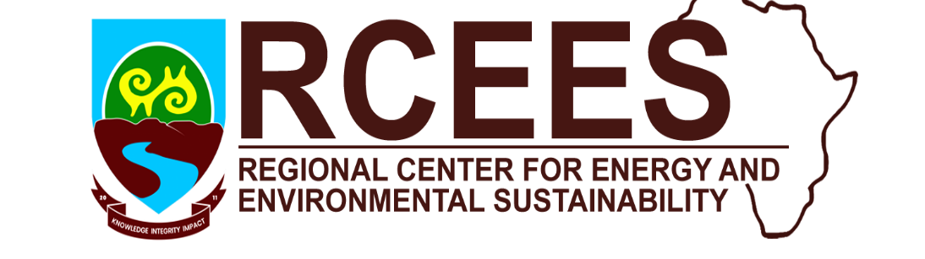
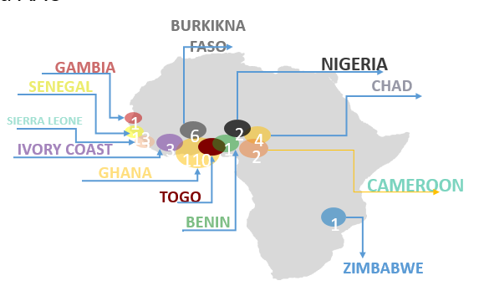
UENR Profile
UENR was established in 2012 by an Act of Parliament (Act 830)
  Vision: To become a world class institution for generating, advancing and applying knowledge in energy and natural resource sciences.
RCEES was established in 2019 by the World Bank (WB) and Association of Africa University (AAU) through the Africa Centre of Excellence (ACE) Impact Project.
  Vision: To be the leading internationally accredited Centre of Excellence that provides Quality Research and Postgraduate Education in Energy and Environmental Sustainability.
www.rcees.uenr.edu.gh
www.uenr.edu.gh

Slide 3
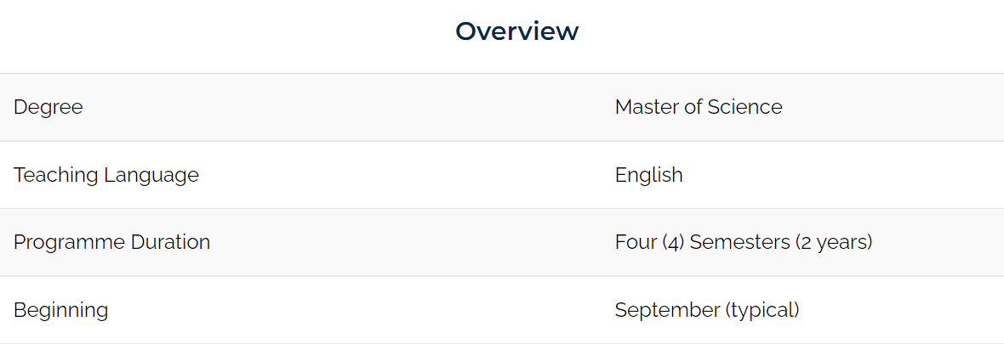
The Master Programme
Master of Science, Sustainable Energy Engineering and Management (SEEM).
It is ran in the Department of Renewable Energy Engineering, under the School of Energy.
The programme aims to produce graduates with advanced knowledge and skills in sustainable energy engineering and management.
Course related to Renewable Energy(Wind Energy, Solar Energy, Bioenergy, Geothermal Energy etc) will be spread across the first two semesters.
Master of Science Renewable Energy Engineering

Slide 4
The Master Programme
Course Structure of SEEM
FIRST YEAR FIRST SEMESTER
Renewable Energy
Advanced Mathematical Tools and Simulation
Energy Systems - Analysis, Design and Optimization
Energy Operations and Supply Chain Management
Energy and Environmental Sustainability
Energy Policy, Economics & Markets
ELECTIVES
Sustainable Energy Resources and Technologies
Modelling and Analysis of Sustainable Energy Systems
Waste to Energy
Power Grid Analysis
Computational Fluid dynamics (CFD)
Application of GIS and Remote Sensing in Energy Systems
Life Cycle Assessment
Energy Storage and Conversion Systems
FIRST YEAR SECOND SEMESTER
Statistics & Research Methods
Energy Efficiency and Management
Entrepreneurship, Project Management and Ethics
Master Plan-Integrated Project
NON SCORING AND RESEARCH
Course Description
Field Trip
MSc. Sustainable Energy Engineering and Management Project (Dissertation)
Energy Seminar

Slide 5
Cooperation with Industry
The university was established with inputs from industry players and have since remained same
The Centre has industrial advisory board linking the university to industry
Industry players apart from making direct inputs into the curriculum, help in the training of students in diverse ways example include;
Seminars and Conferences
Offering internship opportunities for students to complement what they study in school
Giving research problems to students to solve (Bui Power has been instrumental in this aspect).
Sponsoring their staffs to be trained by the University
Offering Supervision guide to students.
Development Partners
Regulatory bodies.
Energy Commission
Ministry of Energy
Industrial players
Volta River Authority
Strategic Power Solutions
Bui Power Authority
Ghana National Petroleum Corporation (GNPC)
Professional Bodies
Ghana Institution of Engineering (GhIE)
International community
Gesellschaft für Internationale Zusammenarbeit GmbH (GIZ), German Agency

Slide 6
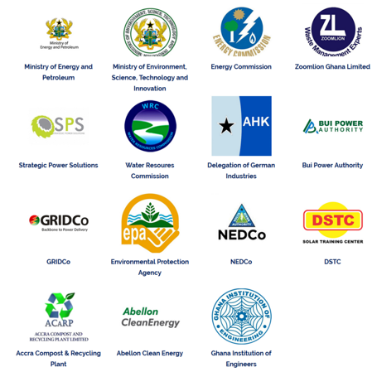
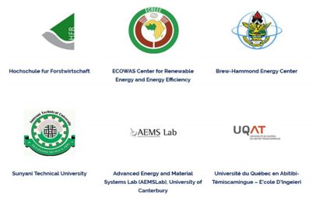
Cooperation with Industry
INDUSTRIAL AND ACADEMIC PARTNERSHIPS

Slide 7
The short term courses
Currently the centre runs short courses in the following areas;
Solar-Powered Irrigation Systems (SPIS)
Design and installation of Solar PV systems
Design and installation of Biogas-Technology.
Energy Audit Practical(EAP)
Duration & Mode of delivery
One week, two weeks to a month and blended mode of delivery
Certification
Certificate of Participation
Certificate of Competence
Professional Certificate (EAP, SEAP & SEMP)
Fee
1000 Cedis to 5000 cedis
Sustainable energy Audit professional (SEAP)
Sustainable Energy Management Professional(SEMP)

Slide 8
Student centred, project organised learning
The university has established a Centre for Professional Development (CePDEV) for staff development where academic enhanced trainings are frequently organised for staff.
The Lecturers in the SEEM course and some other lecturers in the university are familiar with the concept of SCL & PBL.
Students in the Bachelors Renewable Energy Engineering Program are conversant with SCL & PBL
The students undertake semester projects which serves as the semester theme.
The EEISHEA project has been impactful in the area of knowledge in the SCL & PBL ways of teaching. There were a number of teacher trainings organised for the lecturers in the University.

Slide 9
UENR Vision on the ProREG
Vision
  ProREG will develop professionals in the field of renewable energy to enable them develop renewable energy education in Ghana .
Students
  Students will get employable skills and be able to establish companies and employ others.
Industry
  Industries will employ qualified and competent students that are trained by the university(UENR). They will also benefit from the quality research outputs from students.
University
  Through ProREG lecturers will enhance their pedagogical skills to deliver quality and impactful teaching .
  Through research, UENR will attain higher recognition in the world and become a research hub in renewable energy which is in line its vision.
This can be achieved through a strong partnership with the industries and all important stakeholders

Slide 10
THANK YOU

