Slide 1

Edutex-
An Example from Ethiopia
PD Dr. Stefan Wolf | TU Berlin | Kick-Off Meeting of ProREG, 5th December 2022
Funded by

Slide 2




Edutex
  Textile industry in Ethiopia
  Agile, action oriented courses
  Bringing the professional practise to university through real life case studies
  Online course, due to Covid19 and civil war
  Changing between structured information, autonomous work and feedback
*
KNUST
UENR
Funded by

Slide 3
Mini-course on sustainable fashion industry
What | Duration
Opening | 30 min
Presentation of the agenda and the assignments | 15 min
Spotlight: Sustainable Business Leadership | 30 min
Coffee Break | 15 min
1. Assignment: Build a sustainable company, fashion brand or start up | 90 min
Students presentations and feedback | 30 min
Lunch Break | 60 min
Spotlight: Certification Schemes | 30 min
2. Assignment: Create a one picture campaign | 120 min
Students presentations and feedback | 60 min
Closing
Funded by
ProREG | PD Dr. Stefan Wolf | Kick-Off Meeting of ProREG, 5th December 2022

Slide 4
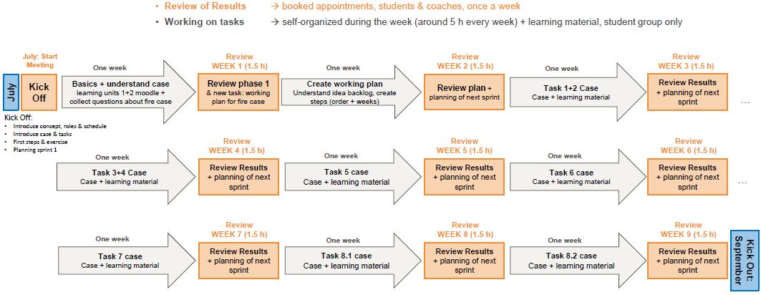
Schedule of long course on chemical management
*
KNUST
UENR
Funded by

