Slide 1


Title
“Enhancing Entrepreneurship, Innovation, and Sustainability in Higher Education in Africa” EEISHEA

Slide 2












THE PROBLEM
TRAINING STAFF TO CHANGE FROM TRADITIONAL TEACHING METHOD TO SCL
REDESIGNING EDUCATIONAL ACTIVITY ACCORDING TO THE CAT.
UNEMPLOYMENT
LIMITED RESOURCES
Effective learning takes place when students are actively engaged and become co-creator of knowledge.
UNFAIR GRADING SYSTEM
QUALITY & RELEVANT R&D VRS MEETING SOCIETAL NEEDS
UNIVERSITY-GOV-INDUSTRY LINKAGES, ABSENT, WEAK OR FRAGMENTED
LARGE STUDENT CLASSES
EMPLOYABILITY

Slide 3
SO NOW, TO TURN THINGS AROUND
E-LEARNING
(TI, TMM, EL)
INNOVATION
REDESIGN EXISTING & NEW CURRICULA/
COURSES
SUSTAINABILITY
(SDGs, IHRD(,CCPD ,IGF, GRANTS , NDA)
ENTREPRENEURESHIP
STUDENTS CENTEREDNESS LEARNING (PBL, CDE,CBL.POL

Slide 4
Partner organisations
EU partners
Denmark
Aalborg University (AAU; applicant)
University of Copenhagen (UCPH)
Roskilde University (RUC)
Sweden
Royal Institute of Technology (KTH; Stockholm)
Spain
Polytechnic University of Catalonia (UPC; Barcelona)
African partners
Ghana
Kwame Nkrumah University of Science and Technology (KNUST; Kumasi)
University of Energy and Ntural Resources (UENR – to be confirmed)
Tanzania
Sokoine University of Agriculture (SUA; Morogoro)
Kilimanjaro Christian Medical University College (KCMUCo; Moshi)
The State University of Zanzibar (SUZA; Zanzibar)

Slide 5
Main roles of KNUST in the project
Training:
KNUST participated actively in the 4 training Work Packages (WP):
Student-Centred Learning (SCL)
E-learning (E-L)
Entrepreneurship & Innovation (incl. collaboration with industry) (E&I)
Sustainability - Ecological, social, and economic (SUS).
Curriculum development:
Development of KNUST curriculum – BSc Aquaculture and Water Resources Management
Dissemination and Exploitation (Use):
KNUST participated actively in the Dissemination and exploitation of project results

Slide 6
Role of KNUST in the training
The KNUST LTF :
Appointed 2 trainees (main and assisting) to participate in the training within each of the four specialist areas
Training took place as
  online training
  two f2f workshops within European universities
  one training workshop within KNUST
The f2f workshops consisted of 2 days of intensive training and 2 days of relevant study and field visits
After each workshop each trainee wrote an individual Reflective Learning Journal (RLJ, max 2 pages) and peer review 2 RLJs written by other trainees
The training workshop in KNUST was a peer-teaching/-learning workshop where the 2 trainees from each of the four specialist areas trained their colleagues in the LTF team

Slide 7
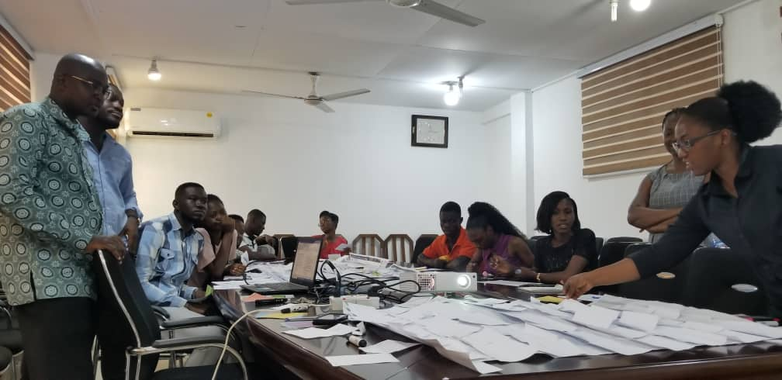
Students & lecturers participate use ABC & CAT approaches
Redesigning Curriculum to Enhance Employability: BSc Aquaculture & Water Resources Mgt., KNUST, Ghana

Slide 8
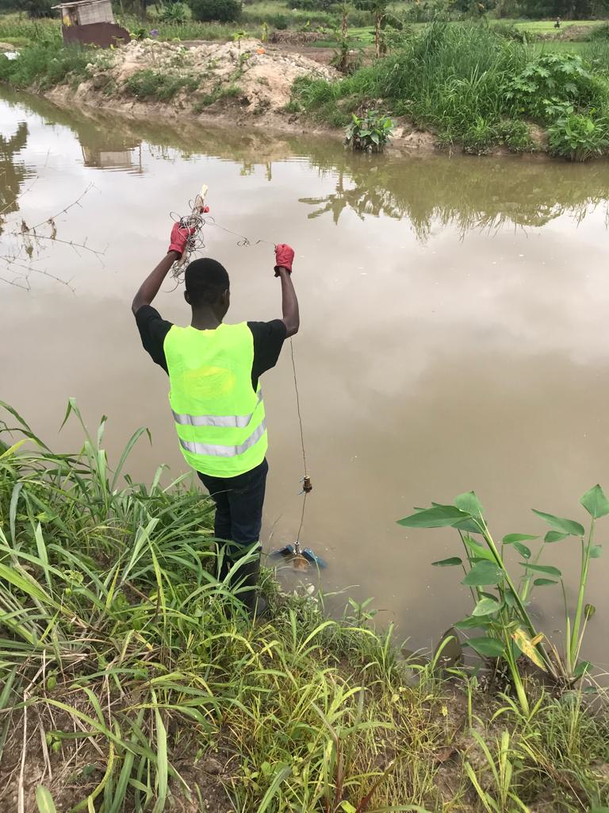
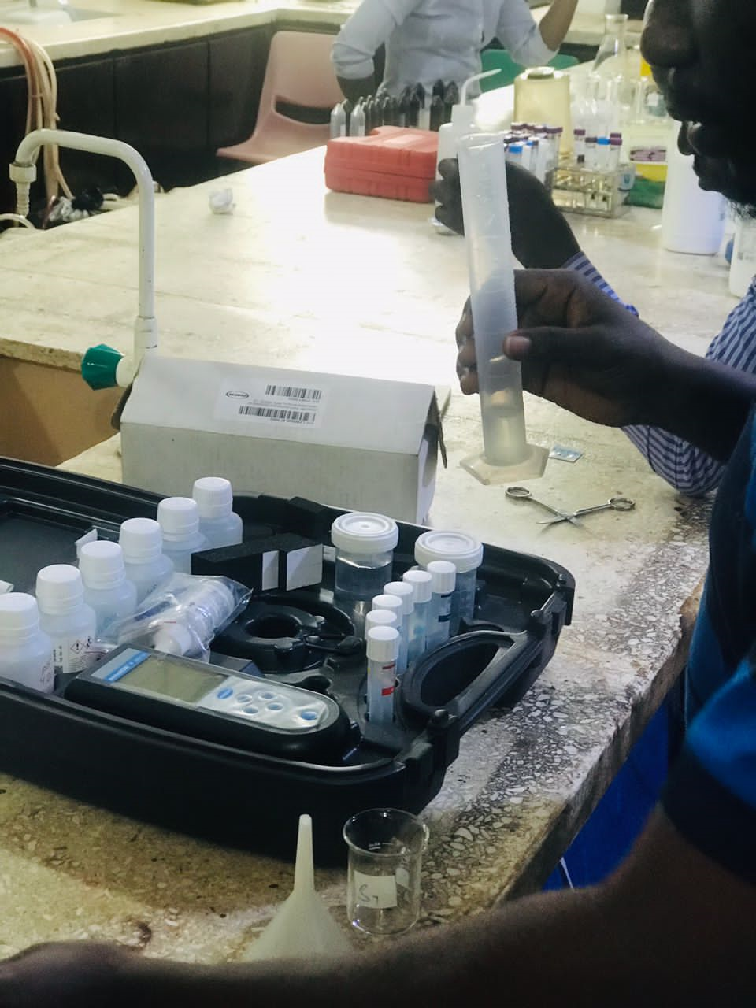
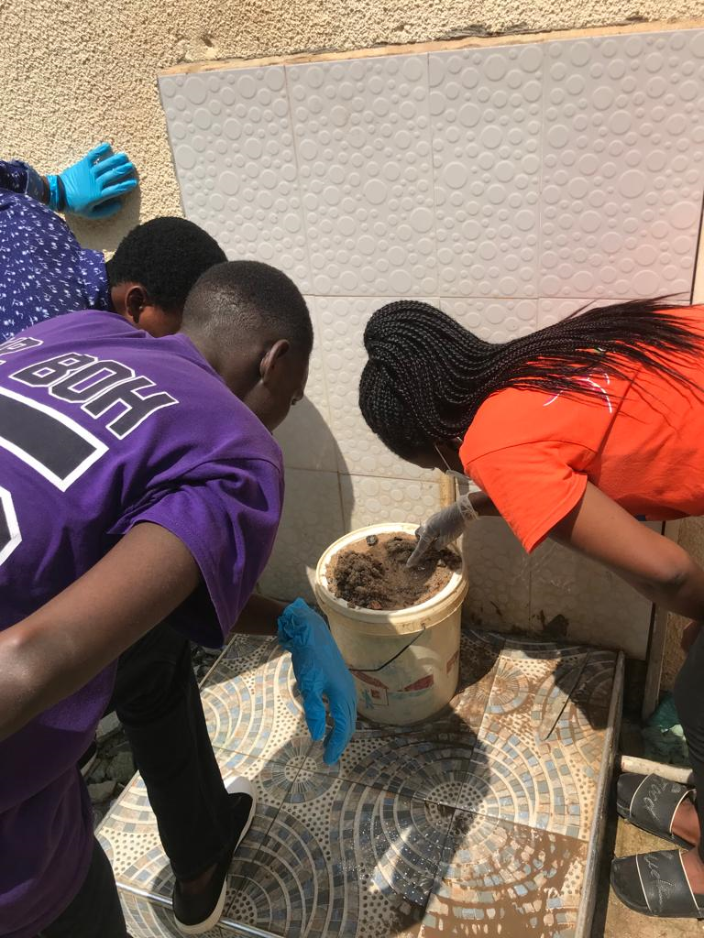
Improved appreciation for ‘real life’ problems
STUDENTS ON INTERNSHIP

Slide 9
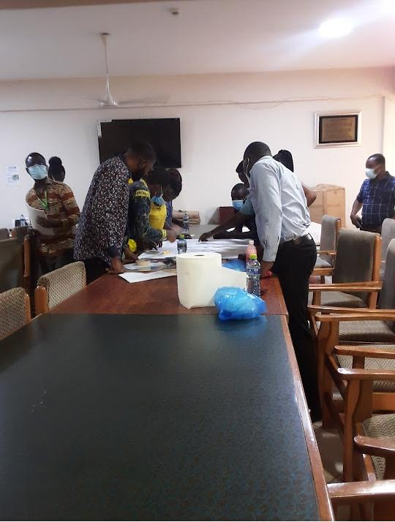
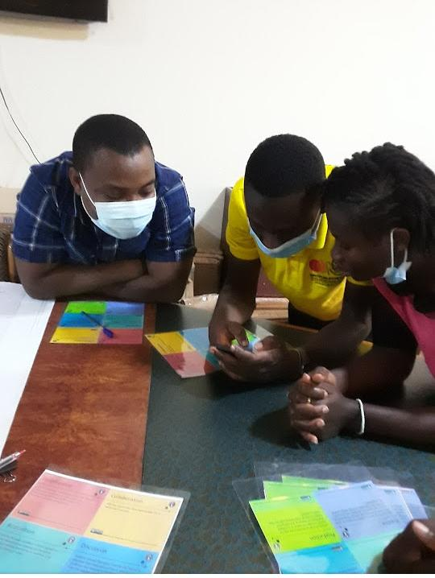
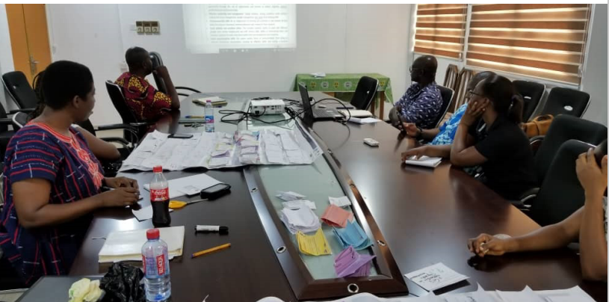
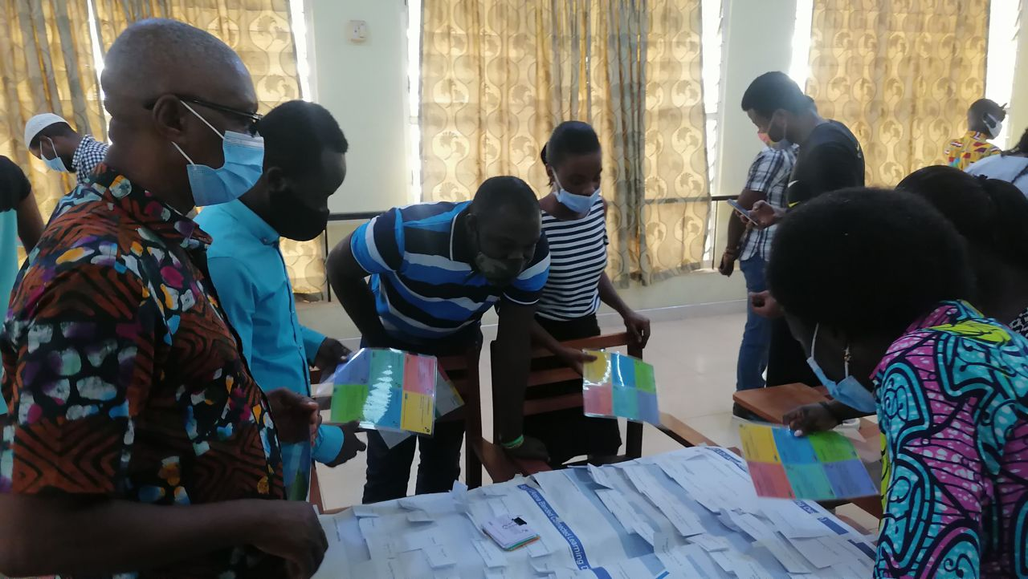
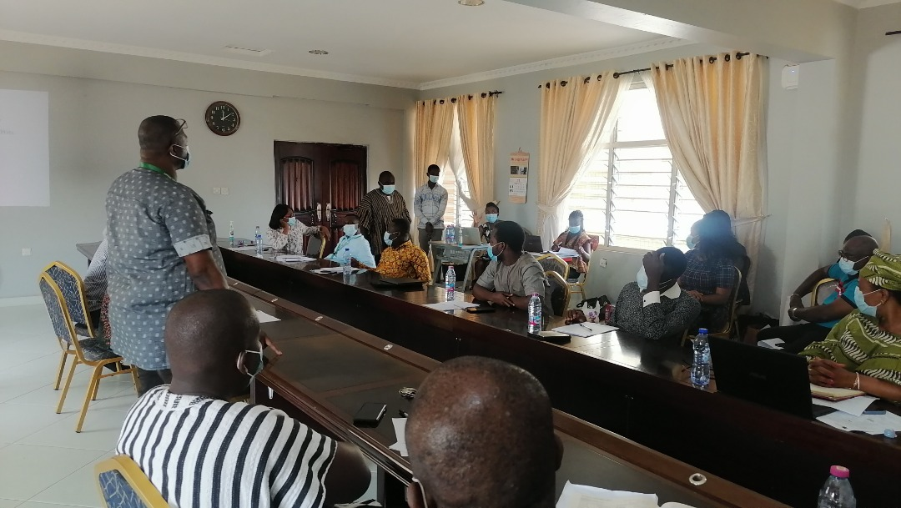
TOT in pictures
Students with facilitator
MATHEMATICS
HORTICULTURE
AQUACULTURE

Slide 10
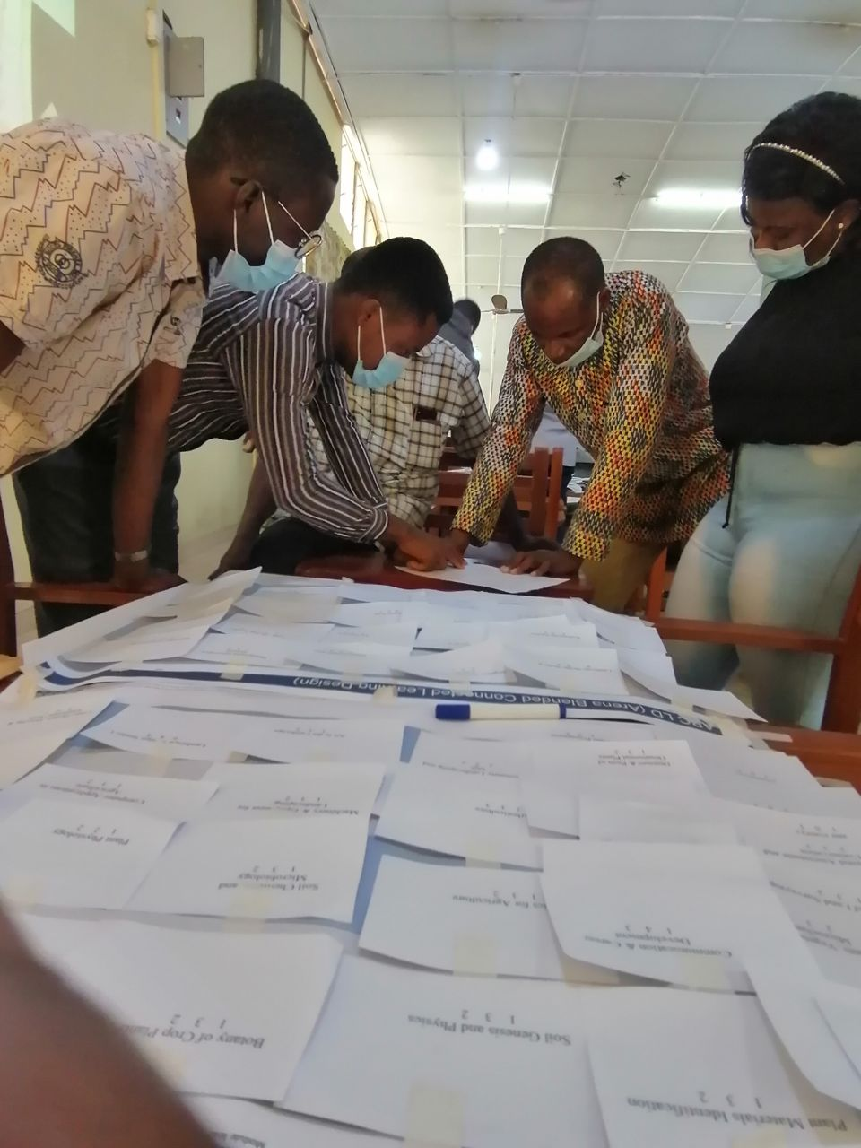
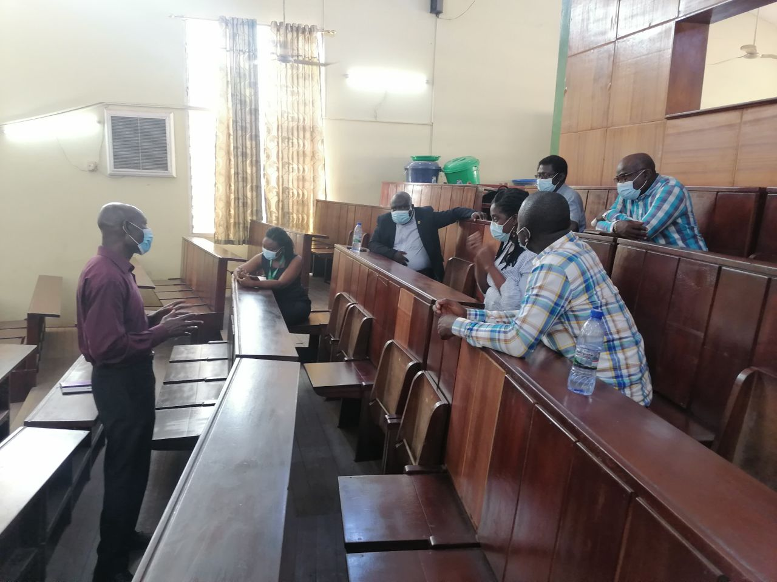
HORTICULTURE
STATISTICS & ACTUARIAL SCIENCE
LTF WRAP-UP
LTF Wrap-up

Slide 11
Project outputs
A ‘best practice’ study program (AQWR) with relevant elements of entrepreneurship & innovation (E&I) and ecological, social, and economic sustainability (SUS) integrated into curricula, delivered through student-centred learning (SCL) approaches and drawing on e-learning (E-L) tools
Curricula served as “best practice” examples in KNUST
KNUST has a team of trainers who have the knowledge, skills, and competences to train and assist colleagues in designing similar programmes

Slide 12


