Slide 1

Professional Education for Renewable Energies in Ghana - ProREG
Andrea Ruiz | TU Berlin | Kick-Off Meeting of ProREG, 5th December 2022
Funded by

Slide 2




Overview of project-based courses
Energy seminar
Autonomous working group led by students
Interdiscipli-nary teaching
Project workshop
Hands-on projects led by students
Funding for student assistant*
Study reform project
Lecture + seminar
Funding for research associate and student assistant*
KNUST
UENR
*Funding duration: 2 years
Funded by
Notes:
Overall: Often, graduates can only be productively employed by companies with great effort and long training periods. This is a major obstacle to the increased expansion of renewable energies in the country. Three project goals were jointly defined for its elimination.
Objective 1 - Issues we should try to perform: 1. The development fields for 10 practical modules are defined until mid 2023 | 2. Learning resources for the 10 modules will be available as OER until spring 2024 | 3. First 2 prototypes will be concluded until autumn of 2024 | 4. Revised OERs will be available until spring of 2025 | 5. 8 further modules have been piloted until summer 2025 | 6. The 10 new modules are integrated into the regular curricula until autumn 2025
Objective 2- Issues we should try to perform: 1. A comprehensive train-the-trainer concept and guidelines are available until autumn 2023 | 2. 10 members of the teaching staff of the Ghanaian universities had a one month stay in Germany to experience engineering work in German companies and project teaching practise at the TU Berlin until summer 2024 | 3. A total of 20 professors / lecturers have been trained in the new teaching/learning formats until autumn 2024 | 4. The teaching / learning process in the 10 new modules has been accompanied by a coaching and has been evaluated until autumn 2025
Objective 3- Issues we should try to perform: 1. 10 companies for the “Council for Education and Renewable Energies” have been identified and declared their willingness to contribute until spring 2023 | 2. 10 other members of the network have been identified and declared their willingness to contribute until summer 2023 | 3. Network members are actively participating in mutual visits to Ghana and Germany until spring 2023 | 4. 20 network members participated in the needs analysis until summer 2023

Slide 3
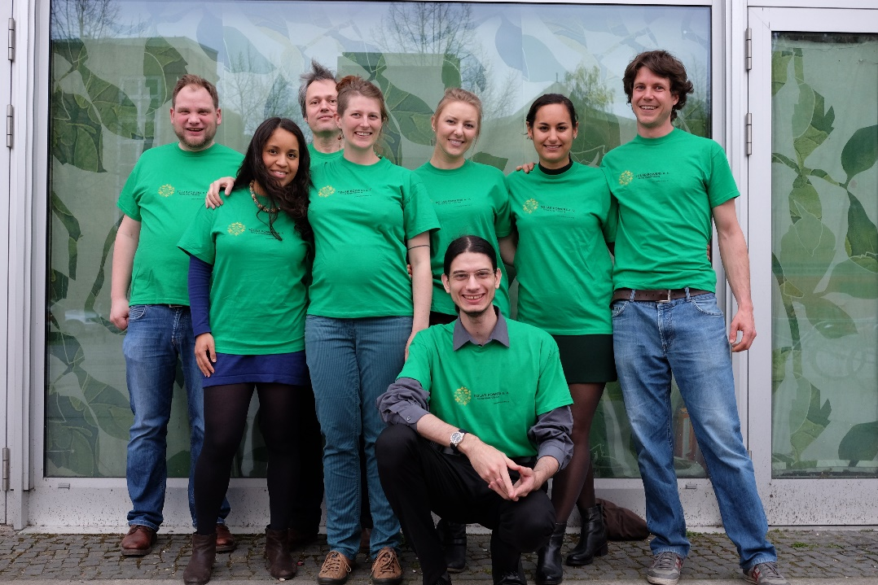

Solar Powers e.V.
  Emerged from the energy seminar 2014/2015 as a result of a feasibility study (previous: potential analysis for the use of solar energy on rooftops of the TU)
  Non-profit association since 2015, signed a contract with the TU for the use of the rooftop area
  Through cooperation with companies and crowdfunding campaigns the needed investment was gathered after 2 years
  Development of tu project
  “Renewables for the TU” and
  interdisciplinary courses with a focus
  on design of PV systems
KNUST
UENR
Funded by

Slide 4
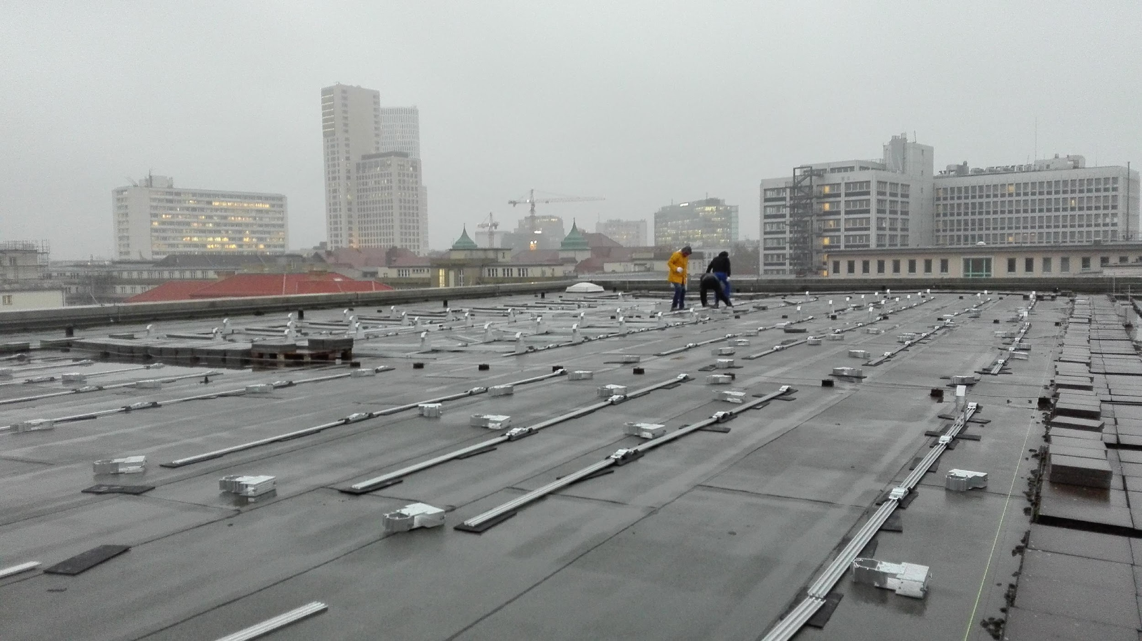
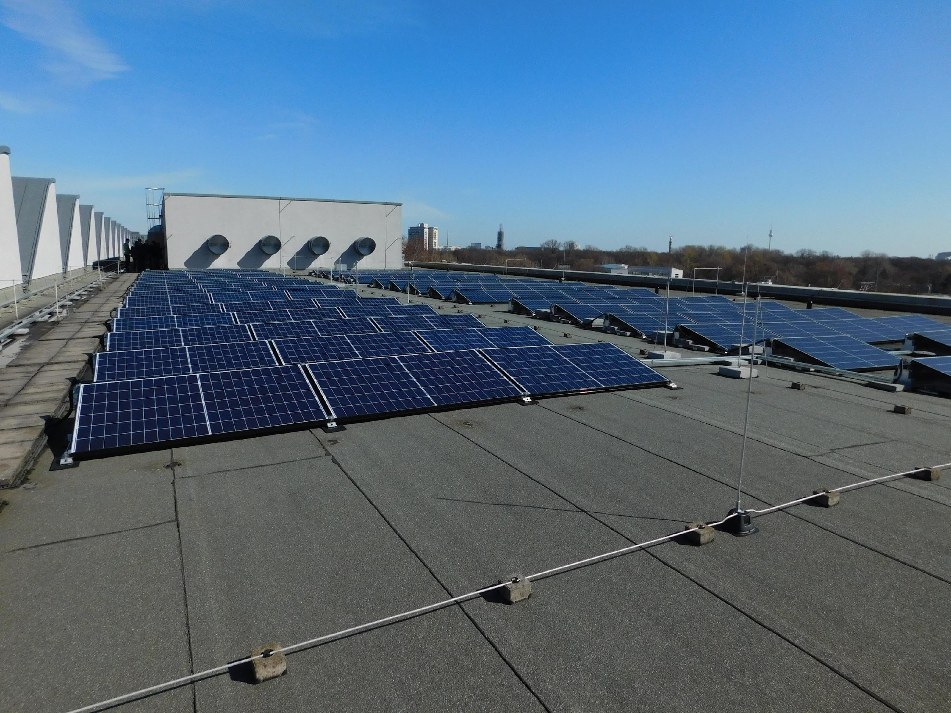
Installation of PV system
November 2016 with the support of professional engineers
Brought into service in March 2017 → since then official plant operator and in charge of O&M
KNUST
UENR
Funded by
Notes:
Overall: Often, graduates can only be productively employed by companies with great effort and long training periods. This is a major obstacle to the increased expansion of renewable energies in the country. Three project goals were jointly defined for its elimination.
Objective 1 - Issues we should try to perform: 1. The development fields for 10 practical modules are defined until mid 2023 | 2. Learning resources for the 10 modules will be available as OER until spring 2024 | 3. First 2 prototypes will be concluded until autumn of 2024 | 4. Revised OERs will be available until spring of 2025 | 5. 8 further modules have been piloted until summer 2025 | 6. The 10 new modules are integrated into the regular curricula until autumn 2025
Objective 2- Issues we should try to perform: 1. A comprehensive train-the-trainer concept and guidelines are available until autumn 2023 | 2. 10 members of the teaching staff of the Ghanaian universities had a one month stay in Germany to experience engineering work in German companies and project teaching practise at the TU Berlin until summer 2024 | 3. A total of 20 professors / lecturers have been trained in the new teaching/learning formats until autumn 2024 | 4. The teaching / learning process in the 10 new modules has been accompanied by a coaching and has been evaluated until autumn 2025
Objective 3- Issues we should try to perform: 1. 10 companies for the “Council for Education and Renewable Energies” have been identified and declared their willingness to contribute until spring 2023 | 2. 10 other members of the network have been identified and declared their willingness to contribute until summer 2023 | 3. Network members are actively participating in mutual visits to Ghana and Germany until spring 2023 | 4. 20 network members participated in the needs analysis until summer 2023

Slide 5
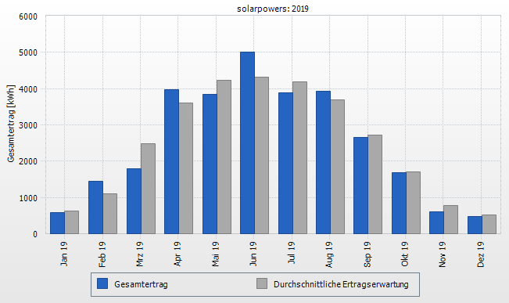
Facts and figures
Capacity: 30 kWp
→ 28.500 kWh/a
107 solar panels and
1 SMA inverter
Installation costs:
approx. 52.000 €
LCOE: 9,58 ct/kWh
The engendered electricity is fed into the grid → the generated revenue of about 3.000 € is used to fund other non-profit student initiatives or other projects in the fields of RE, environmental protection and education.
KNUST
UENR
Funded by
Notes:
Overall: Often, graduates can only be productively employed by companies with great effort and long training periods. This is a major obstacle to the increased expansion of renewable energies in the country. Three project goals were jointly defined for its elimination.
Objective 1 - Issues we should try to perform: 1. The development fields for 10 practical modules are defined until mid 2023 | 2. Learning resources for the 10 modules will be available as OER until spring 2024 | 3. First 2 prototypes will be concluded until autumn of 2024 | 4. Revised OERs will be available until spring of 2025 | 5. 8 further modules have been piloted until summer 2025 | 6. The 10 new modules are integrated into the regular curricula until autumn 2025
Objective 2- Issues we should try to perform: 1. A comprehensive train-the-trainer concept and guidelines are available until autumn 2023 | 2. 10 members of the teaching staff of the Ghanaian universities had a one month stay in Germany to experience engineering work in German companies and project teaching practise at the TU Berlin until summer 2024 | 3. A total of 20 professors / lecturers have been trained in the new teaching/learning formats until autumn 2024 | 4. The teaching / learning process in the 10 new modules has been accompanied by a coaching and has been evaluated until autumn 2025
Objective 3- Issues we should try to perform: 1. 10 companies for the “Council for Education and Renewable Energies” have been identified and declared their willingness to contribute until spring 2023 | 2. 10 other members of the network have been identified and declared their willingness to contribute until summer 2023 | 3. Network members are actively participating in mutual visits to Ghana and Germany until spring 2023 | 4. 20 network members participated in the needs analysis until summer 2023

Slide 6
Study reform project
Projektlehre Photovoltaik (Project Teaching Photovoltaics) to teach students how to design a PV system considering not only technical, but also legal and economical aspects based on a specific project
    → eligible by any student, but in the currila of students from electrical, mechanical, civil, industrial and physical engineering
Projektlehre Solarenergie (Project Teaching Solar Energy) → expansion to include the heat sector through solar thermal (until 2021)
Since July 2021 Praxislehre Solarcampus (Praxis Teaching Solar Campus) as a new SRP until 2023
    → heat is no longer part of the lecture part, integration of safety technology and development of a guideline, focus on public buildings
KNUST
UENR
Funded by

Slide 7
Building blocks
Theory
Teaching of technical, legal and economical basics regarding PV
Practical
Application of theory through the design of a PV system including all relevant aspects, validation of results with PV*Sol → report + “Pitch” with results for customer
Input/short presentation of a topic for a deeper understanding
KNUST
UENR
Funded by

Slide 8
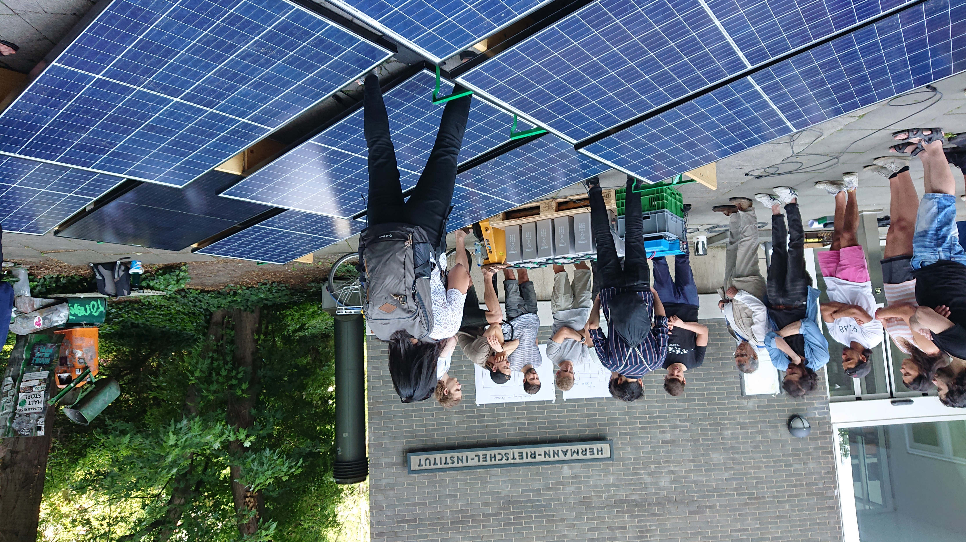

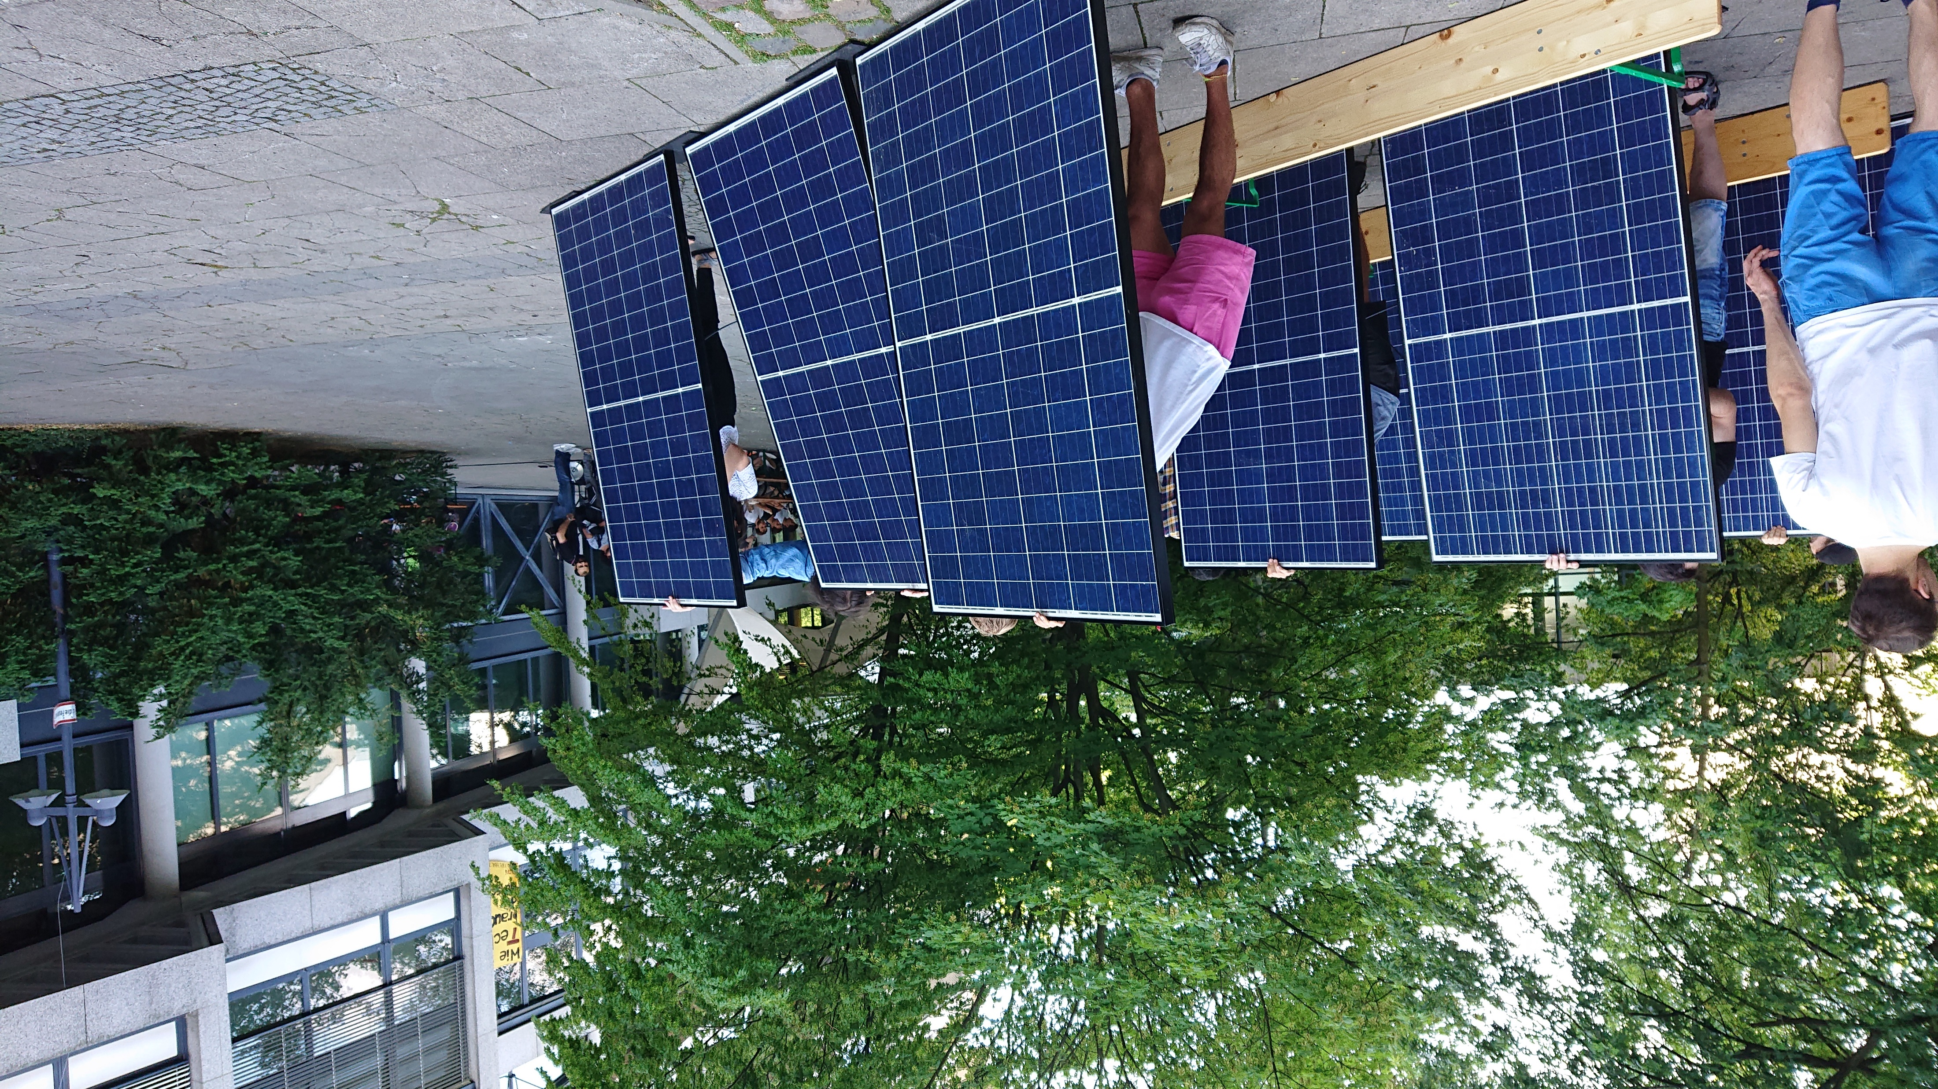
Installation workshop
KNUST
UENR
Funded by

Slide 9
Thank you
for your attention!

Slide 10
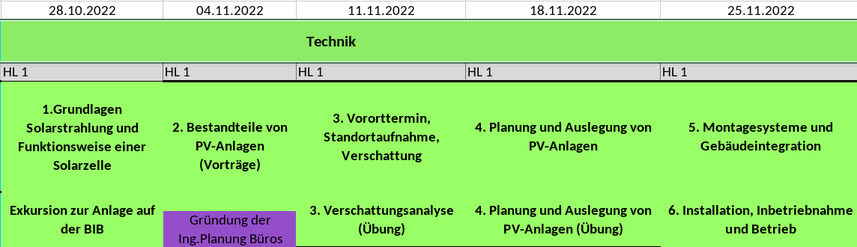
Exemplary Timeline – Technical part
KNUST
UENR
Funded by

Slide 11
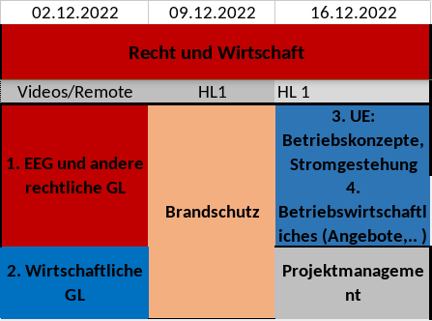
Exemplary Timeline – Legal and economical part
KNUST
UENR
Funded by

Slide 12
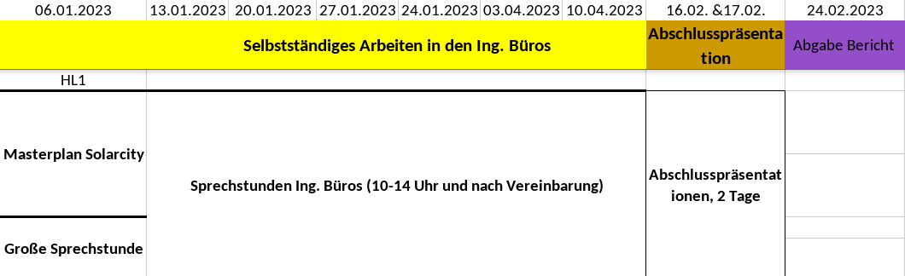
Exemplary Timeline – Practical part
KNUST
UENR
Funded by

