Slide 1




E-learning Tools for Effective Teaching in HEIs
Presenters
Benjamin Asubam Weyori
University of Energy and Natural Resources
May 5th – 6th, 2025

Slide 2
eLearning tools for teaching encompass a wide range of digital resources that support instructors in creating, delivering, and managing online learning experiences. Examples include learning management systems (LMS), interactive presentation tools, and authoring software.
E-LEARNING TOOLS

Slide 3
E-Learning Tool | Description | Uses
Learning Management Systems (LMS) (e.g., Moodle, Blackboard, Canvas) | Online platforms used to create, manage, deliver, and track educational content and courses. | Delivering courses, tracking student progress, assessments, and communication.
Video Conferencing Tools (e.g., Zoom, Microsoft Teams, Google Meet) | Tools enabling real-time, online face-to-face interactions among teachers and learners through video and audio communication. | Conducting live online classes, webinars, group discussions, and virtual meetings.
Collaborative Platforms (e.g., Google Workspace, Microsoft 365) | Cloud-based productivity tools enabling document sharing, collaborative editing, presentations, and real-time collaboration. | Conducting live online classes, webinars, group discussions, and virtual meetings.

Slide 4
E-Learning Tool | Description | Uses
Assessment and Quiz Tools (e.g., Kahoot!, Quizlet, Socrative) | Online tools designed to create interactive quizzes, flashcards, and learning games to assess student learning. | Interactive assessments, revision exercises, gamified learning experiences, quick evaluations.
Authoring Tools (e.g., Articulate Storyline, Adobe Captivate, iSpring Suite) | Software used to create interactive digital learning content and courses. | Designing interactive courses, simulations, quizzes, and multimedia-rich learning content.
Interactive Whiteboards (e.g., Jamboard, Miro, Microsoft Whiteboard) | Online collaborative whiteboards allowing multiple users to interact visually and simultaneously in real-time. | Brainstorming, collaborative learning, visual explanations, group projects, and interactive lessons.

Slide 5
E-Learning Tool | Description | Uses
Educational Video Platforms (e.g., YouTube, Vimeo, Edpuzzle) | Platforms providing hosting, sharing, and creation of educational videos, with features such as interactive video assignments. | Lecture capture, instructional videos, flipped classroom activities, and multimedia content sharing.
Content Curation Tools (e.g., Padlet, Pinterest, Wakelet) | Online tools for organizing, curating, and sharing educational resources in visual formats. | Organizing resources, collaborative projects, creating resource libraries, and supporting research assignments.
Virtual Reality (VR) and Augmented Reality (AR) (e.g., Google Expeditions, zSpace, Nearpod VR) | Tools providing immersive, interactive experiences through virtual or augmented environments. | Simulations, experiential learning, virtual labs, and interactive field trips.

Slide 6
E-Learning Tool | Description | Uses
Screen Recording Software (e.g., Camtasia, Loom, Screencast-O-Matic) | Applications used to capture screen activity, audio, and webcam footage to create instructional videos and tutorials. | Creating instructional videos, demonstrations, video feedback, and tutorials.

Slide 7
AI-generated text refers to written content produced by artificial intelligence (AI) systems, specifically language models trained using machine learning techniques, rather than human authors.
TOOLS TO HELP US DETECT AI-GENERATED TEXT

Slide 8
TOOLS | DESCRIPTION | PRIMARY USES
Copyleaks AI Content Detector | AI-based tool capable of identifying text generated by ChatGPT, GPT-4, and similar AI models. | Plagiarism checking, content originality verification, and educational assessments.
Crossplag | Combines plagiarism and AI detection in a single interface, capable of identifying ChatGPT and other GPT-model texts. | Academic and publishing sectors to verify originality and integrity of submissions.
Sapling.ai | AI content detector designed to distinguish AI-written text from human writing with high accuracy. | Business, marketing, and educational institutions for quality assurance and originality checking.

Slide 9
TOOLS | DESCRIPTION | PRIMARY USES
Hugging Face's GPT-2 Output Detector | A free, online, open-source detector for identifying text produced by GPT-based language models. | General purpose checks by educators, researchers, and content creators to determine AI-generated content.
Content at Scale AI Detector | Quickly scans and scores content to detect AI-generated text accurately. | Online content publishers, SEO experts, educators, and writers verifying authenticity and originality.
ZeroGPT | AI text detection tool, analyzing linguistic patterns, style, and complexity to identify GPT-generated text. | Education, content marketing, and publishing industries to ensure human-written authenticity.

Slide 10
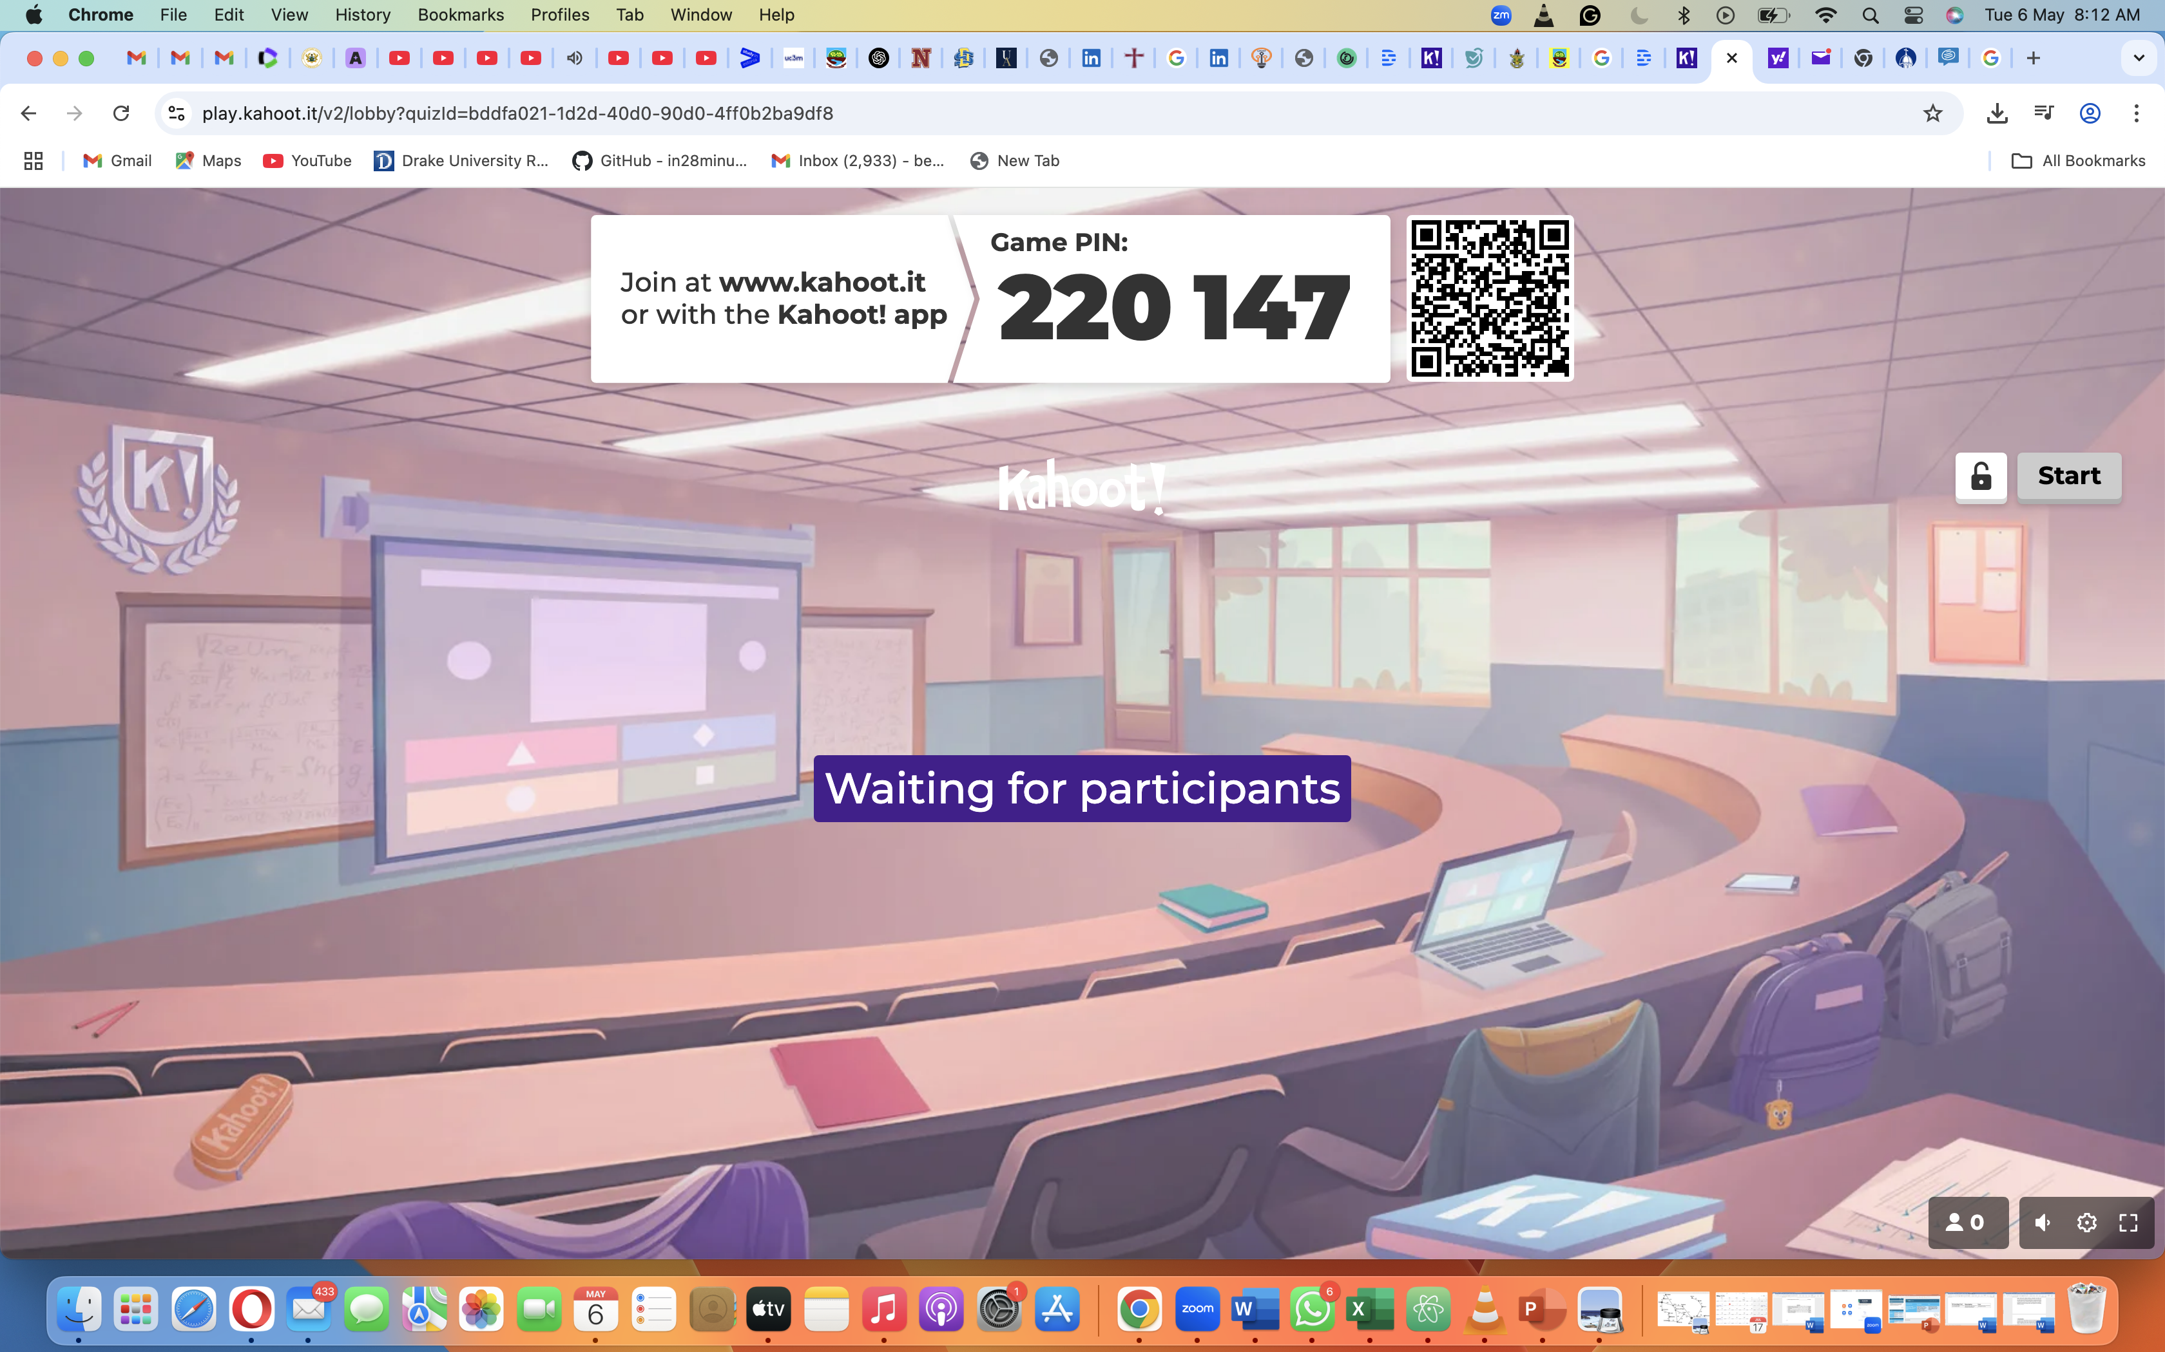

Slide 11
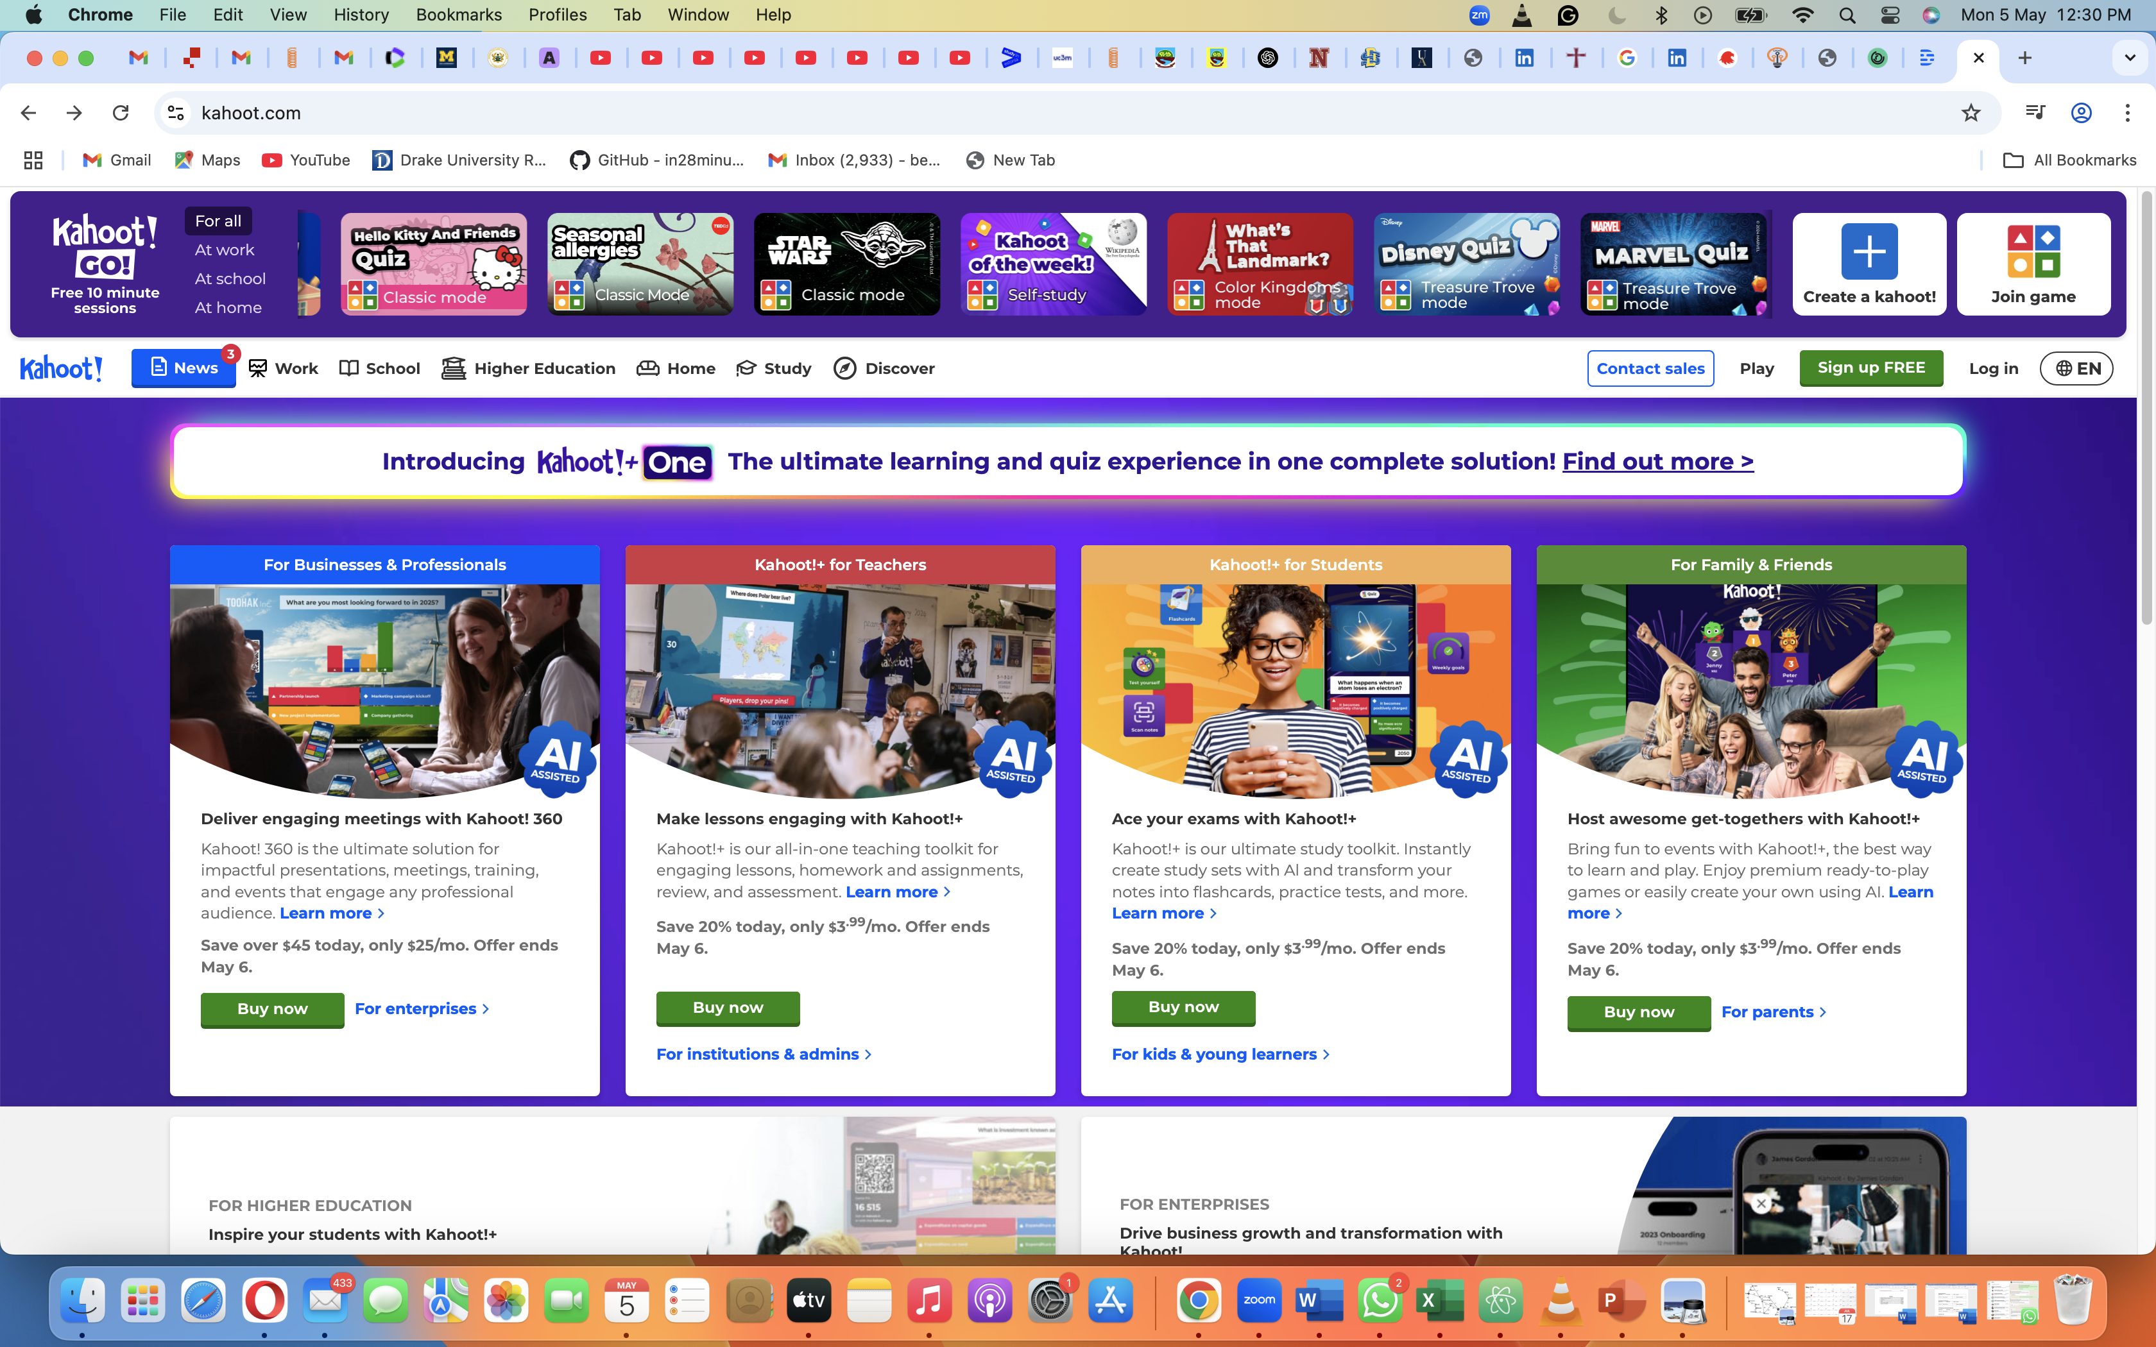
Kahoot! is a digital game-based student response system that allows teachers and learners to interact through competitive knowledge games using existing infrastructure. To host a live Kahoot, questions appear on a shared screen – a big screen in a room or on mobile devices.
IMPORT IMAGE HERE

Slide 12
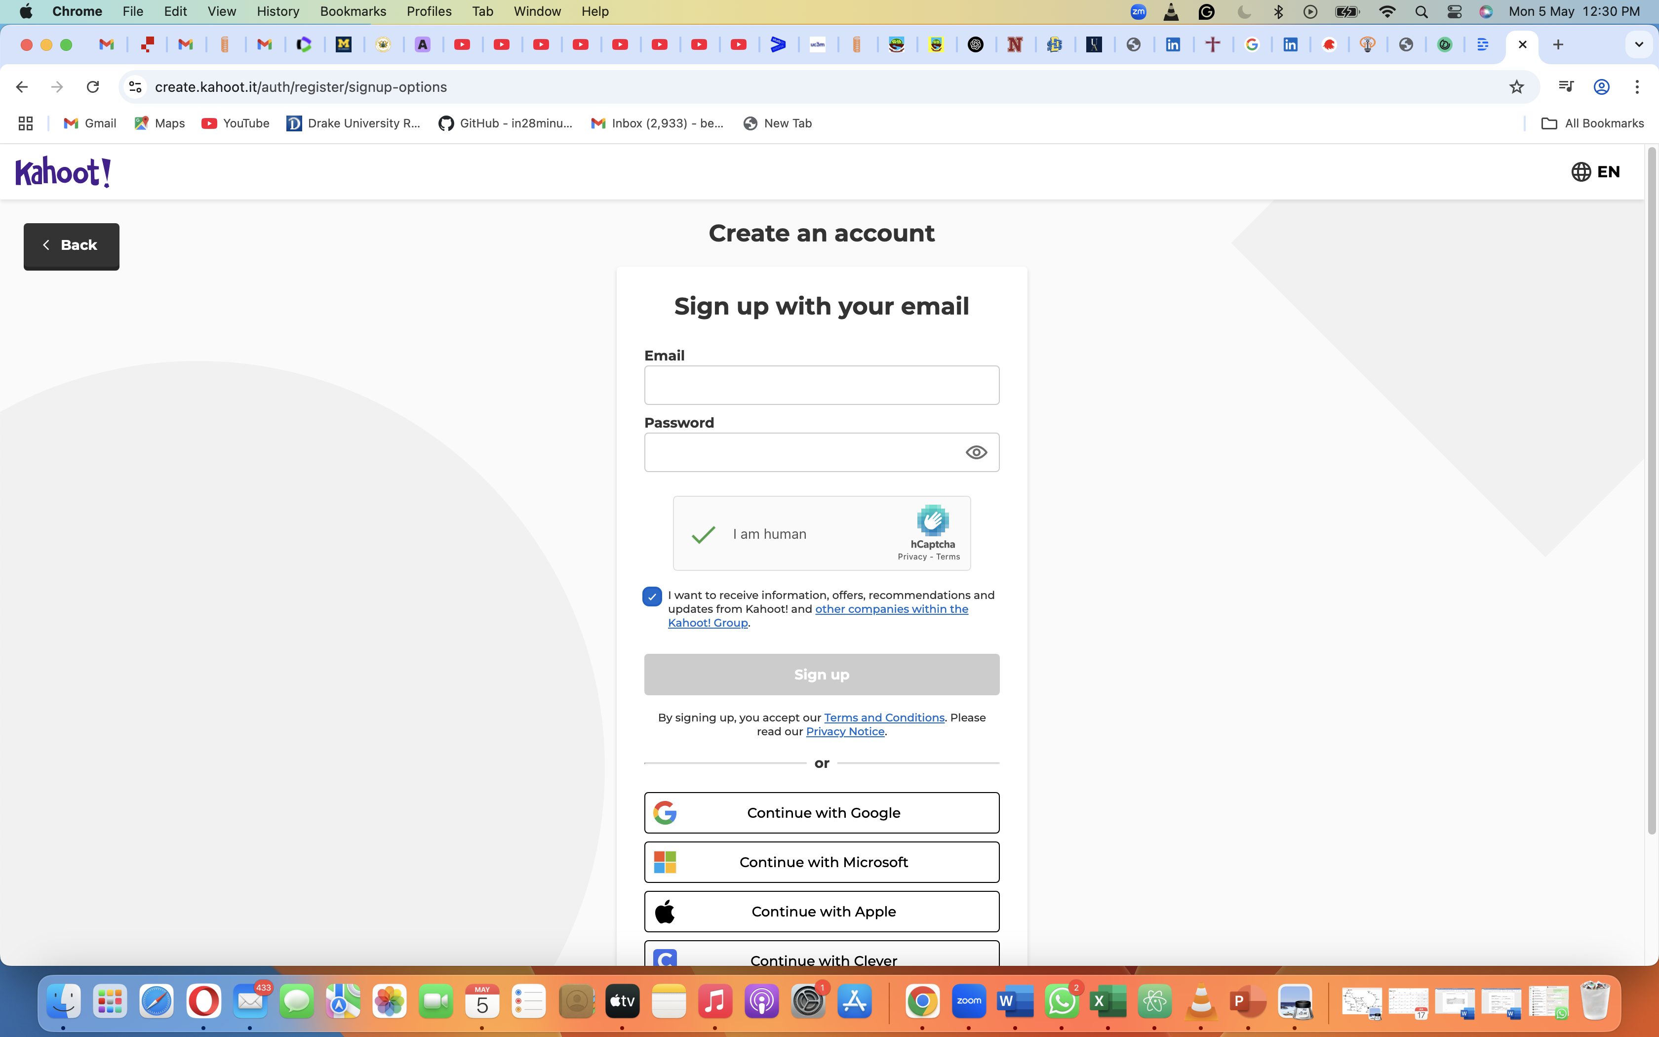
Background

Slide 13
Descript is an all-in-one audio and video editing software that allows users to edit multimedia content as easily as a text document. It transcribes audio and video files automatically and enables editing by simply editing text—removing filler words, correcting errors, or rearranging segments. It leverages artificial intelligence (AI) to streamline multimedia editing, transcription, and content production.
DESCRIPT

Slide 14
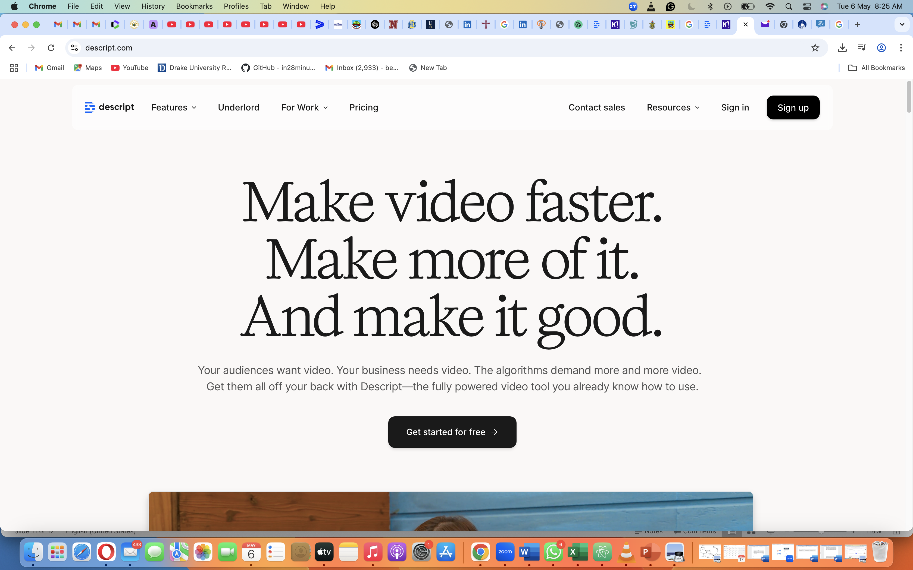

Slide 15
