Slide 1









Title
RCEES STAKEHOLDER ENGAGEMENT WORKSHOP
UENR
28 February -1st. March 2024
Conference language: English
Venue:
EUSBETTE HOTEL , Sunyani
KNUST
Name: WILLIAM ODURO
Department: WRM
Faculty & College: FRNR, CANR

Slide 2

Title:
2
F │
What Academia Expects from Industry
KNUST
Name: WILLIAM ODURO
Department: WRM
Faculty & College: FRNR, CANR
UENR

Slide 3
In this presentation
Concept of academia-industry partnership –what academia expects from industry
Examples of academia-industry partnership-general
Examples of academia-industry partnership- specific examples in energy

Slide 4
Introduction
THIS PRESENTATION addresses several key objectives to strengthen partnerships, highlight industry advancements, and foster cooperation.
Academia's expectations from industry encompass a broad range of objectives and aspirations to enhance educational outcomes, research endeavors, and societal impact. Here are key expectations that academia typically has from its industry partners:

Slide 5

1. Practical Exposure and Real-world Applications
Provide students and researchers with practical exposure to real-world applications of their studies and research.
Offer internships, co-op programs, and project-based learning opportunities that enrich the academic curriculum with hands-on experience.

Slide 6

2. Research Funding and Resources
Provide essential financial support for research and access to cutting-edge technology, laboratories, and other resources that might be beyond the reach of academic budgets.

Slide 7
3. Collaboration on Applied Research
Academia expects the industry to collaborate on research projects directly applicable to industry challenges.
This involves funding and active participation in defining research questions, sharing data and expertise, and implementing findings.

Slide 8

4. Innovation and Technology Transfer
Academic institutions are hubs of innovation, and they expect industry partners to support and engage in the transfer of technology and ideas from academia to commercial and practical applications.
This includes support for patents, startups, and entrepreneurship among students and faculty.

Slide 9
5. Curriculum Development and Workforce Training
Academia looks to industry to provide insights into emerging trends, skills requirements, and knowledge gaps in the workforce.
Collaboration on curriculum development ensures that educational programs remain relevant and graduates are well-prepared for their careers

Slide 10

6. Career Opportunities for Graduates
A key expectation from the industry is the provision of career opportunities for students and graduates.
This includes job placements, career fairs, mentorship programs, and other initiatives that facilitate the transition from academia to industry

Slide 11

7. Societal Impact and Sustainability
Academic institutions are increasingly focused on addressing societal challenges and promoting sustainability.
They expect industry partners to share these values and collaborate on projects that have a positive impact on society and the environment.

Slide 12

8. Long-term Partnerships and Engagement
Beyond transactional interactions, academia seeks long-term, meaningful partnerships with industry.
This involves continuous engagement, joint ventures in research and development, and shared goals that evolve.

Slide 13
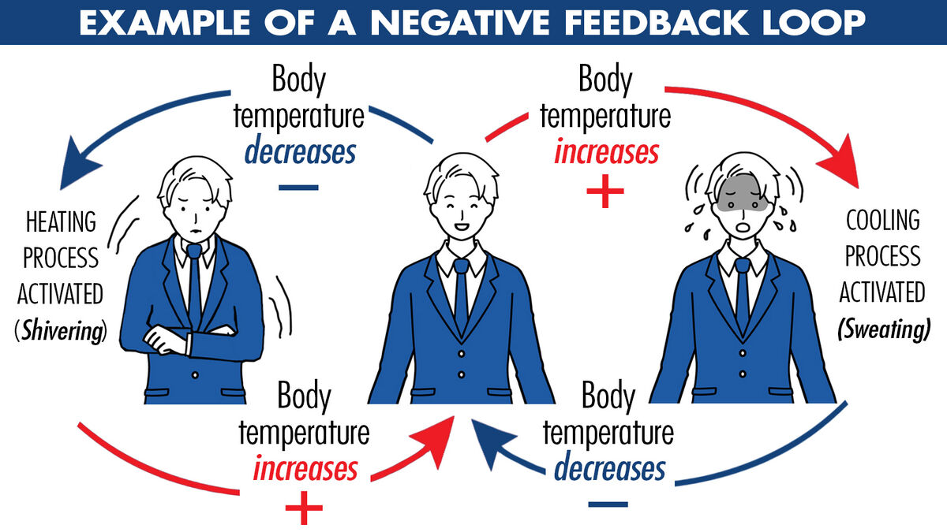
9. Feedback Mechanisms
Expects constructive feedback from industry partners on the quality of graduates, research relevance, and educational programs' effectiveness.
This feedback is crucial for continuous improvement and alignment with industry needs.

Slide 14

10. Ethical and Responsible Conduct
Expects industry partners to uphold high standards of ethical and responsible conduct in all aspects of their collaboration.
This includes ethical research practices, responsible use of data, and commitment to diversity and inclusion.

Slide 15
Conclusion
These expectations are grounded in a mutual understanding that strong Academia-Industry partnerships are essential for fostering innovation, addressing global challenges, and preparing students for successful careers in an ever-evolving job market.

Slide 16
Several world-class examples highlight the successful collaboration between academia and industry, demonstrating how these partnerships can drive innovation, research, and education while addressing societal needs.
Here are some notable instances:

Slide 17
1. MIT-IBM Watson AI Lab
The Massachusetts Institute of Technology (MIT) and IBM partnered to form the MIT-IBM Watson AI Lab. This collaboration focuses on fundamental artificial intelligence (AI) research to propel scientific breakthroughs that unlock the potential of AI. The lab works on a variety of projects, including AI algorithms, physics of AI, and application of AI in industries such as health care and cybersecurity
2. Stanford University and Google
The partnership between Stanford University and Google is a landmark example of how academic research can lead to monumental industry outcomes. Google's search engine was developed as a research project by Larry Page and Sergey Brin, PhD students at Stanford. This collaboration led to the creation of one of the world's most influential companies and resulted in numerous ongoing partnerships between Stanford and Google in research and development.

Slide 18
3. Cambridge University and Microsoft
Collaboration through the Microsoft Research Cambridge lab. Established in 1997, it focuses on computer science, technology, and engineering research, aiming to solve global challenges and innovate within various fields. The partnership has led to advancements in machine learning, security, and healthcare, among others
4. ETH Zurich and Disney Research
The partnership between ETH Zurich, a leading technical university in Switzerland, and Disney Research has resulted in innovative projects that blend entertainment technology with cutting-edge scientific research. This collaboration focuses on computer graphics, computational fabrication, augmented reality, and artificial intelligence, demonstrating the potential of combining academic research with industry creativity.

Slide 19
5. University of Michigan and Ford
Collaborates through the Ford Motor Company Robotics Building, a state-of-the-art facility that houses researchers from both the university and Ford. This partnership focuses on autonomous vehicles, robotics, and mobility solutions, aiming to address future transportation challenges.
6. Oxford University and AstraZeneca
The collaboration between Oxford University and the pharmaceutical company AstraZeneca led to the rapid development and deployment of a COVID-19 vaccine. This partnership is a prime example of how academia and industry can work together to address urgent global health challenges, combining Oxford's vaccine technology with AstraZeneca's international manufacturing and distribution capabilities.

Slide 20
Conclusion
These examples illustrate the diverse ways in which academia and industry can collaborate across various fields to drive innovation, enhance education, and address societal challenges. Each partnership leverages the strengths of both sectors to achieve outcomes that neither could accomplish alone, highlighting the value of academia-industry collaborations.

Slide 21
Notable examples of Academia-industry collaborations in energy and environmental sustainability are pivotal for advancing research, innovation, and the application of sustainable solutions. These partnerships leverage academic expertise in research and development with industry capabilities in technology scaling, commercialization, and implementation.

Slide 22
1. Stanford University and Tesla
Stanford University and Tesla, Inc. have collaborated on various research projects on electric vehicles (EVs) and renewable energy technologies. This partnership focuses on advancing battery technologies and energy storage solutions and improving the efficiency and sustainability of electric vehicles. The collaboration benefits from Stanford's leading research in energy and Tesla's innovation in electric vehicle technology and renewable energy systems.
2. Massachusetts Institute of Technology (MIT) and Eni
The MIT Energy Initiative (MITEI) with Eni, an Italian multinational oil and gas company. This collaboration focuses on advancing energy research to develop renewable energy sources, improve energy efficiency, and create innovative solutions for environmental sustainability. Projects cover various topics, including solar power, advanced biofuels, carbon capture and storage technologies, and nanotechnologies for energy applications.

Slide 23
3. University of California, Berkeley, and Total
The University of California, Berkeley, has partnered with Total, a French multinational energy company, to form the Total-Berkeley Lab Energy Innovation Research Program. This program focuses on solar energy, bioenergy, and materials for energy storage, aiming to develop sustainable energy solutions and innovative technologies to address global energy challenges.
4. Imperial College London and Shell
Imperial College London partners with Shell through the Shell-Imperial Advanced Interfacial Materials Science (AIMS) Centre for Doctoral Training. This collaboration supports research in energy efficiency, carbon capture and storage, and the development of sustainable energy technologies. The partnership aims to create new materials that can improve the sustainability of energy systems and reduce environmental impact.

Slide 24
5. University of Texas at Austin and ExxonMobil
The University of Texas at Austin has a long-standing partnership with ExxonMobil through its Energy Institute. This collaboration focuses on research and development in areas such as energy efficiency, greenhouse gas reduction, and advanced biofuels. The partnership aims to find scalable and economically viable solutions to meet global energy demands sustainably.
6. Norwegian University of Science and Technology (NTNU) and Equinor
NTNU and Equinor (formerly Statoil), a Norwegian multinational energy company, collaborate on research and development projects in the fields of energy, including offshore wind, carbon capture and storage, and environmental management. This partnership aims to develop sustainable energy solutions and reduce the environmental impact of energy production and consumption.

Slide 25
Conclusion
These examples illustrate how academia-industry collaborations drive innovation and development in energy and environmental sustainability. By combining academic research excellence with industry expertise in commercialization and implementation, these partnerships are essential for advancing sustainable technologies and solutions to address global energy and environmental challenges.

Slide 26

This Photo by Unknown Author is licensed under CC BY-NC

