Slide 1

Circularities in Production, Product Development and Education
Kanban, Scrum and Agile Learning
Workshop at KNUST, 3rd - 4th March 2025
Dr Joerg Longmuss, Sustainum Institute Berlin
Funded by

Slide 2

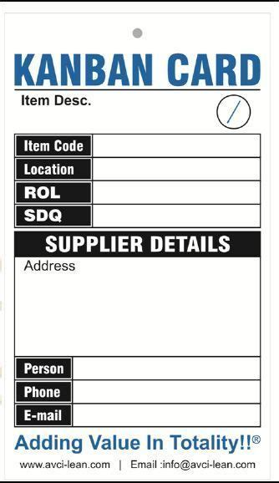
What is Kanban?
Developed by Toyota for production control
Pull principle: tasks are processed as required, not assigned
Transparency and continuous adaptation
Basis for just-in-time production
Funded by

Slide 3
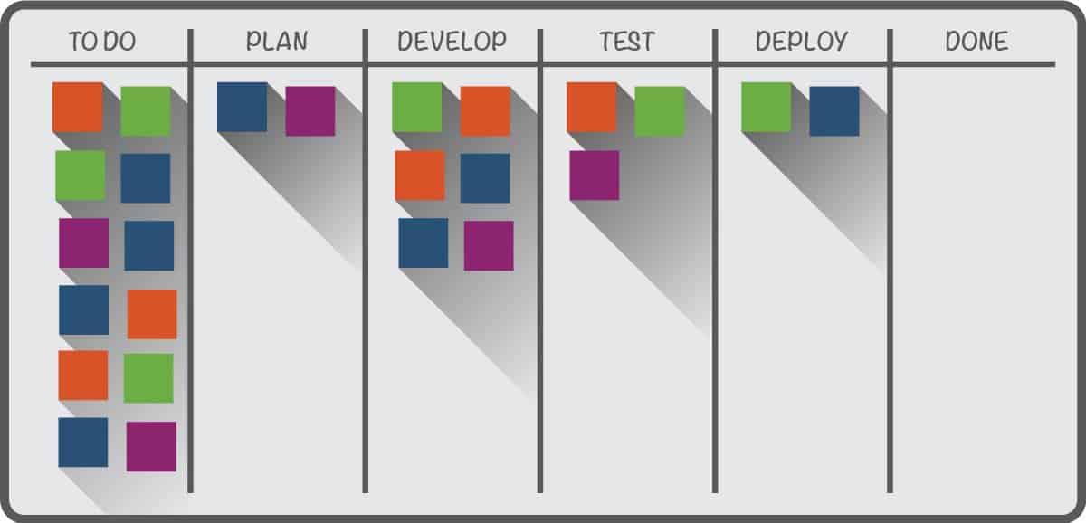
Kanban in practice
Use in production worldwide
Avoids shortages and overloads
Visualisation through a Kanban board
Retrospectives and improvements
Funded by

Slide 4
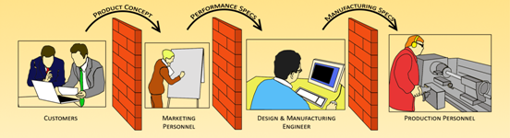
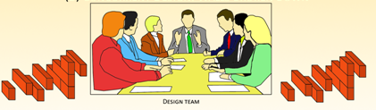
Paradigm shift in product development
Traditional Process vs Simultaneous Engineering
Funded by

Slide 5
Paradigm shift in development II
Project start phase
Execution phase 1
Coordination
phase 1
Execution phase 2
Coordination
phase 2
...
Project completion phase
Funded by

Slide 6

Funded by

Slide 7
What is SCRUM?
Agile method for product development
Iterative development (sprints, usually 2 weeks)
Roles:
    Product Owner (defines requirements)
    Scrum Master (moderates)
    Development team (works self-organised)
Funded by

Slide 8
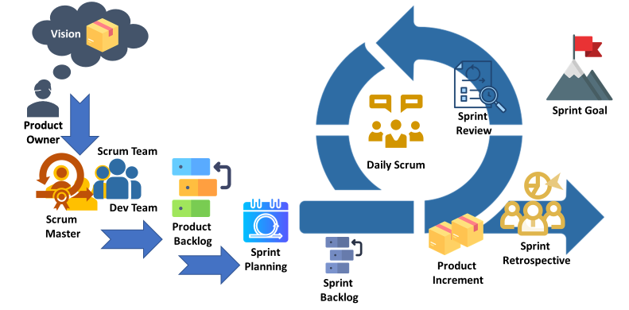
SCRUM - the process
Funded by

Slide 9
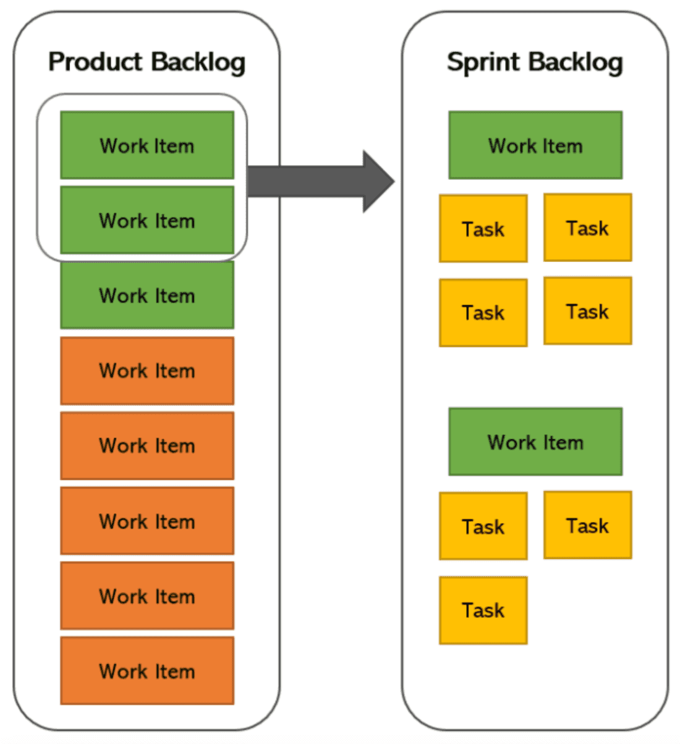
SCRUM in practice
Requirements organised in a product
backlog
Sprint backlog defines tasks for a sprint
Daily meetings („stand-ups“) for voting
After each sprint: feedback loops for optimisation – review and retrospective
Funded by

Slide 10
Circular Thinking in Education
"Kolb's circle"
Concrete experience
Traditional vocational training
Active experimentation
Reflective observation
Academic training
Abstract concept formation

Slide 11
What is agile learning?
Applies agile principles to the learning process
Focus on flexibility, self-organisation and iterative improvement
Learning in short cycles
Adaptation to new findings and needs
Regular reflections
Funded by

Slide 12
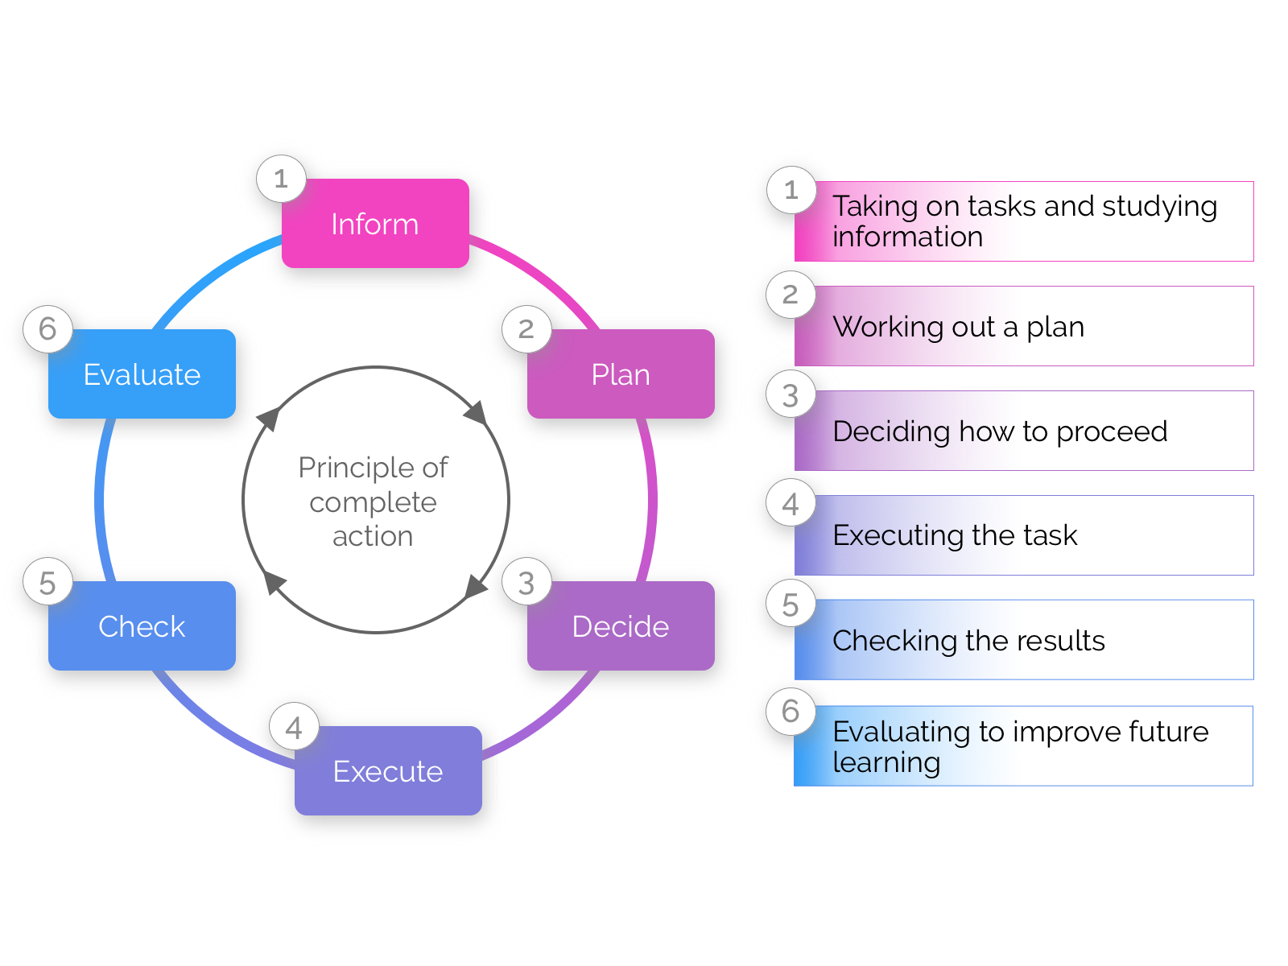
Transfer into VET: The principle of complete action

Slide 13

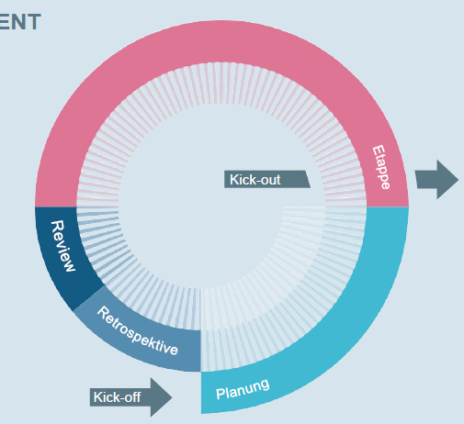
Advanced learning: Repeated Circles

Slide 14
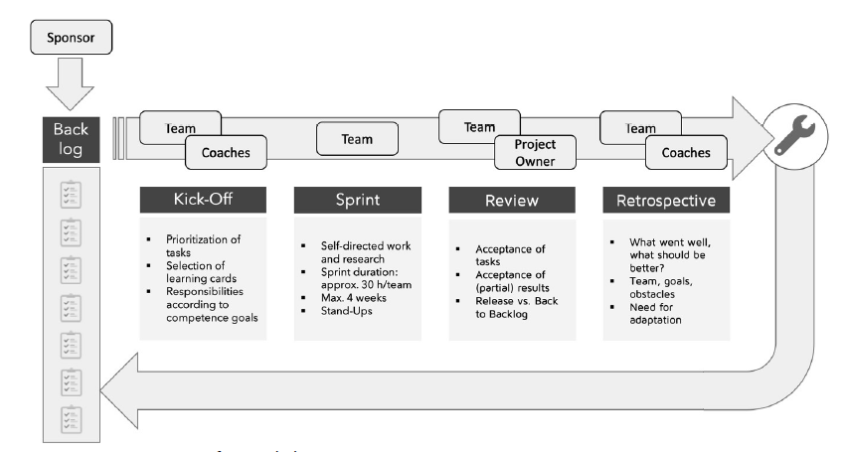
Advanced learning: Repeated Circles

Slide 15
The open question:
Where does the learning take place?
Points for discussion:
How important is the product?
How important is the learning process?

Slide 16
Back-up

Slide 17



Inform
An Assignment should
  Be to be completed within the specified time
  Have new and generalisable technical and interdisciplinary content
  Have a technically plausible question
  Be didactically customised due to the complexity involved
  Have various possible solutions!
KNUST
UENR
Funded by

Slide 18
Plan
A learning project should
  Be divided into work packages and activities by the students
  Be backed up with a timetable for the activities
  Students may choose this freely within limits, but must also commit to it
  (Changes in the course of the work do not prove a mistake, but a step forward in knowledge)
KNUST
UENR
Funded by

Slide 19
Decide
Students should
  Show up options / possible solutions
  Evaluate the options
  Justify the decision they took
  Follow up their decision: Where did it lead them?
KNUST
UENR
Funded by

Slide 20
Execute
A learning project should
  Ensure a steady flow of work for the students
  Allow to recognise technical errors / mistakes at an early stage
  Checking if activities are the activities completed on time and technically sound:
Intermediate presentations
Individual group consultations
Written submission of interim results
Hybrid, i.e. written submission and short online appointments
KNUST
UENR
Funded by

Slide 21
Check
In the final report and/or the final presentation, students should have
  Fulfilled all parts of the assignment completely,
  Documented all steps they have taken,
  Given reasons for the decision they had taken,
  Evaluated their work technically and
  Reflected on the learning and the group process.
KNUST
UENR
Funded by

Slide 22
Evaluate
Technically
  How would we plan a task like this again?
  Would we (with the level of knowledge at the time!) have done things better differently?
  What other approaches could we have taken?
  Socially
  How did our group develop as a team?
  What would we pay more attention to in future when working as a team?
KNUST
UENR
Funded by

Slide 23
Differentiation from directly operational projects
Current problems from a company are practically always very specific and therefore
need a long familiarisation period,
need in-depth processing (otherwise the engineers on site would have already solved this),
often require a longer stay on site,
the methodology can usually be generalised, but the technical content is often very specific.
  Industry-based learning projects should therefore allow sufficient time for student work, e.g. a master's thesis.
KNUST
UENR
Funded by

