Slide 1
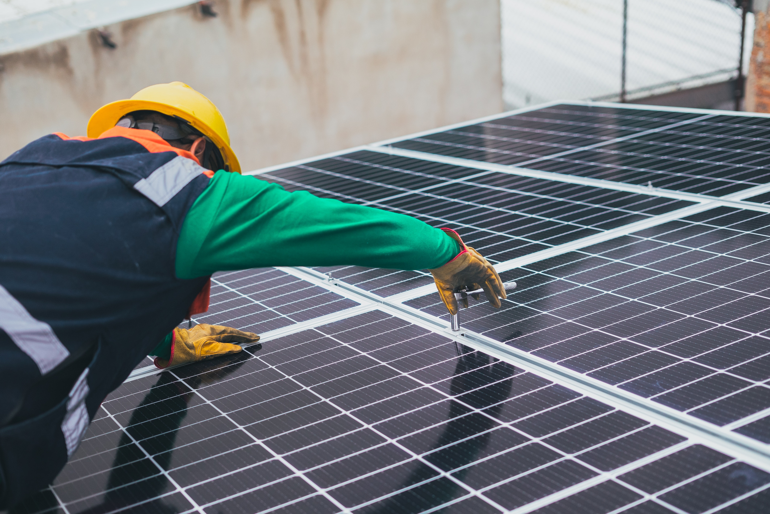



KNUST
UENR
PROFESSIONAL RENEWABLE ENERGY EDUCATION IN GHANA:
STAKEHOLDERS FEEDBACK ANALYSIS
BY
JOSEPH OPPONG AKOWUAH (PhD)

Slide 2
Overall Response Outlook
40 respondents filled out the questionnaire
34 past and currents students
18 companies with 10 employees being past students of the MRETs programme
Companies:
Daystar Power Group Limited, ECG, Danfopa Solar Energy Enterprise, Solar Enablers Ghana Limited (SOLAREnablers), Sunpower Innovations Ltd., Power Fuels Distribution Company Limited, AGA Obuasi Mine, Solar Taxi, Consummate Engineering limited, Greentech Biogas Engineering Services, Bui Power Authority, Renewable Energy Solutions, Ghana Institution of Engineering, GIZ, etc.

Slide 3
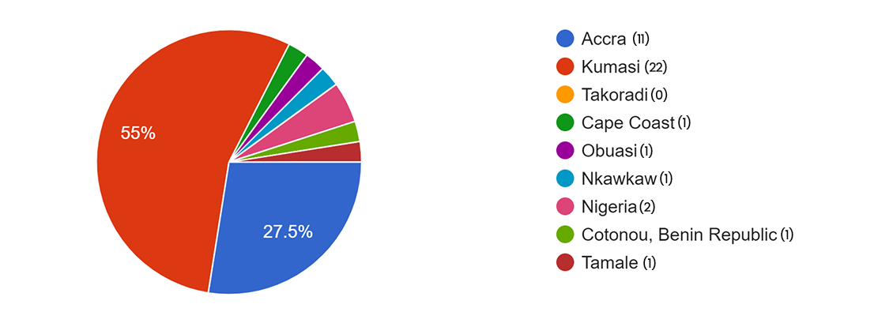
LOCATION OF WORKPLACE/COMPANY/INSTITUTION

Slide 4
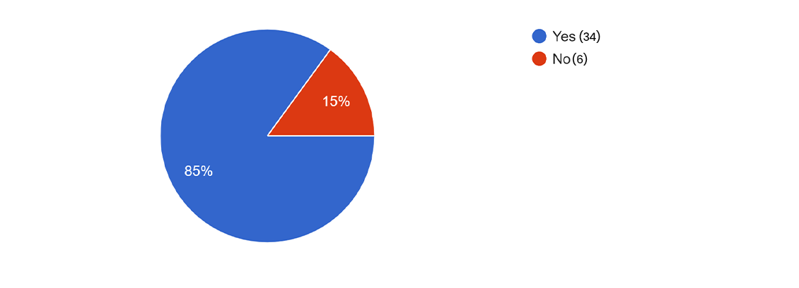
Past/current student of the Master’s in Renewable Energy Technologies(MRET)

Slide 5
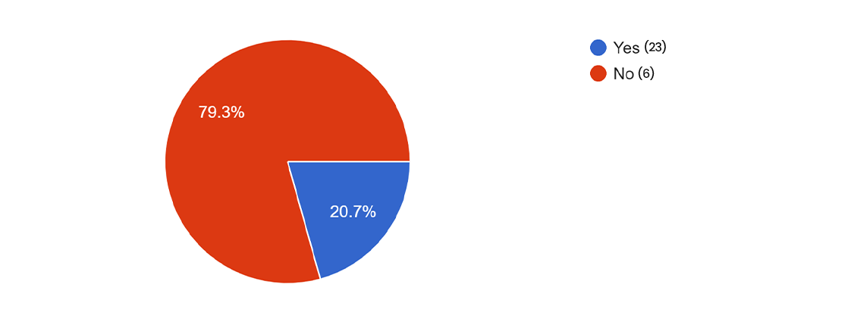
PAST/CURRENT STUDENT CURRENTLY WORKING IN
THE RE SECTOR
Yes (6)
No (23)

Slide 6
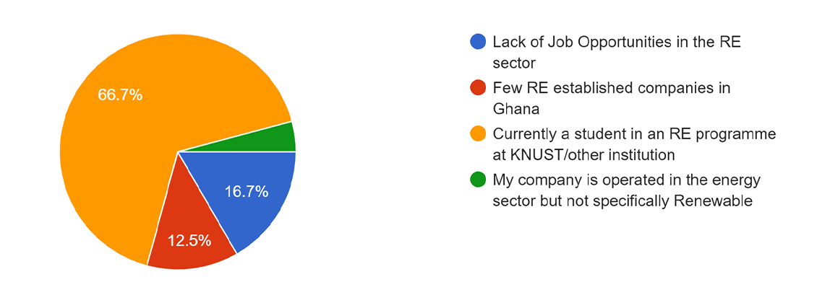
REASONS WHY GRADUATES OF MRETs ARE NOT WORKING IN
THE RE SECTOR

Slide 7
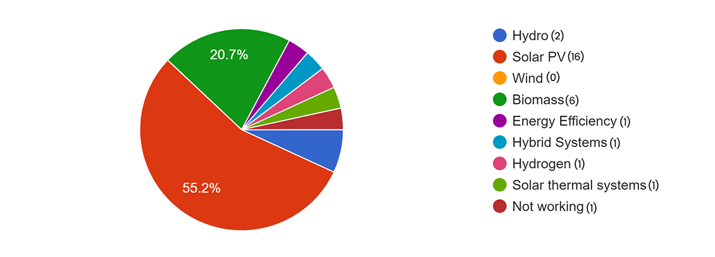
AREA OF RENEWABLE ENERGY(RE) FOCUSED
Solar PV is the highest RE Area focused

Slide 8
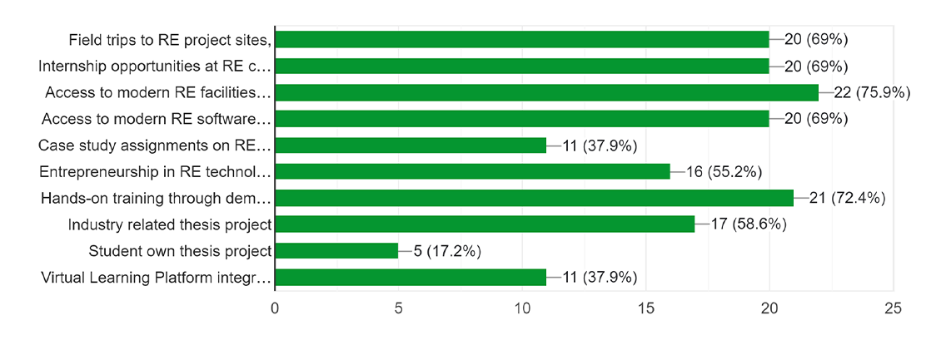
FEEDBACK ON KEY AREAS TO ENRICH THE MRETs PROGRAMME

Slide 9
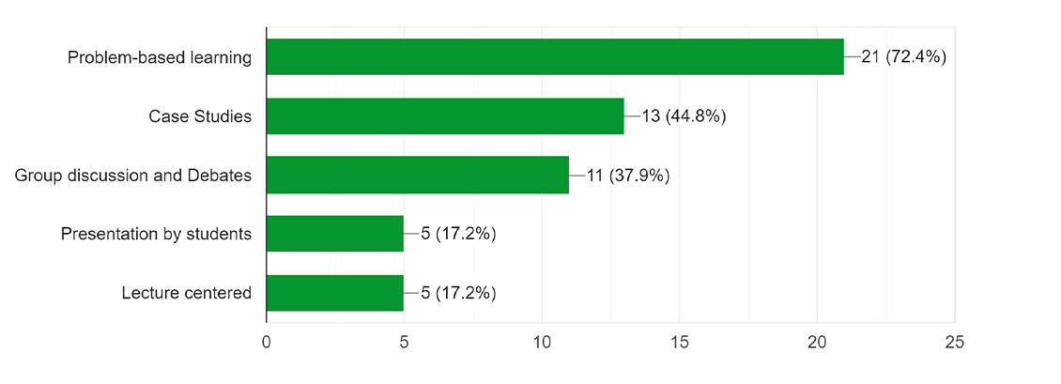
PEDAGOGY RECOMMEND IN THE DELIVERY OF THE MRETs

Slide 10
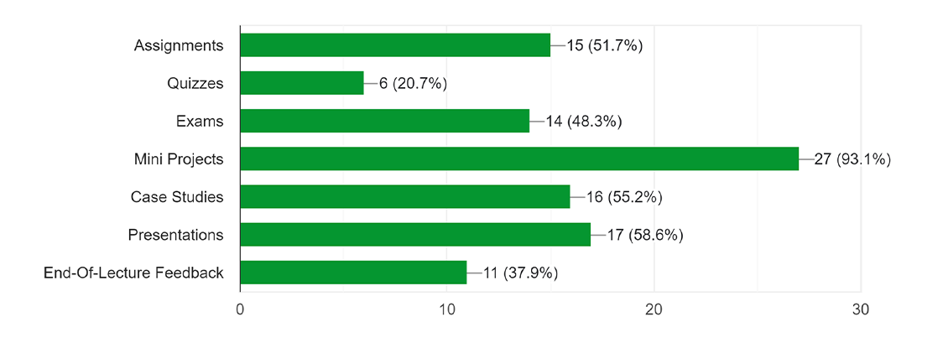
FEEDBACK ON MODE OF ASSESSMENT FOR STUDENTS ON THE MRETs

Slide 11
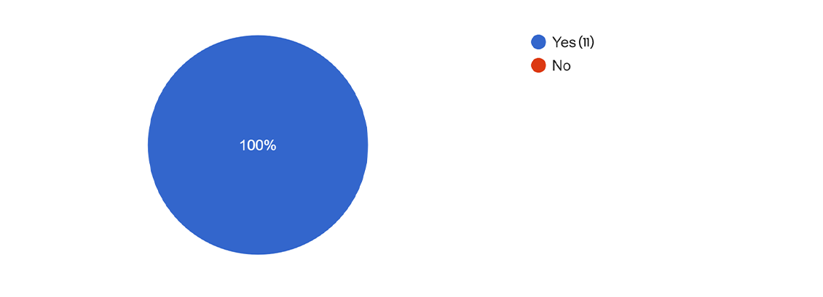
ORGANIZATIONS OPEN FOR PARTNERSHIP WITH PROREG TO EXPOSE STUDENTS TO RE PROJECTS

Slide 12
SOME GENERAL COMMENTS ON RE TRAINING IN GHANA
RE training is good opportunity to solve renewable energy deficit in Ghana
The MRETs programme practical session is missing. Need to be looked at
Good program, enhancing and encouraging the implementation of RE in many sectors of Ghana.
The programme should explore more in the area of Solar PV technologies since we have enough sun available in Ghana.

