Slide 1

Professional Education for Renewable Energies in Ghana - ProREG
Running Student Project Work
- Train the Trainers -
Workshop at KNUST, 4th-5th March 2024
Funded by

Slide 2

Agenda Day 1
11:00 | 11:15 | 00:15 | Welcome, agenda
11:15 | 11:55 | 00:40 | Presentation of student projects already having taken place to each other By KNUST and UENR staff, 20 min each
11:55 | 12:20 | 00:25 | Reflection in the group: what was positive / critical / surprising? What do we learn from this?
12:20 | 13:20 | 01:00 | Lunch break
13:20 | 13:50 | 00:30 | Exercise: How do we learn best?
13:50 | 14:20 | 00:30 | Learning theory: Types of competences and how they can be acquired
14:20 | 14:50 | 00:30 | Reflection of own learning experiences => good personal learning experience
14:50 | 15:20 | 00:30 | coffee break
15:20 | 15:50 | 00:30 | How can learning take place in projects?
15:50 | 16:35 | 00:45 | How to develop working/learning assignments accordingly?
16:35 | 16:50 | 00:15 | Outlook to tomorrow, appointments
16:50 | 17:00 | 00:10 | Closure for the day,
17:00 |  |  | End of the working day

Slide 3
Agenda Day 2
09:30 | 09:40 | 00:10 | Coming in, agenda
09:40 | 10:25 | 00:45 | Developing participant’s own future projects: What do we want to achieve?
10:25 | 11:10 | 00:45 | How could that work? Assignment sheet, scheduling, interin checks, marks,…
11:10 | 11:30 | 00:20 | What do teachers have to do?
11:30 | 12:00 | 00:30 | Coffee break
12:00 | 12:45 | 00:45 | Technical / organisational framework (IT, semester structure, resources / capacities, …) What are the options?,What can be realised and how?
12:45 | 13:15 | 00:30 | Support of the projects by ProREG: Technically, IT, supervision, evaluation, …
13:15 | 13:30 | 00:15 | Last appointments, closure of the meeting, good bye
13:30 | 14:00 | 00:30 | Quick lunch

Slide 4



Retrospective: your last projects
  Framework
Time budget of students
Group size
Remote / hybrid / in presence
IT infrastructure
  Assignments
  Schedule
KNUST
UENR
Funded by

Slide 5
Reflection together:
  What was
Positive
Critical
Surprising
  What do we learn from it?
KNUST
UENR
Funded by

Slide 6
Reflecting your own learning experiences:
  “What was a good learning experience for me”
  Exchange in subgroups of 5 persons
  Find similarities / coincidences / basic patterns (2-3 core sentences)
  Report them to the plenary
KNUST
UENR
Funded by

Slide 7
"Kolb's circle" in study projects
Concrete experience
Traditional vocational training
Active experimentation
Reflective observation
Academic training
Abstract concept formation

Slide 8
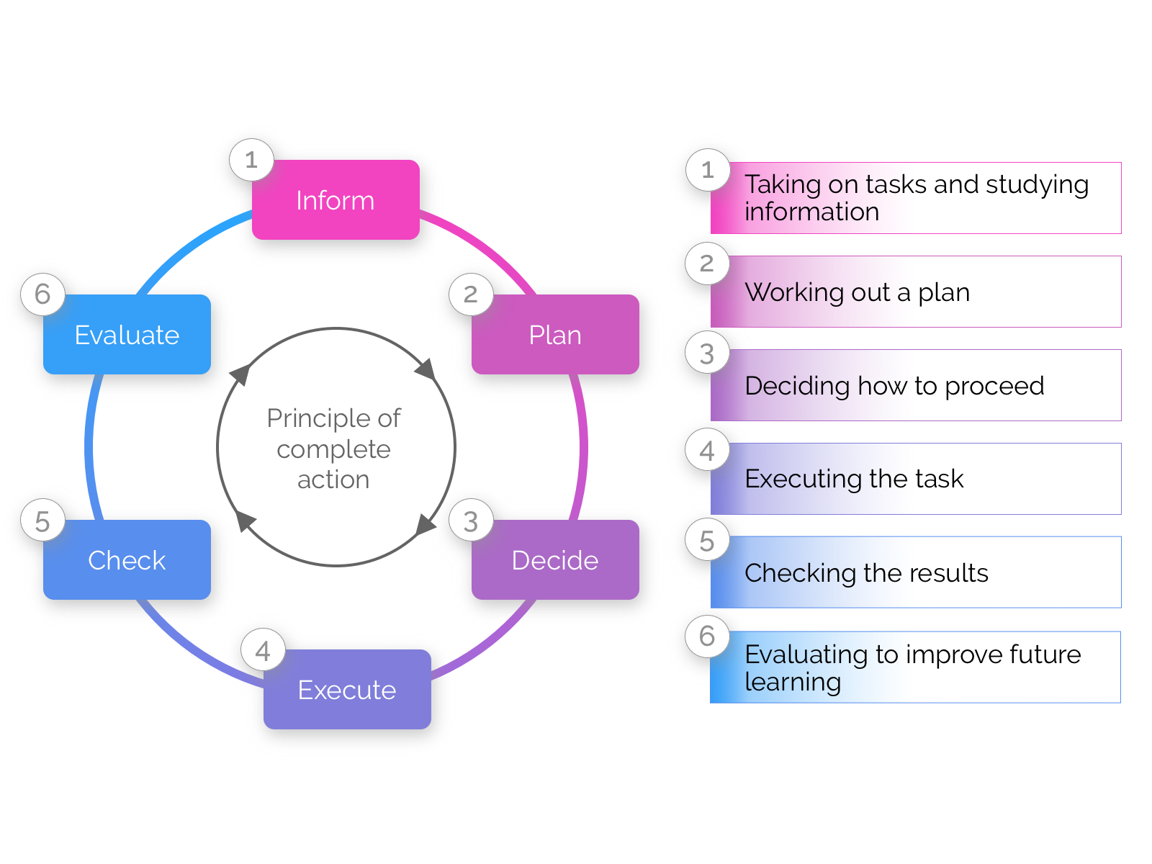
The principle of complete action

Slide 9
Inform
An Assignment should
  Be to be completed within the specified time
  Have new and generalisable technical and interdisciplinary content
  Have a technically plausible question
  Be didactically customised due to the complexity involved
  Have various possible solutions!
KNUST
UENR
Funded by

Slide 10
Plan
A learning project should
  Be divided into work packages and activities by the students
  Be backed up with a timetable for the activities
  Students may choose this freely within limits, but must also commit to it
  (Changes in the course of the work do not proof a mistake, but a step forward in knowledge)
KNUST
UENR
Funded by

Slide 11
Decide
Students should
  Show up options / possible solutions
  Evaluate the options
  Justify the decision they took
  Follow up their decision: Where did it lead them?
KNUST
UENR
Funded by

Slide 12
Execute
A learning project should
  Ensure a steady flow of work for the students
  Allow to recognise technical errors / mistakes at an early stage
  Checking if activities are the activities completed on time and technically sound:
Intermediate presentations
Individual group consultations
Written submission of interim results
Hybrid, i.e. written submission and short online appointments
KNUST
UENR
Funded by

Slide 13
Check
In the final report and/or the final presentation, students should have
  Fulfilled all parts of the assignment completely,
  Documented all steps they have taken,
  Given reasons for the decision they had taken,
  Evaluated their work technically and
  Reflected on the learning and the group process.
KNUST
UENR
Funded by

Slide 14
Evaluate
Technically
  How would we plan a task like this again?
  Would we (with the level of knowledge at the time!) have done things better differently?
  What other approaches could we have taken?
  Socially
  How did our group develop as a team?
  What would we pay more attention to in future when working as a team?
KNUST
UENR
Funded by

Slide 15
Back-up

Slide 16
Differentiation from directly operational projects
Current problems from a company are practically always very specific and therefore
need a long familiarisation period,
need in-depth processing (otherwise the engineers on site would have already solved this),
often require a longer stay on site,
the methodology can usually be generalised, but the technical content is often very specific.
  Industry-based learning projects should therefore allow sufficient time for student work, e.g. a master thesis.
KNUST
UENR
Funded by

