Slide 1

Development of renewable energy in Ghana and training of engineers in this field. A review and reflections from the ProREG project
Prof. Dr. Osvaldo Romero Romero https://orcid.org/0000-0003-1447-3151
Prof. Dr. Katia Caraballoso Granado https://orcid.org/0000-0002-8757-0705
Assoc. Prof. Dr. Stefan Wolf https://orcid.org/0000-0003-3325-5555

Slide 2
SUMMARY
Introduction
Methodology
Results
World economic and energy situation. Africa as epicenter to achieve sustainable development
Energy management in Ghana, a country south of the Sahara
Historical synthesis of Ghana's energy development and policy
Energy policy based on renewable energy
Analysis of energy statistics in Ghana
Main challenges in the development of renewable energy sources in Ghana
University training of engineers for renewable energy in Ghana
Conclusions
References

Slide 3
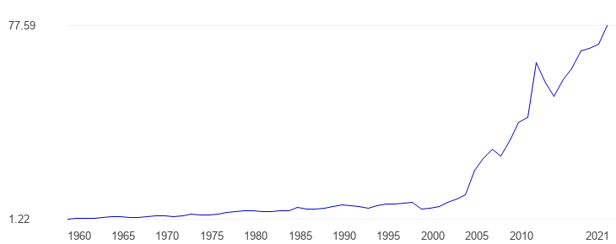
Introduction
Methodology
Results
Conclusions
References
Geiger et al., 2019
  Between 2005 - 2015 Ghana achieved impressive and stable economic growth, literally doubling income in the period.
  Starting in 2005, economic growth accelerated markedly with an average GDP growth of 4.5 percent since then, in this period the country is considered to have escaped low-income country status, it is seen as accelerating economic growth.
Gross Domestic Product (GDP), billions of US Dollars

Slide 4

Introduction
Methodology
Results
Conclusions
References
The present work is oriented to a bibliographic review, of the history and current state of the generation and demand of energy in Ghana and its relationship with economic growth, and specifically of the production and use of energy coming from the RES, as well as the current situation of university training in engineering to support the plans and policies of the country in the implementation of the RES. The analyzes and elements exposed in the work are part of the critical vision of the authors, as members of the management team of the project financed by the DAAD "Professional Training for Renewable Energies in Ghana”.

Slide 5

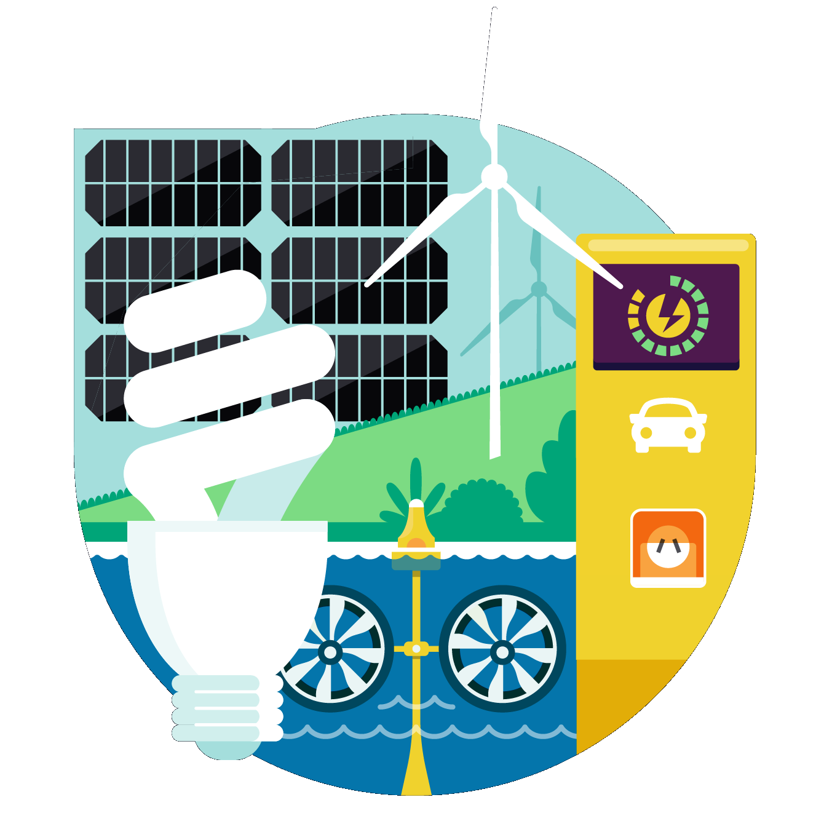

Introduction
Methodology
Results
Conclusions
References
Cuali
Cuanti
Historical analysis of the energy development of Ghana
Different information resources

Slide 6
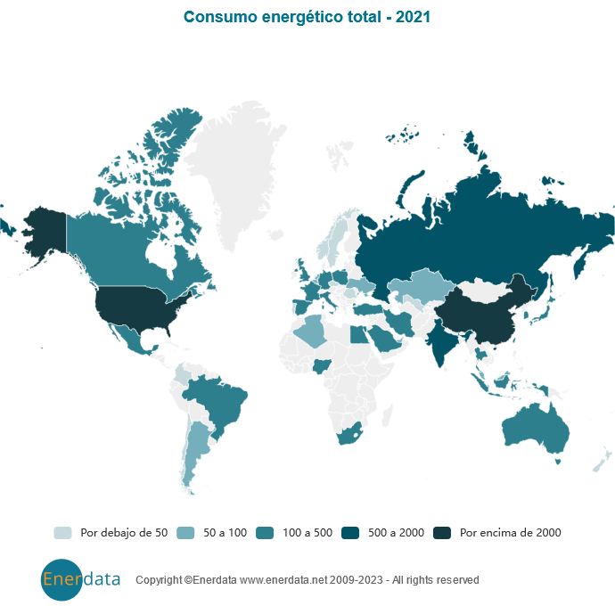
Introduction
Methodology
Results
Conclusions
References
The growth of global energy consumption, which had a rebound of 5% in 2021 after having suffered a reduction of 4.5% in 2020 within the framework of the global pandemic.
Enerdata, 2023

Slide 7
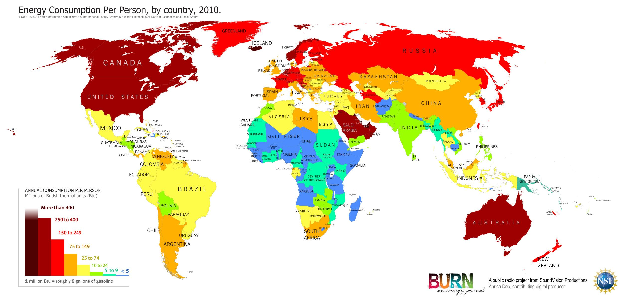
Introduction
Methodology
Results
Conclusions
References
World economic and energy situation. Africa as epicenter to achieve sustainable development

Slide 8
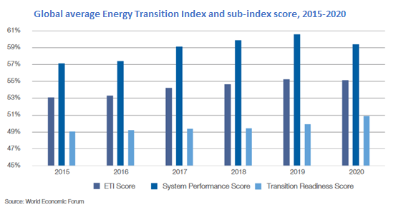
Introduction
Methodology
Results
Conclusions
References
Between the years 2015-2020 where the improvement of the ETI score has been greater for energy-importing countries than for fuel-exporting countries, which has caused a substantial increase in the difference between their mean scores.
(World Economic Forum, 2020

Slide 9
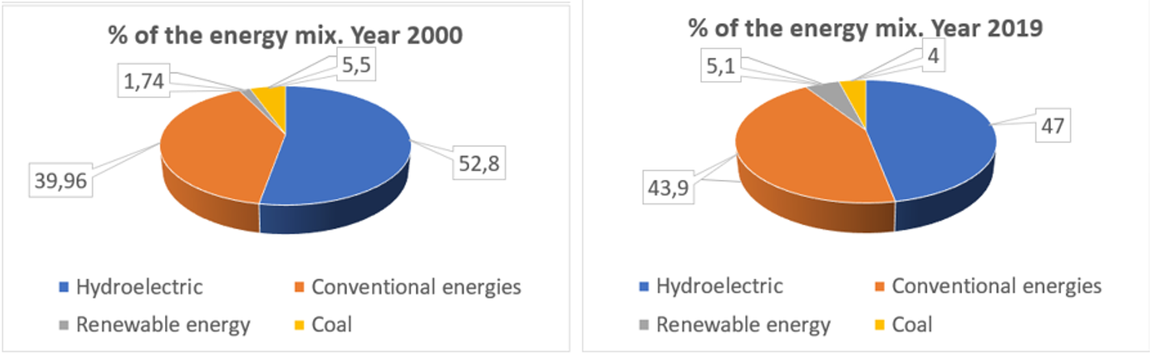
Introduction
Methodology
Results
Conclusions
References
One transformations that is generated in the African continent is aimed at energy, which has gone from using 1.74% renewable energy (excluding hydroelectric energy).
Simón Ballesteros, 2020

Slide 10
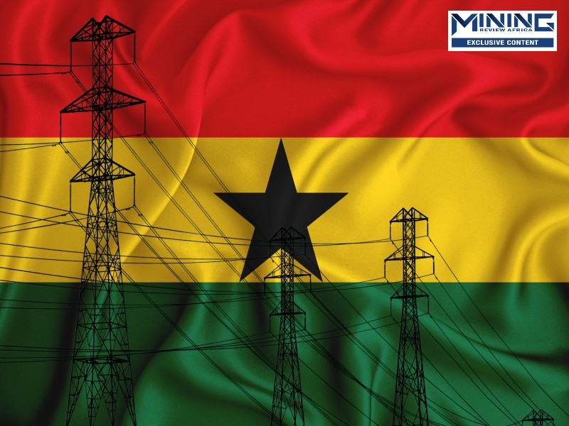
Introduction
Methodology
Results
Conclusions
References
Energy management in Ghana, a country south of the Sahara

Slide 11
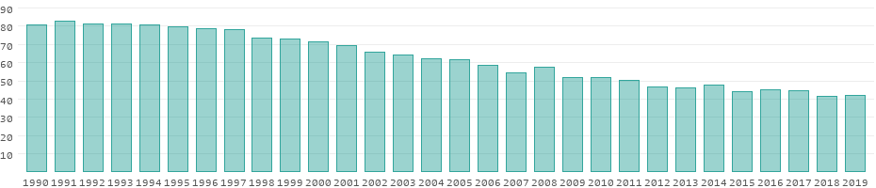
Introduction
Methodology
Results
Conclusions
References
The percentage participation from 1990 to 2019, in which it can be seen that production through renewable energy represented around 41.8% of total real consumption in Ghana until 2019.
DatosMundial.com, 2023

Slide 12
Introduction
Methodology
Results
Conclusions
References
Energy source | Total in Ghana | Percentage in Ghana | Percentage in USA | per capita in Ghana | per capita in USA
Fossil energy sources | 19,31 MM kWh | 58,0 % | 70,0 % | 588,19 kWh | 20.083,19 kWh
Nuclear energy | 0,00 kWh | 0,0 % | 9,0 % | 0,00 kWh | 2.582,12 kWh
Hydroelectric power | 13,98 MM kWh | 42,0 % | 7,0 % | 425,93 kWh | 2.008,32 kWh
Renewable energies | 332,97 M kWh | 1,0 % | 14,0 % | 10,14 kWh | 4.016,64 kWh
Total production capacity | 33,30 MM kWh | 100,0 % | 100,0 % | 1.014,12 kWh | 28.690,27 kWh
Actual total production | 12,52 MM kWh | 37,6 % | 43,0 % | 381,32 kWh | 12.338,29 kWh
The power generation capacity in Ghana under ideal conditions since the value shown is theoretical as it would be the amount of power that could be generated from all the power plants under permanent and full use of the total capacity, as well as comparing some indicators with USA.
DatosMundial.com, 2023

Slide 13
Introduction
Methodology
Results
Conclusions
References
Historical synthesis of Ghana's energy development and policy
1914. Ghana's first government-sponsored public electricity supply
1922. Limited direct current (DC) supply in Accra.
Several generating plants were built in the following years.
1963. It was put into operation the first transmission system of 161 kV.
1928. Electricity supply to Sekondi-Takoradi was extended.
1924. Started a large alternating current (AC) project and a small generating plant.
1926. It spread to Kumasi.
1961. Volta River Development Act.
1972. Construction of the Akosombo dam (hydroelectric power).
Until 1965, 75% of electricity was used in the capital Accra
(ResearchDivision, 1994)

Slide 14
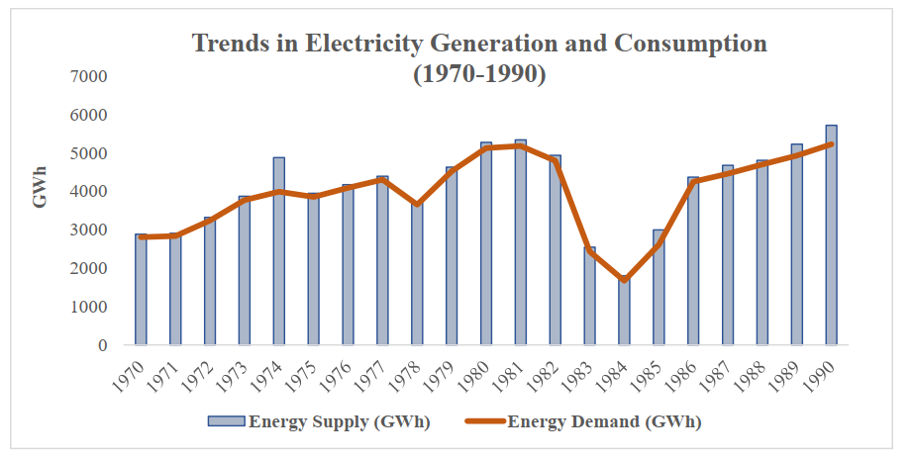
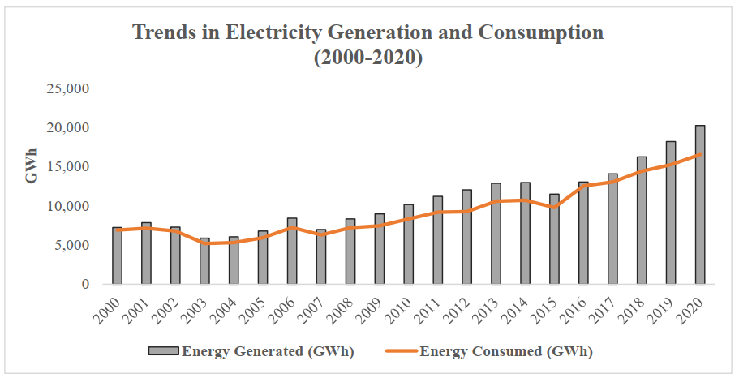
Introduction
Methodology
Results
Conclusions
References
energy consumption tripled between 1984 and 1990
Energy generation and consumption maintained sustained growth until 2020, which continues today

Slide 15
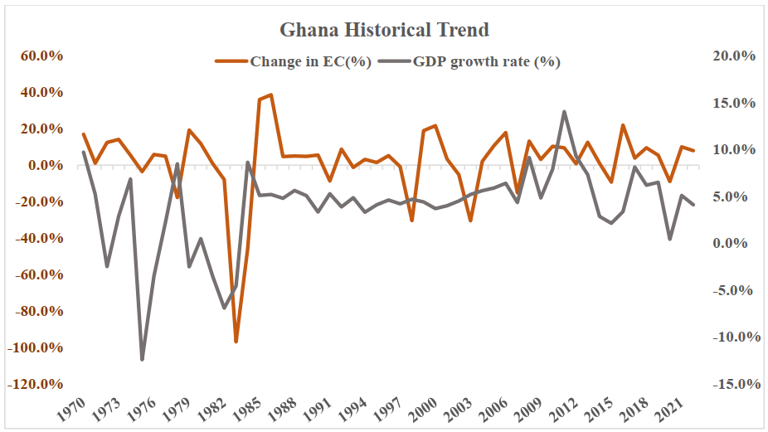
Introduction
Methodology
Results
Conclusions
References
The strong correlation between economic recovery and increased energy demand in Ghana through 2021. In the last five years, the maximum energy consumption increased at a rate of 10.3%, although, the supply capacities meet the current energy demand, and even it is considered higher than the demand, it is estimated that the total demand will exceed supply capacities by 2025 (Geiger et al., 2019).

Slide 16
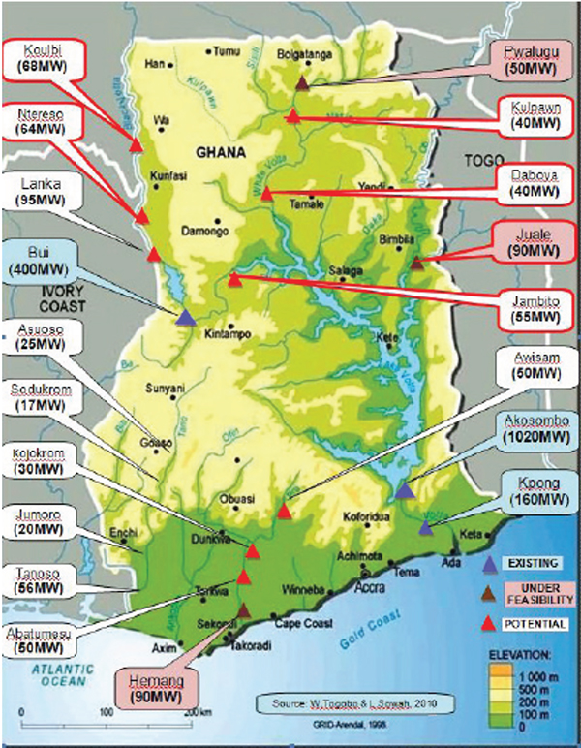
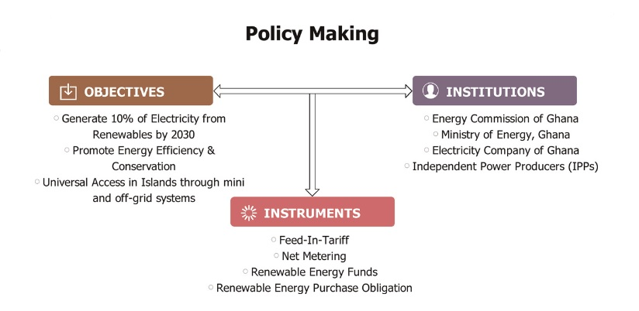
Introduction
Methodology
Results
Conclusions
References
Conceptual framework showing the policy making process in renewable energy sector of Ghana. The information source taken from to Adobea et.al., 2020.

Slide 17
Introduction
Methodology
Results
Conclusions
References
Energy Policies in Ghana
The policy also set the target to achieve 10% of renewables by the year 2020, reduce the consumption of wood fuels from 66 to 30% by 2020 and encourage the use of clean cooking alternatives such as LPG, and efficient cookstoves.
Energy sector Strategy and Development Plan (2010)
It covered, programs and projects intended to support the national development agenda of Ghana in the fallowing areas: energy sector institutions, power sub-sector, petroleum sub-sector, and renewable energy sub-sector. This policy sets the goal and strategies to increase the percentage of renewable in the total national energy mix efficient use of stoves and establish legislation to encourage the development of renewable energy technologies.
SE4ALL Action Agenda 2012
The sustainable energy for all (SE4ALL) action plan targets universal access to electricity to island and riverside communities in Ghana both on-and off-grid systems and providing universal access to clean cooking solutions.
Renewable Energy Master Plan 2019
This plan aims to achive the following by 2030: 1) increase the proportion of renewable energy in the national energy generation mix from 42.5 MW in 2015 to 1363.63 MW (with grid connected systems totaling 1094.63 MW). 2) reduce the dependence on biomass as main fuel for thermal energy applications. 3) provide renewable energy based decentralized electrification options in 1000 off-grid communities, and 4) promote local content and local participation in the renewable energy industry.
National Strategic Energy Policy Plan (2006-2020)
The renewable energy objective of the policy aimed at increasing the share of renewable up to 10% by 2020 while ensuring energy efficiency and conservation and achieving universal access to electricity by the year 2020.
National Energy Policy (2010)
Renewable Energy Act (832), 2011
Under this act, there are Licensing procedures, fees-in-tariff scheme, purchase obligation and rights to transmission and distribution systems for renewable energy (RE) plants, net metering and renewable energy fund. The feed-in-tariff scheme was established under the renewable energy act 2011 of Ghana to guarantee the sales of electricity generated from RE sources into the national grid.
Adapted from Asante et.al., 2022

Slide 18

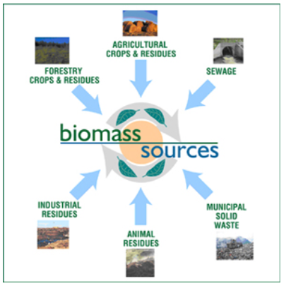
Introduction
Methodology
Results
Conclusions
References
Analysis of energy statistics in Ghana
Total energy supply doubled to 12,371 ktoe in 2021 relative to 2000. Ghana's total final energy consumption increased from 5,467 ktoe in 2000 to 9,345 ktoe in 2021.
Biomass was Ghana's primary energy source between 2000 and 2011
Oil as the dominant fuel until 2020.
And biomass returned to its place with 34% of the total energy supply in 2021
  Although the wide participation of biomass as an energy resource has a grid of domestic use and penetrates less in electricity generation.

Slide 19
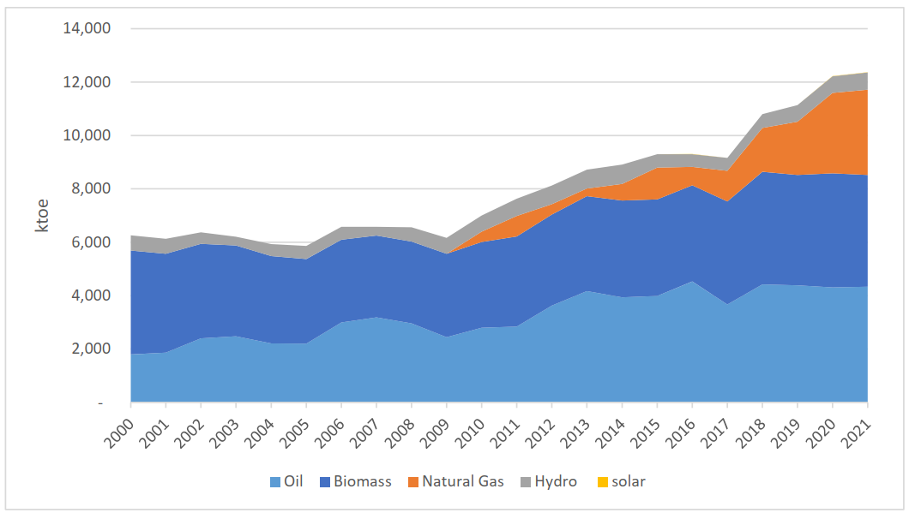
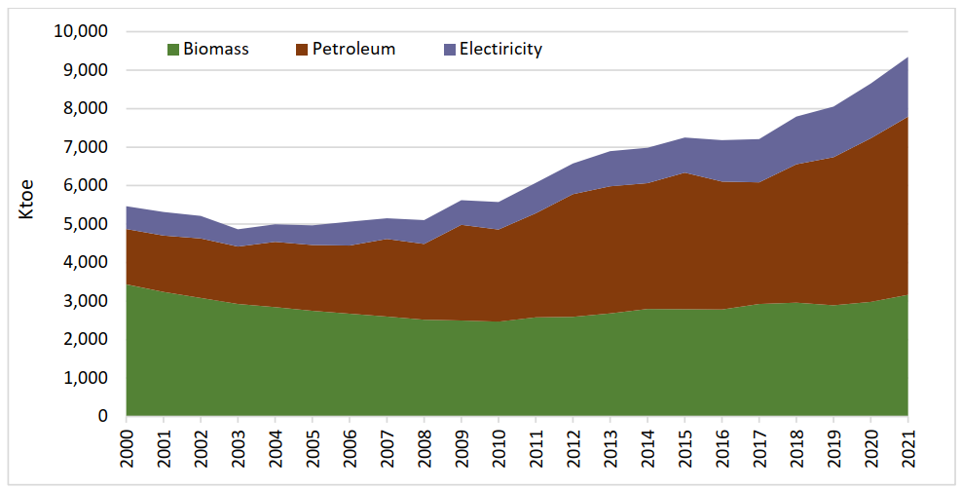
Introduction
Methodology
Results
Conclusions
References
Total power supply by sources in Ghana (2000 - 2021). Energy Comission Ghana, 2022
Evolution of Final Energy Consumption by Fuel. Energy Comission Ghana, 2022
It can be seen how by increasing the consumption of electricity and oil, the consumption of biomass decreases, which is explained by a change in the domestic use of energy resources. The most of the primary energy consumption is in the residential sector.

Slide 20
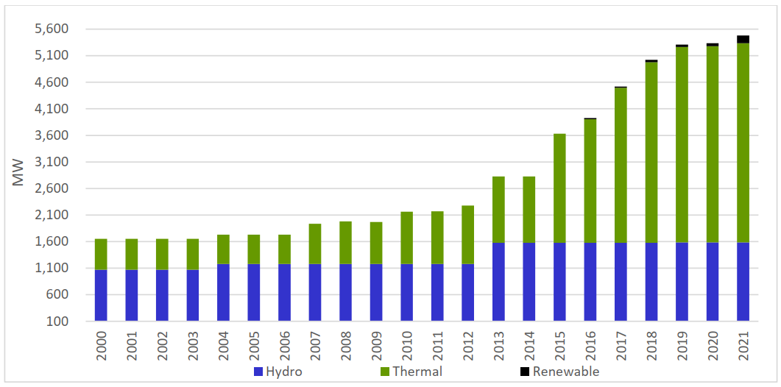
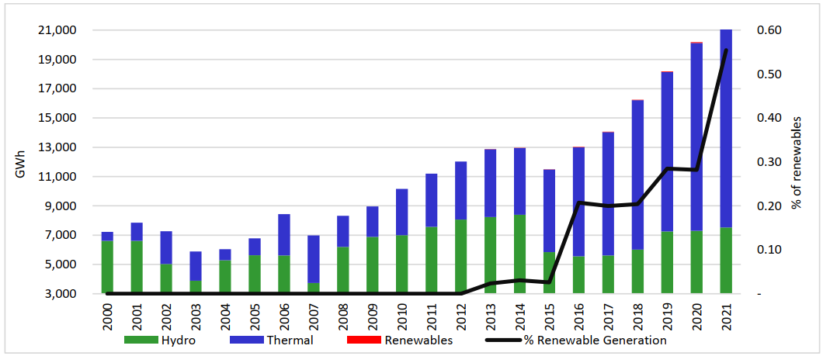
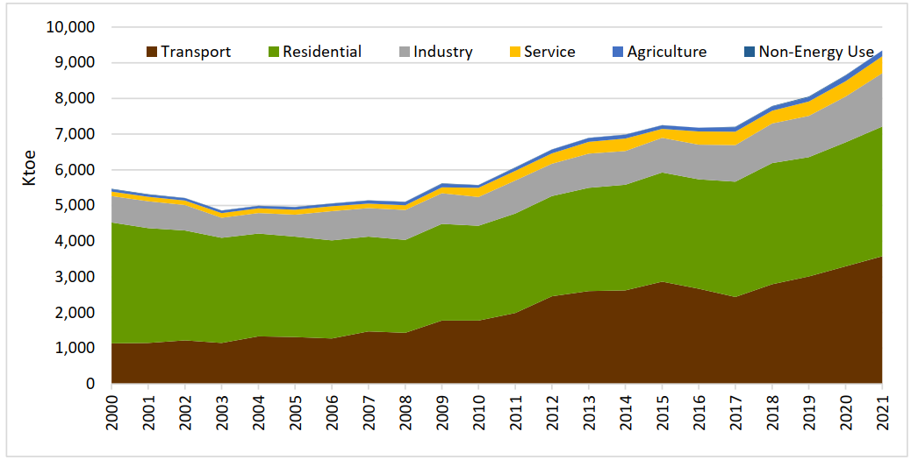
Introduction
Methodology
Results
Conclusions
References
Although the installed capacity for electricity generation is much higher in thermal plants, the sum of the electricity generated by hydroelectric plants and other renewable energy sources contribute 56% of the electricity that is generated. uses in the country.

Slide 21
Introduction
Methodology
Results
Conclusions
References
Main challenges in the development of renewable energy sources in Ghana
Aboagye et al., 2021
Romero, Caraballoso, Wolf, 2023
High initial capital cost.
Inadequate, unaffordable, and unsustainable financial assistance.
Lack of skills to effectively operate, maintain, and manage renewable energy technologies.
Strict and relatively new legal and regulatory frameworks.
Theft of major parts and high cost of replacement.
Human resources skills
Modify the curricula of professional training.
Modify the curricula of Universities for training in engineering with emphasis on the skills to design, manage, promote and operate renewable energy facilities.
Especially promoting entrepreneurial skills among engineering graduates for the development of sustainable businesses in this sector.

Slide 22

Introduction
Methodology
Results
Conclusions
References
University training of engineers for renewable energy in Ghana
Ghana is one of the fastest growing economically African countries with additional value offered by engineering education and training. Currently Ghana has become a powerful country in science and technology universities where young people from many African countries study, Ghanaian universities occupy top places in the ranking of universities on the continent, however there is evidence that the training of engineers does not yet efficiently accompany the development of renewable energy sources in the country.

Slide 23
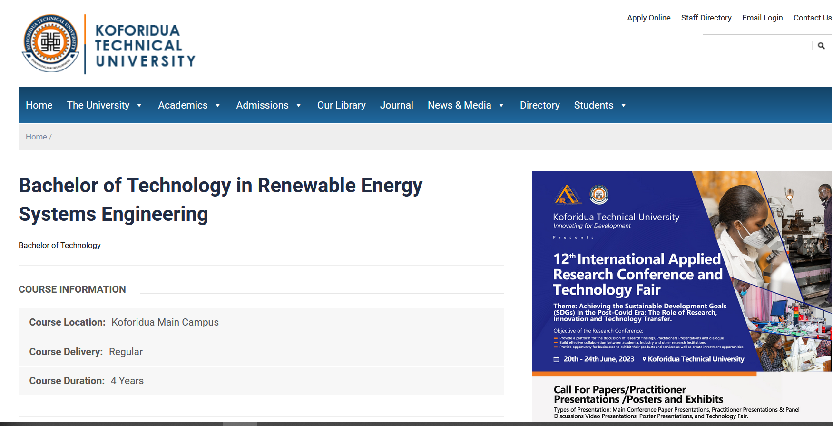
Introduction
Methodology
Results
Conclusions
References
https://www.ktu.edu.gh/course/bachelor-of-technology-in-renewable-energy-systems-engineering/

Slide 24
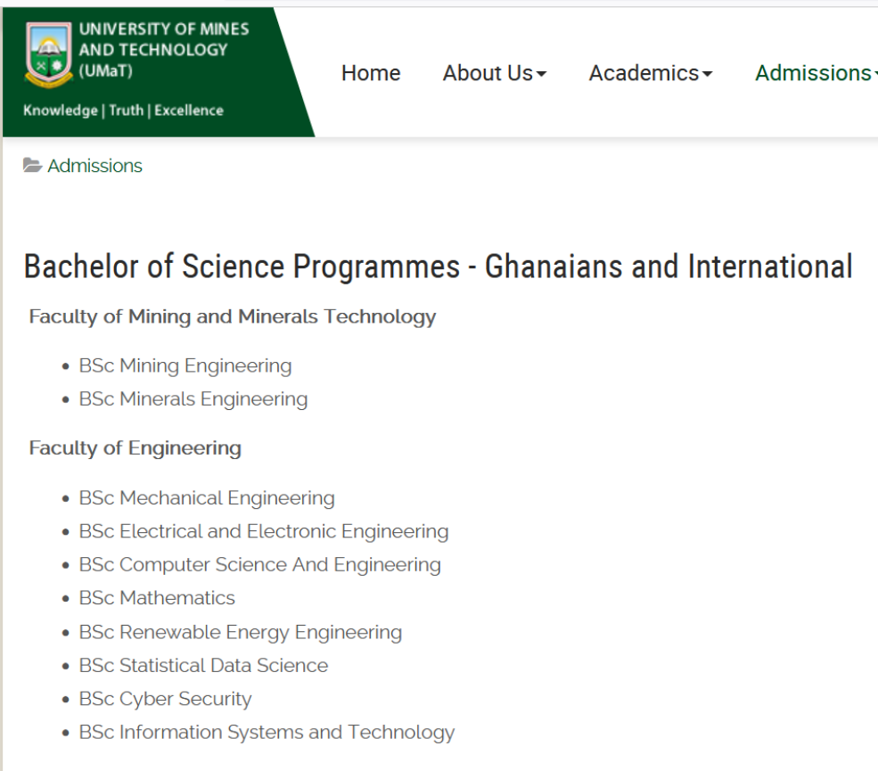

Introduction
Methodology
Results
Conclusions
References
https://www.umat.edu.gh/

Slide 25
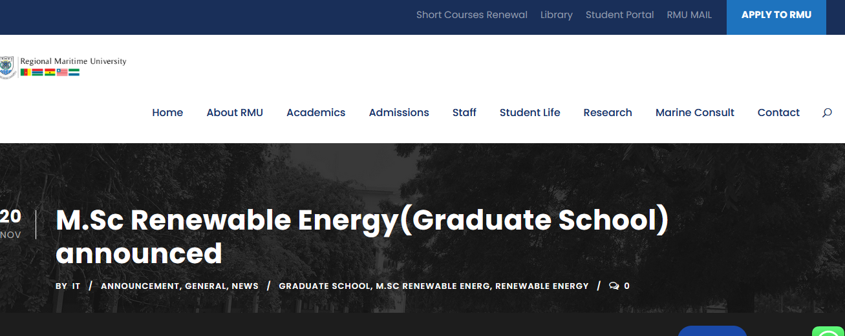
Introduction
Methodology
Results
Conclusions
References
https://rmu.edu.gh/m-sc-renewable-energygraduate-school-announced/

Slide 26
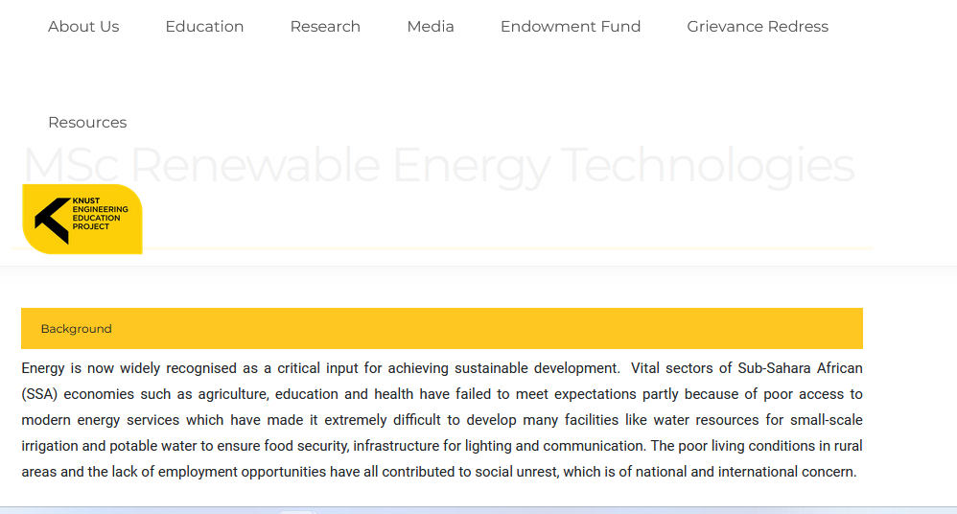
Introduction
Methodology
Results
Conclusions
References
https://keep.knust.edu.gh/page/msc-renewable-energy-technologies

Slide 27
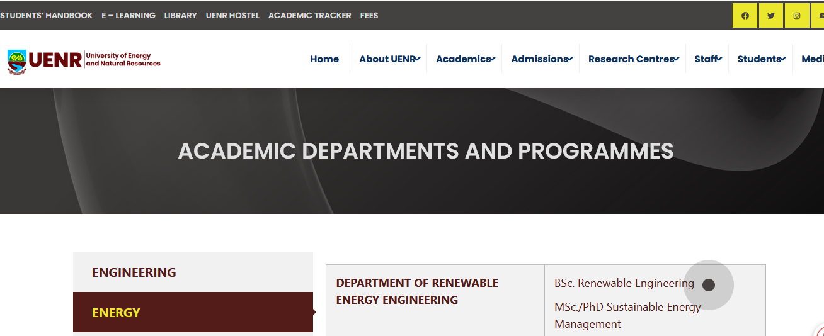
Introduction
Methodology
Results
Conclusions
References
https://uenr.edu.gh/academic-departments-and-programmes/

Slide 28
Introduction
Methodology
Results
Conclusions
References
As can be understood, despite the great development of Ghana's universities based on renewable energies, the offer and objectives of the bachelor's and master's programs still seem insufficient based on the expected development of renewable energies in the country, specifically in the competence development of the students.
The authors during the initial visit of the ProREG project to Ghana to identify
Graduates still express dissatisfaction with the skills acquired at university and the demands of the job.
Teachers and employers recognize the weaknesses in the training of engineers' skills.
There are technological resources for the training of specific professional skills in universities that are being little used in academic programs and are even deteriorating due to lack of resources for their maintenance and use.
Greater financial support is required for universities and for the interaction between universities and companies that enables practical theoretical training simultaneously and effectively.
The career accreditation system needs to be made more flexible so that universities can react from the curricula to changes in the demands for professional skills in the renewable energy sector.
An interaction platform with a renewable energy information management system is required where companies, universities, experts, public managers, and the community can interact to respond more effectively to the development of renewable energy sources and the formation of human’s resources that these demands.

Slide 29
Introduction
Methodology
Results
Conclusions
References
In general, it can also be observed that the engineering curricula focused on renewable energies in Ghana, both at the bachelor's and master's levels, are limited in topics relevant to the country's labor market and to the international context of the renewable energy, as discussed below.
Training of skills for the integration of the analysis of renewable energy sources into other sectors.
food production,
waste management
water management
International project management skills training
Entrepreneurial skills training
2030 agenda
Focus on the green economy

Slide 30
Introduction
Methodology
Results
Conclusions
References
Facing the energy future, a greater development is proposed, with an energy demand greater than the current one, together with a greater use of renewable energies worldwide. Therefore, it is essential that governments worldwide become aware of the importance of the global transition from fossil fuels to clean and sustainable energy, as well as the educational transformations to achieve it.
Africa could become the continent that generates the greatest potential for clean and sustainable energy on the planet and for this, it receives various forms of financing that enable the energy transition and the RES facilities corresponding to each African country to provide solutions to the transformations proposed in the agenda 2030 through SDG 7.
Ghana, as a case study of the present investigation, has stable natural characteristics that guarantee energy production, aiming at the self-sufficiency of the country in which the potential of hydroelectric and renewable energy is used.
In the historical development of the energy sector in Ghana, it arose on the basis of a renewable resource such as hydropower and had to be extended towards fossil fuels due to the effects of climate change.

Slide 31
Introduction
Methodology
Results
Conclusions
References
Ghana has a well-defined legal framework and implementation targets in the Renewable Energy Act 832 of 2011 and the National Renewable Energy Action Plan, although it does not include engineering skills training as a necessity for achieving the goals. objectives that the country proposes.
Ghana maintains a high participation of renewable energies in its energy mix with 56%, but the largest participation continues to be from hydropower, while other renewable energies contribute only 0.8%, which requires giving value to other renewable energy resources in the country such as technologies for the use not only of direct solar radiation, but also biomass and MSW; therefore, it is necessary to deepen the professional skills of engineers to promote and develop their use.
There are several universities that offer bachelor's and master's degree programs about renewable energies, but only UNER has programs at both levels of education, so continuity of studies is limited in most universities to promote development of professional skills in this sector.

Slide 32
Introduction
Methodology
Results
Conclusions
References
The current university engineering curricula have still weaknesses in regard of professional skills in area such as energy storage systems, the automation of grid regulation, hydrogen production and use, sector coupling, which are focus of the Government policies.
Several dissatisfactions were identified in managers, graduates, teachers and businessmen in relation to the professional skills that are acquired by engineers at the university and the demand in the business world of the renewable energy sector, which requires an in-depth analysis of the academic curricula.
It is also necessary that the curricula deepen the training of professional skills of engineers for the management of international projects, entrepreneurship and the integrated management of energy systems with food production and waste and water management, taking into account the international context in which these projects are developed, the situation of the labor market on the country and the link between the different sectors in the context of the 2030 agenda.

Slide 33
Introduction
Methodology
Results
Conclusions
References
Acknowledgements
The authors of this article would like to thank the German Academic Exchange Service (German acronym DAAD) for funding the project "Vocational training in renewable energies in Ghana (ProREG)", which has supported the realization of this contribution.

Slide 34
Introduction
Methodology
Results
Conclusions
References
Aboagye, B., Gyamfi, S., Ofosu, E., & Djordjevic, S. (2021). Status of renewable energy resources for electricity supply in Ghana. Scientific African(28).
Banco Europeo de Inversiones. (2016). Responder a las necesidades de energía de África. https://www.eib.org/attachments/general/energy_needs_africa_es.pdf
DatosMundial.com. (2023). Gestión de energía en Ghana. https://www.datosmundial.com/africa/ghana/balance-energetico.php
Enerdata. (2023). Energía y clima mundial - Anuario estadístico 2022. In (2023 ed., Vol. 2009 - 2023): Enerdata.
Energy Comission Ghana. (2022). NATIONAL ENERGY STATISTICS.
Energy Commission of Ghana. (2016). NATIONAL ENERGY STATISTICS 2006 - 2015. http://energycom.gov.gh/files/National%20Energy%20Statistics_2016.pdf
Faculty of Engineering. (2023). Renewable Energy Systems Engineering Department. EngineeringFacultyKTU. https://foe.ktu.edu.gh/departments/renewable-energy-systems-engineering-department/
Geiger, M., Trenczek, J., & Wacker, K. (2019). Understanding Economic Growth in Ghana in Comparative Perspective. https://documents.worldbank.org/curated/en/144891547137796751/pdf/WPS8699.pdf
Renewable energy, 26 (2011). https://bcp.gov.gh/acc/registry/docs/Renewable%20Energy%20Act,%202011(Act%20832)%20.pdf
Goitia, F. (2023). La mitad de África vive sin electricidad: el reto de vivir sin luz. XLSemanal. https://www.xlsemanal.com/conocer/sociedad/20191012/vivir-sin-luz-electricidad-efecto-problemas-africa.html
KNUST Engineering Education Project (KEEP) Kwame Nkrumah University of Science & Technology. (2023). https://keep.knust.edu.gh/page/msc-renewable-energy-technologies

Slide 35
Introduction
Methodology
Results
Conclusions
References
Martin, K. (2021). Solar Tax Equity Structures. Norton Rose Fulbright LLP. https://www.projectfinance.law/publications/2021/december/solar-tax-equity-structures/
Nkansah-Nyarko, J. (2022). Senior Manager, Renewable Energy Regulation. In S. Wolf & O. Romero Romero (Eds.): Energy Comission Ghana.
Nowak, M. R. (1996). III Ghana, 1983–91. Adjustment for Growth - The African Experience. International Monetary Fund. https://www.elibrary.imf.org/view/books/084/00149-9781557755667-en/C3.xml
Phillips, M. (2007). How Ghana’s Economic Turnaround Is Threatened. Wall Street Journal. https://www.wsj.com/articles/SB118635544536388723
Ponkshe, P. (2022). Financing Sustainable Energy in the Ghanaian Energy Market – A Comprehensive Policy Review and Recommendations FIRST ACADEMIC CONFERENCE ON THE SUSTAINABLE DEVELOPMENT GOALS “WHY IT MATTERS” AS PART OF THE DECADE OF ACTION, Utah, USA.
Regional Maritime University. (2023). https://rmu.edu.gh/m-sc-renewable-energygraduate-school-announced/
REN21. (2022). RENEWABLES 2022. GLOBAL STATUS REPORT. https://www.ren21.net/wp-content/uploads/2019/05/GSR2022_Full_Report.pdf
ResearchDivision, F. (1994). Ghana a country study. La Verle Berry.
Robles Algarin, C., & Rodríguez Álvarez, O. (2018). Un panorama de las energías renovables en el Mundo, Latinoamérica y Colombia. Revista Espacios, 39(34). https://www.revistaespacios.com/a18v39n34/a18v39n34p10.pdf
Simón Ballesteros, Á. d. (2020). África, ¿una revolución verde en marcha? UnitedExplanations. https://www.unitedexplanations.org/2020/05/27/africa-la-necesaria-revolucion-verde/
University of Energy and Natural Resources. (2023). https://uenr.edu.gh/academic-departments-and-programmes/
University of Mines and Technology (UMaT). (2022). https://www.umat.edu.gh/

Slide 36
Introduction
Methodology
Results
Conclusions
References
World Economic Forum. (2020). Fostering Effective Energy Transition. 2020 edition. W. E. Forum. https://www3.weforum.org/docs/WEF_Fostering_Effective_Energy_Transition_2020_Edition.pdf
World Energy Trade. (2023). La inversión mundial en energías renovables alcanzó un récord en 2022, pero sigue por debajo de los objetivos. Retrieved 24 Febrero 2023 from https://www.worldenergytrade.com/energias-alternativas/general/inversion-mundial-energias-renovables-record-2022
WorldBank. (2021). GDP Growth (annual%) - Ghana. https://data.worldbank.org/indicator/NY.GDP.MKTP.KD.ZG?locations=GH
WorldBankGroup. (2017). State of Electricity Access Report. http://documents.worldbank.org/curated/en/364571494517675149/full-report

