Slide 1
Panel Discussion : Industry needs and Challenges

Slide 2
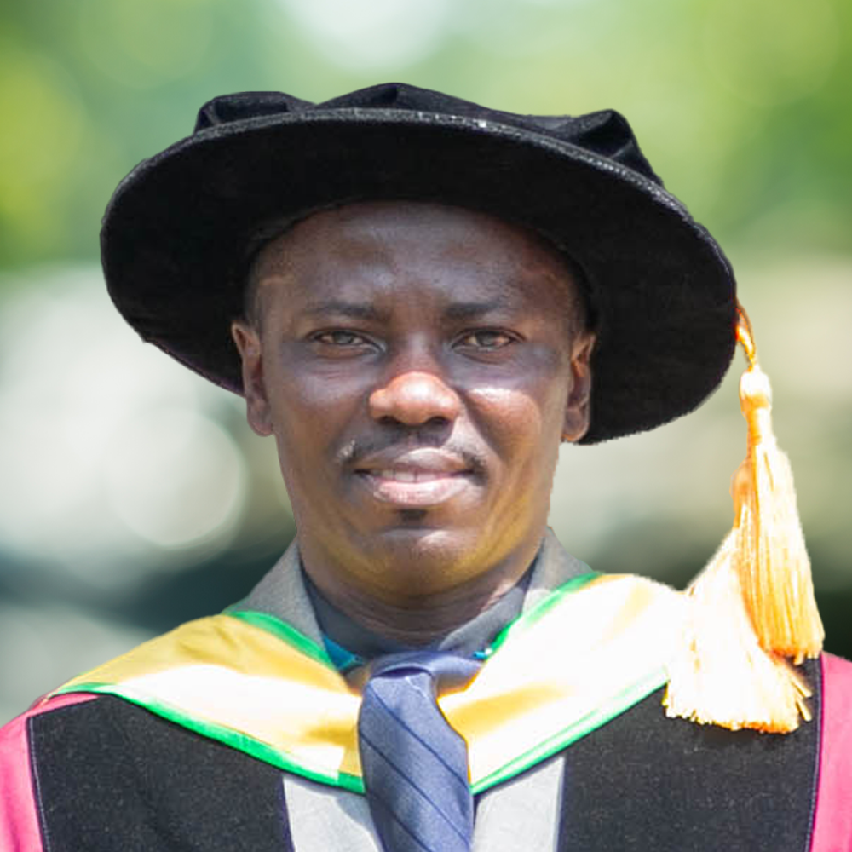
Prof. Joseph Akowuah
KNUST
MODERATOR

Slide 3
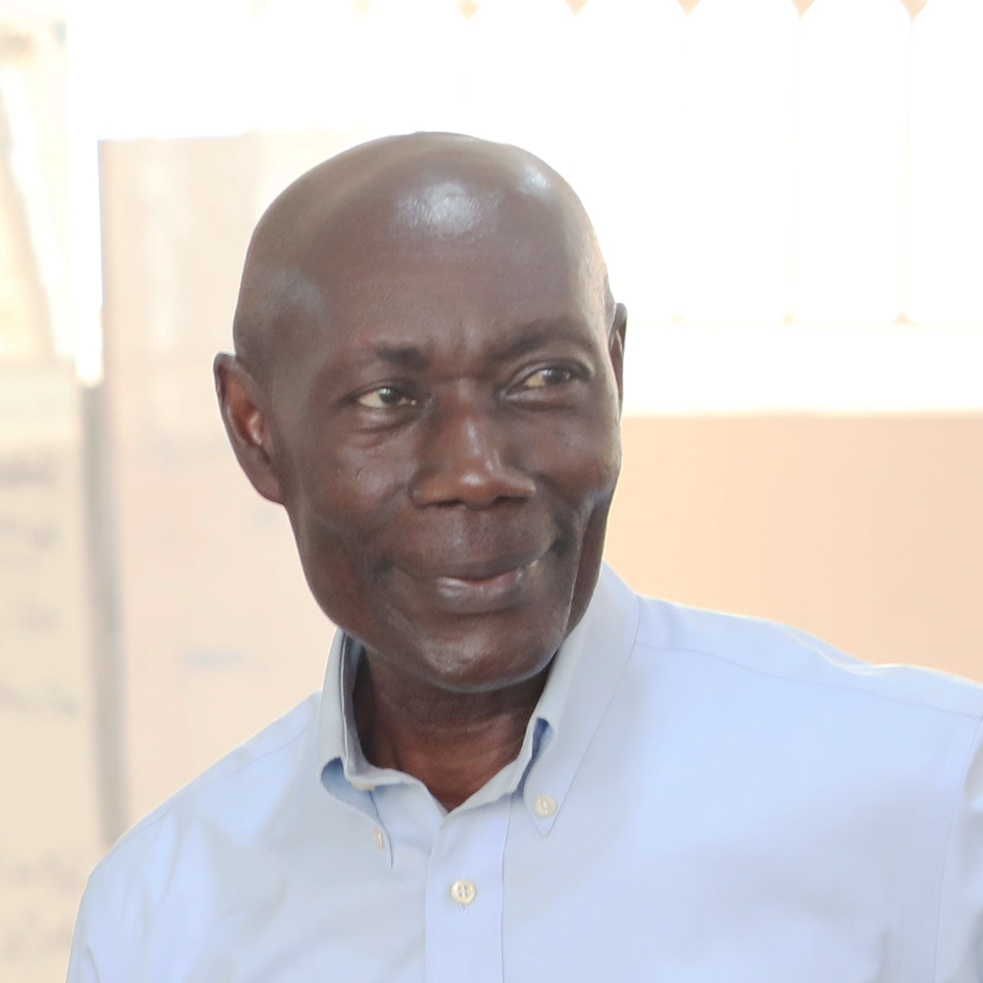
Prof. Williams Oduro
KNUST

Slide 4

Mr. Wisdom Togobo
BUI POWER

Slide 5
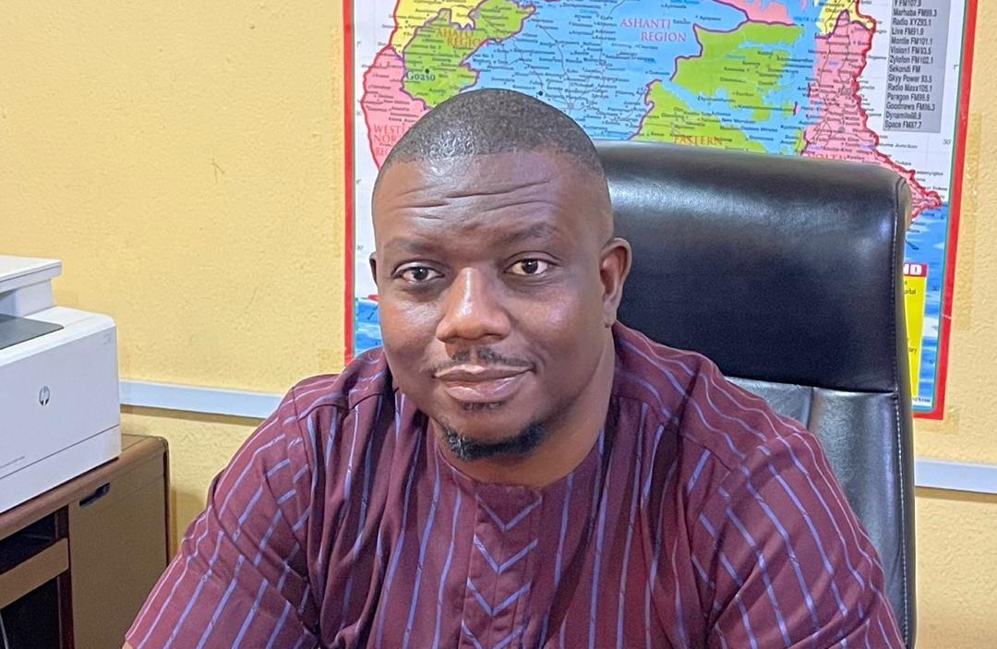
Mr. Patrick Antwi
PURC

Slide 7
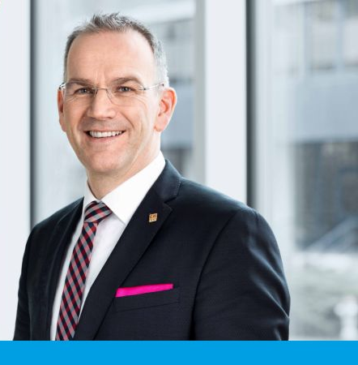
Dr. Stefan Wolf

