Slide 1

Student Centred Learning
-
Background and Options
Workshop at UENR, 5th - 6th May 2025
Dr Joerg Longmuss, Sustainum Institute Berlin
Funded by

Slide 2

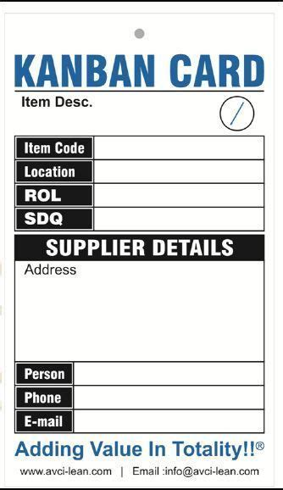
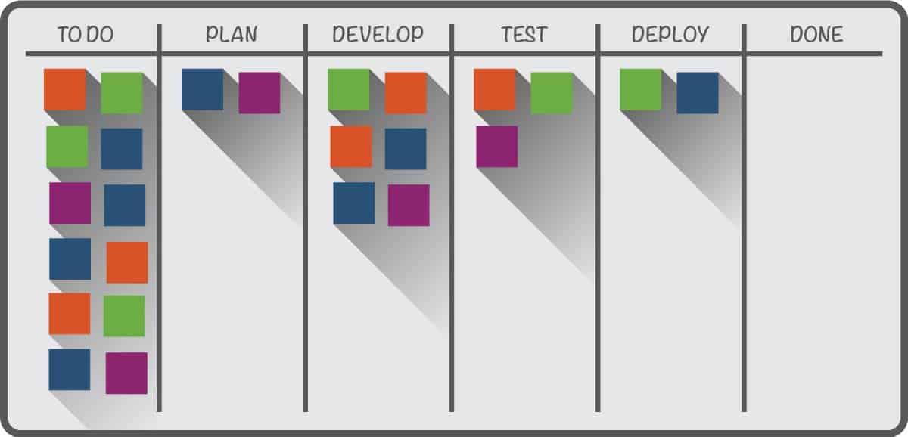
Kanban: Loops in the Production
Developed by Toyota for production control
Pull principle: tasks are processed as required
Transparency and continuous adaptation
Retrospectives and improvements
Funded by

Slide 3


Paradigm shift in product development
Traditional Process vs Simultaneous Engineering
Funded by

Slide 4
Paradigm Shift in Project Management: Loops
Project start phase
Execution phase 1
Coordination
phase 1
Execution phase 2
Coordination
phase 2
...
Project completion phase
Funded by

Slide 5

Funded by

Slide 6
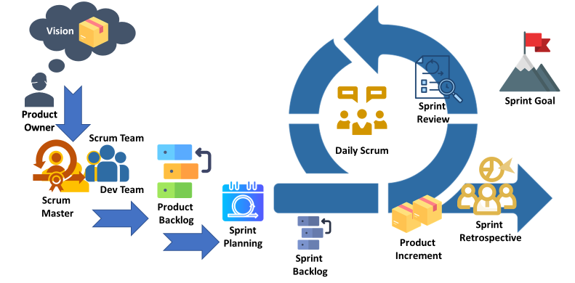
Loops in the Centre: SCRUM
Funded by

Slide 7
Circular Thinking in Education
"Kolb's circle"
Concrete experience
Traditional vocational training
Active experimentation
Reflective observation
Academic training
Abstract concept formation

Slide 8
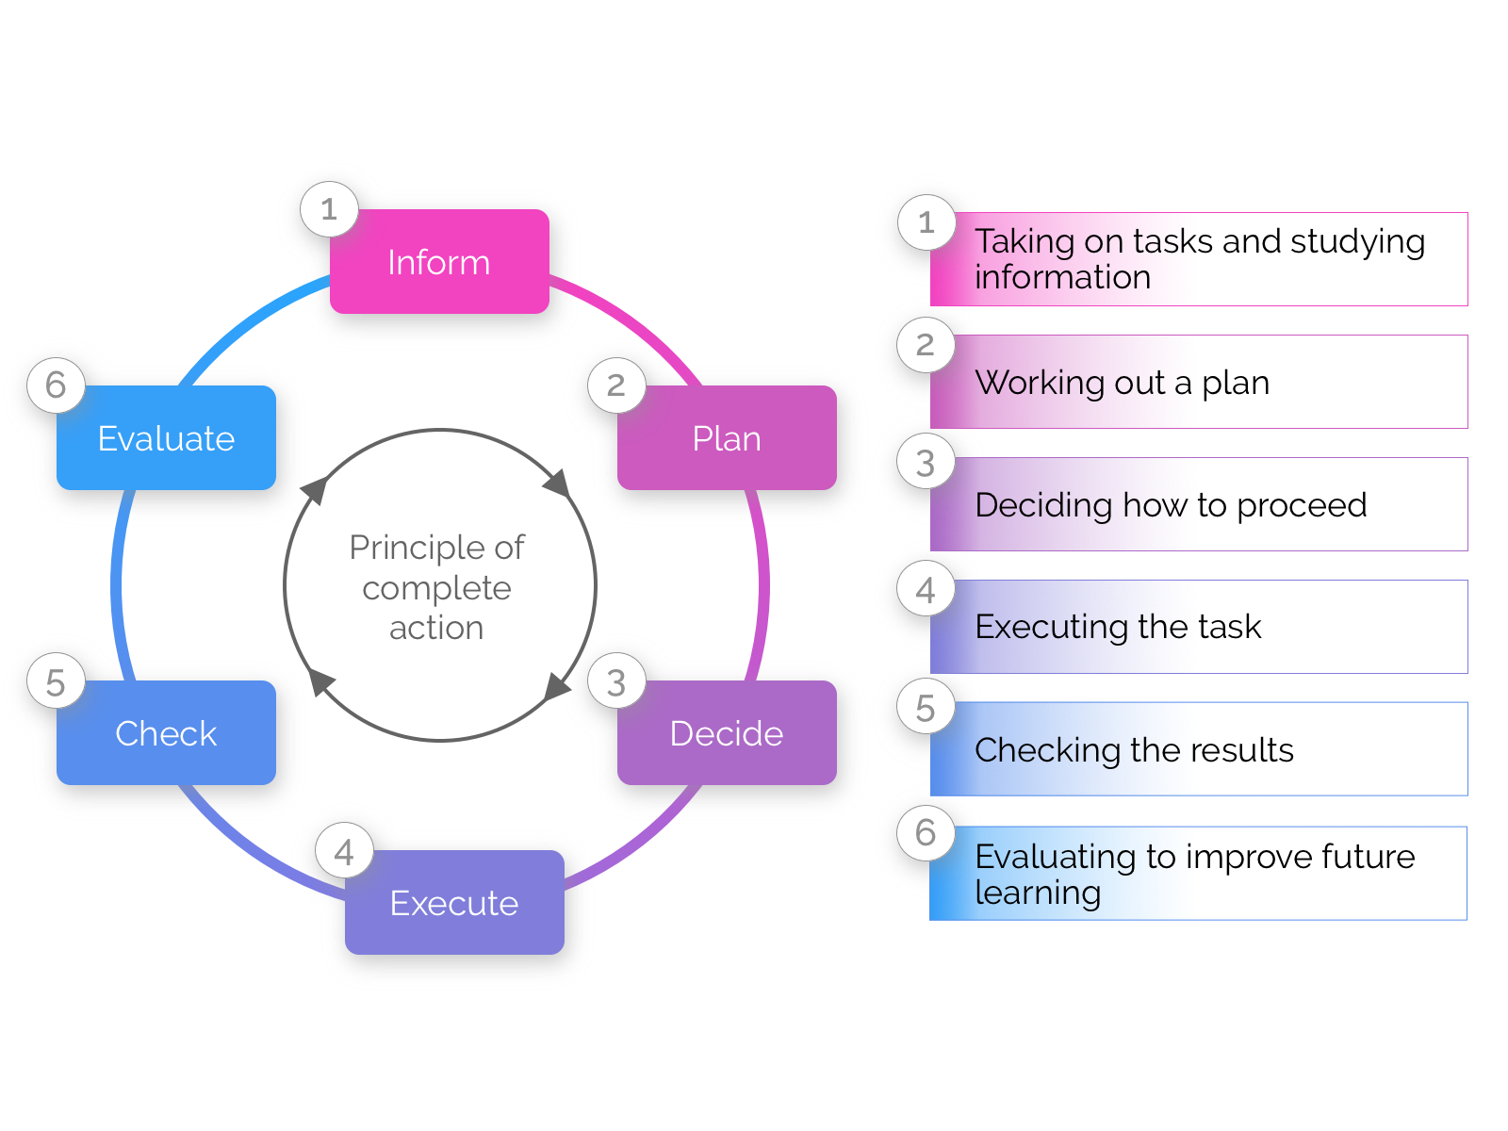
Transfer into VET: The principle of complete action

Slide 9



Student-Centred Learning (SCL)
Focus on student's active role in the learning process
Emphasizes learning as a personal process
Students to take responsibility for their education
Teachers act as facilitators
The goal: critical thinkers who can apply their knowledge in real-world contexts
Funded by

Slide 10
Key variants of SCL
Inquiry-Based Learning (IBL): Students explore questions and problems through research and critical thinking
Flipped Classroom: Students engage with content outside of class, using class time for interactive learning activities
Problem-Based Learning (PBL): Students tackle real-world problems, working on them collaboratively
Project-Oriented Learning (POL): Students work on a specified task, applying knowledge to solve complex problems
Agile learning as a subgroup: Highly structured POL with SCRUM methodology
Funded by

Slide 11
Problem Based Learning (PBL)
An open-ended real-world phenomenon is introduced
Students formulate their questions and research for answers
Students share their findings, reassess the problem, and develop possible explanations
Finally, the group presents a report, a presentation, or an action plan
The focus is on the development of problem-solving skills, teamwork, and self-directed learning
Funded by

Slide 12
Project Oriented Learning (POL)
A technical assignment is formulated
Students clarify the requirements and discuss options for a solution
Students apply their knowledge and search for additional information
Finally, the group presents a well grounded product
The focus is on a technically viable solution as well as on the development process
Funded by

Slide 13
What is Agile Learning?
Applies agile principles to the learning process
Focus on flexibility, self-organisation and iterative improvement
Learning in short cycles
Adaptation to new findings and needs
Regular reflections
Funded by

Slide 14
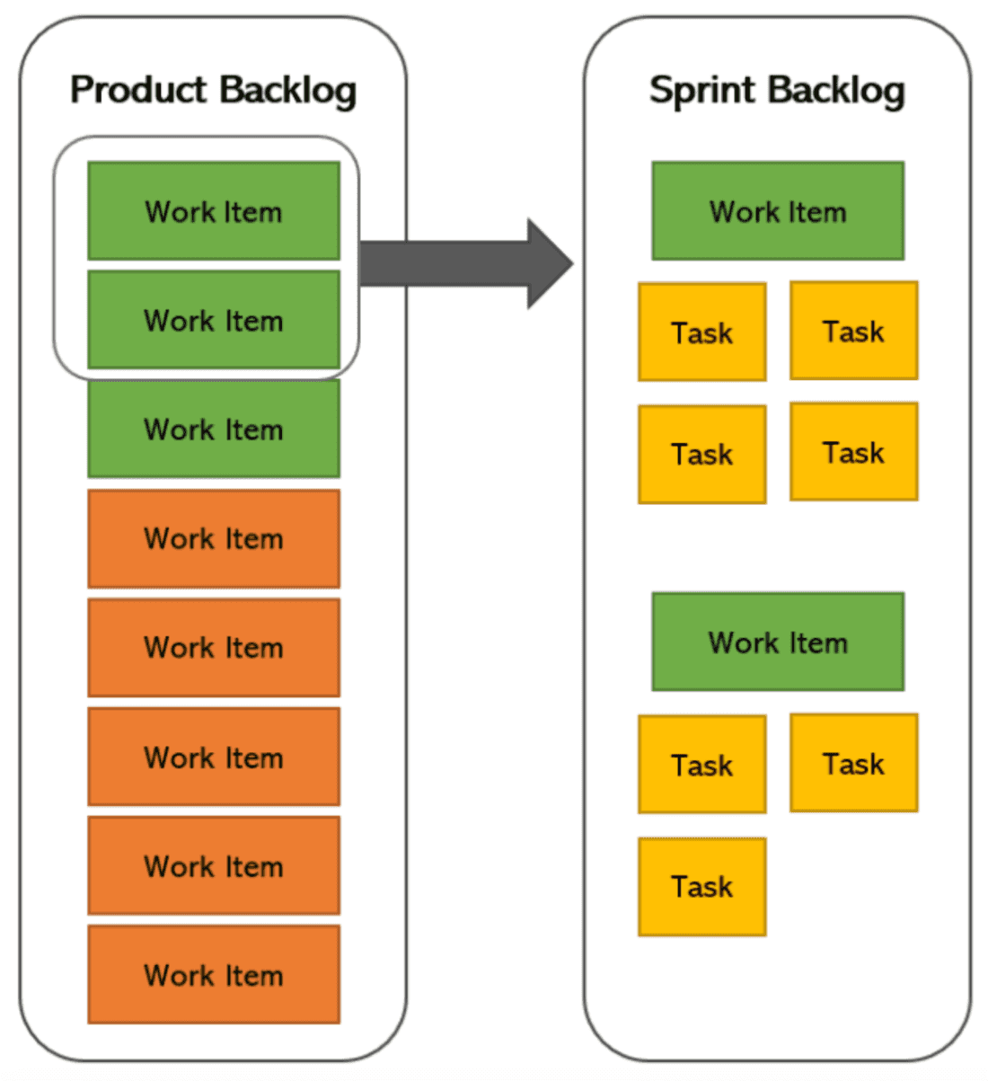
Agile Learning: SCRUM in Education
Requirements organised in a project
backlog
Sprint backlog defines tasks for a sprint
Frequent meetings for adjustment
After each sprint: feedback loops for optimisation – review and retrospective
Funded by

Slide 15
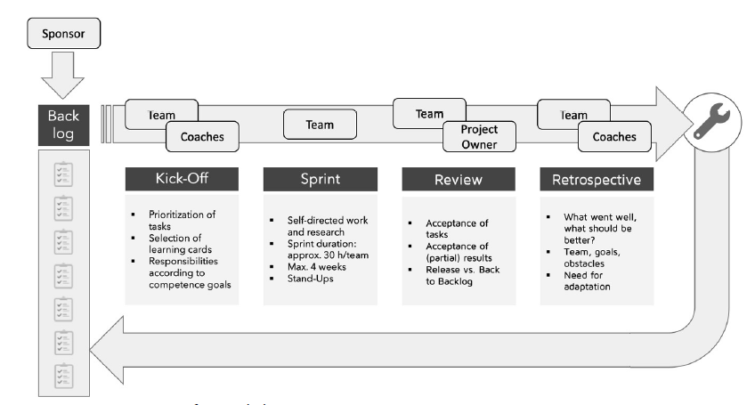
Advanced learning: Repeated Circles

Slide 16
The open questions:
How important is the product?
How important is the learning process?

Slide 17
Back-up

Slide 18

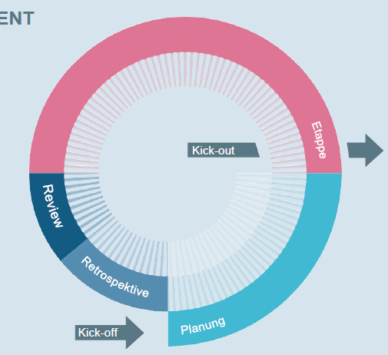
Advanced learning: Repeated Circles

Slide 19



Inform
An Assignment should
  Be to be completed within the specified time
  Have new and generalisable technical and interdisciplinary content
  Have a technically plausible question
  Be didactically customised due to the complexity involved
  Have various possible solutions!
KNUST
UENR
Funded by

Slide 20
Plan
A learning project should
  Be divided into work packages and activities by the students
  Be backed up with a timetable for the activities
  Students may choose this freely within limits, but must also commit to it
  (Changes in the course of the work do not prove a mistake, but a step forward in knowledge)
KNUST
UENR
Funded by

Slide 21
Decide
Students should
  Show up options / possible solutions
  Evaluate the options
  Justify the decision they took
  Follow up their decision: Where did it lead them?
KNUST
UENR
Funded by

Slide 22
Execute
A learning project should
  Ensure a steady flow of work for the students
  Allow to recognise technical errors / mistakes at an early stage
  Checking if activities are the activities completed on time and technically sound:
Intermediate presentations
Individual group consultations
Written submission of interim results
Hybrid, i.e. written submission and short online appointments
KNUST
UENR
Funded by

Slide 23
Check
In the final report and/or the final presentation, students should have
  Fulfilled all parts of the assignment completely,
  Documented all steps they have taken,
  Given reasons for the decision they had taken,
  Evaluated their work technically and
  Reflected on the learning and the group process.
KNUST
UENR
Funded by

Slide 24
Evaluate
Technically
  How would we plan a task like this again?
  Would we (with the level of knowledge at the time!) have done things better differently?
  What other approaches could we have taken?
  Socially
  How did our group develop as a team?
  What would we pay more attention to in future when working as a team?
KNUST
UENR
Funded by

Slide 25
Learning Process vs.
Company Needs
Urgent problems from a company are practically always very specific and therefore
need a long familiarisation period,
need in-depth processing (otherwise the engineers on site would have already solved this),
often require a longer stay on site,
the methodology can usually be generalised, but the technical content is often very specific.
  Industry-based learning projects should therefore allow sufficient time for student work, e.g. a master's thesis.
KNUST
UENR
Funded by

