Slide 1

A PRESENTATION ON RCEES
(FEBRUARY 2024)
BY:
REV. PROF. ING. ERIC ANTWI OFOSU

Slide 2


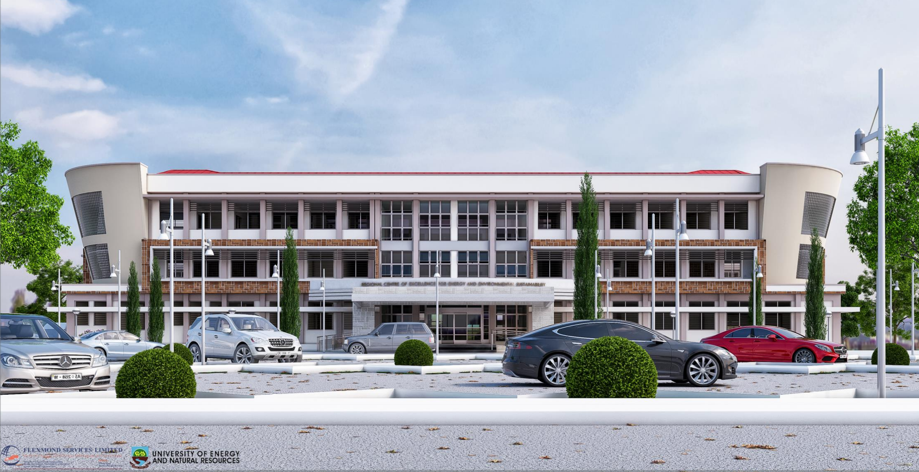
ABOUT RCEES
Background
Partnerships
Postgraduate Education & Short Courses
Research
Grants and Projects
IMPORT IMAGE HERE

Slide 3
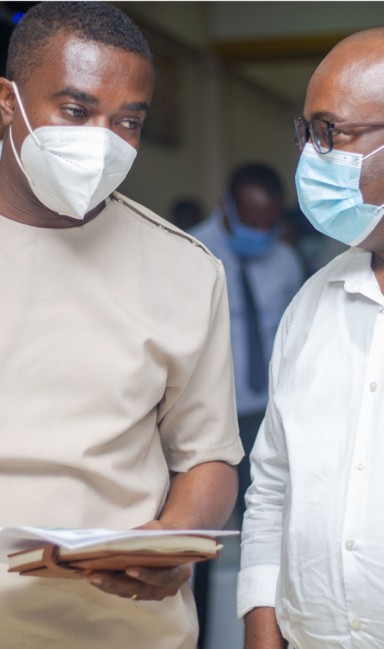

BACKGROUND
In response to the “call for proposals” by the Africa Centres of Excellence (ACE) for Development Impact, the University of Energy and Natural Resources submitted a proposal on establishing an ACE in the University in 2018.
The centre name “Regional Centre for Energy and Environmental Sustainability (RCEES)” aptly indicates the focus of the centre, to deal with issues regarding power (energy), environmental/social safeguards and water
The proposal was accepted as one of 8 centres of excellence in Ghana (44 across the region).
The Centre was thus established in 2019

Slide 4
Objectives of the ACE Impact Project
Enhance
Enhance capacity to deliver regional high quality training to address the development challenge.
Enhance
Enhance capacity to deliver applied research to address the regional development challenge.
Build and use
Build and use industry/sector partnerships to enhance impact of the Center on development and increase relevance of the centers education and research.
Build and strengthen
Build and strengthen regional and international academic partnerships to raise quality of education in other institutions in the region.
Enhance
Enhance governance and management to improve monitoring and evaluation, administration, fiduciary management, transparency, ability to generate resources, and project implementation.

Slide 5
RCEES MISSION and VISION
1
2
VISION
MISSION
To be the leading internationally accredited Centre of Excellence that provides Quality Research and Postgraduate Education in Energy and Environmental Sustainability.”
Our mission is to provide Excellent and Quality Postgraduate Education, Discover, Preserve and Disseminate cutting-edge interdisciplinary Research. RCEES also aims, through Training and Capacity Building, Consulting, Professional Development, and securing Grants and Donor funding to enhance the lives of our students, industry and society”

Slide 6
VALUES
C
ORE VALUES
R: Responsive: Innovative ways to solve energy and environmental challenge.
C: Collaborative: Engage and Build partnership with stakeholders.
E: Equality: Create an environment that promote equal opportunity, gender balance and diversity.
E: Excellence: Demonstrate world class leadership in research and teaching.
S: Sustainability: Maintain excellence in higher education, particularly in STEM.

Slide 7
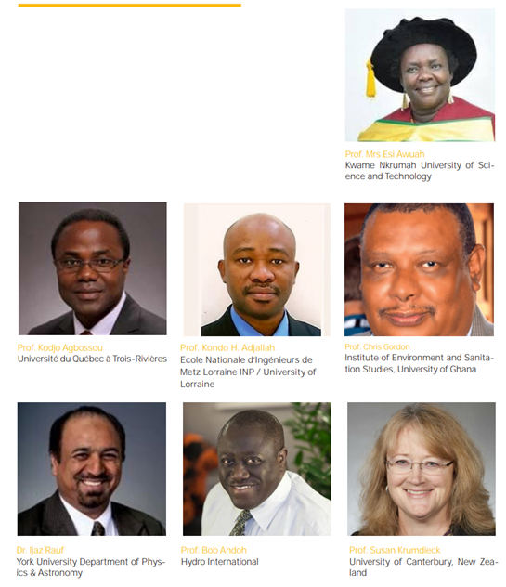
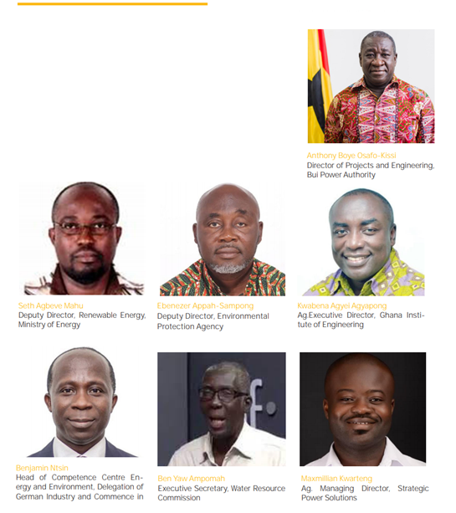
BOARD MEMBERS
International Scientific Advisory Board
Industrial Advisory Board

Slide 8
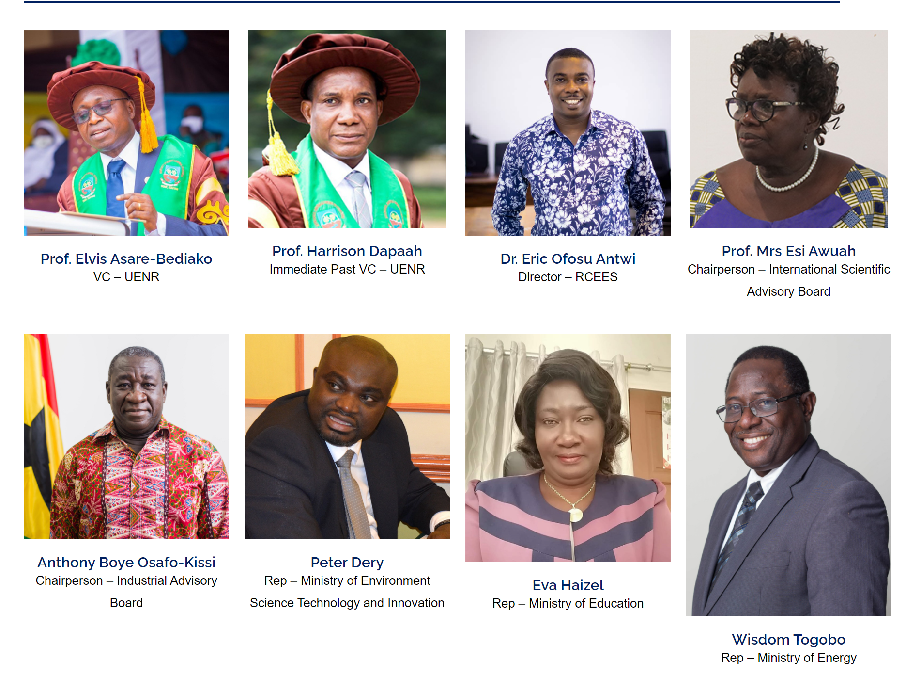
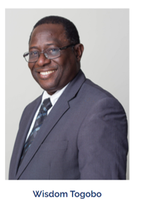
BOARD MEMBERS
STEERING COMMITEE
Industrial Advisory Board

Slide 9
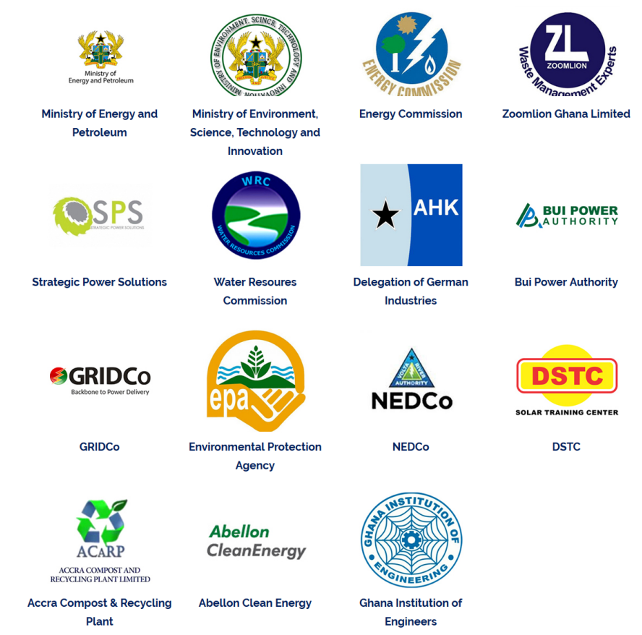
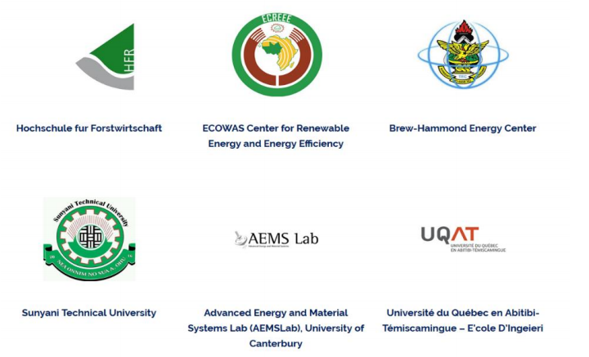
INDUSTRIAL AND ACADEMIC PARTNERSHIPS

Slide 10
PARTNERSHIPS
INDUSTRIAL PARTNERSHIPS
ACADEMIC PARTNERSHIPS
E T C.

Slide 11
POSTGRADUATE EDUCATION & PROFESSIONAL SHORT COURSES

Slide 12
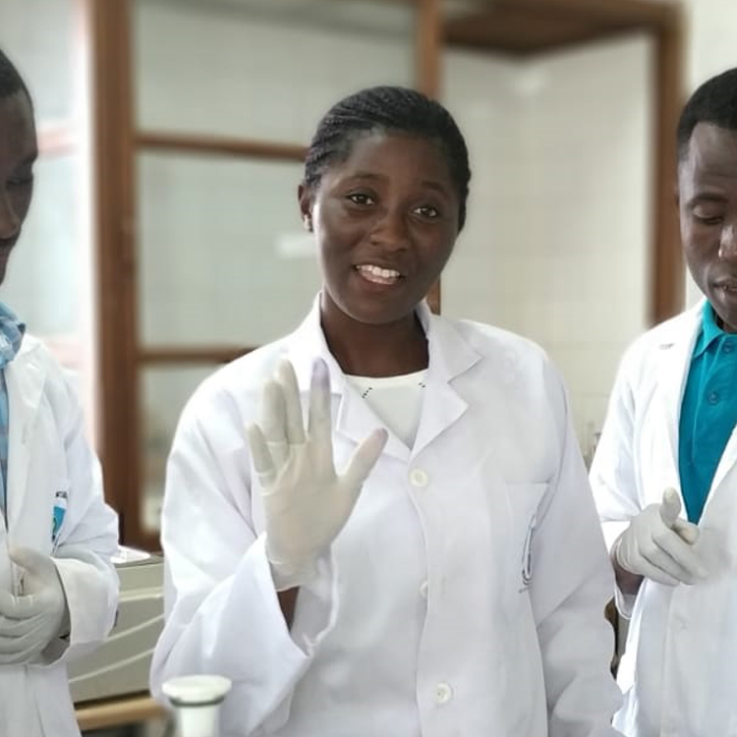
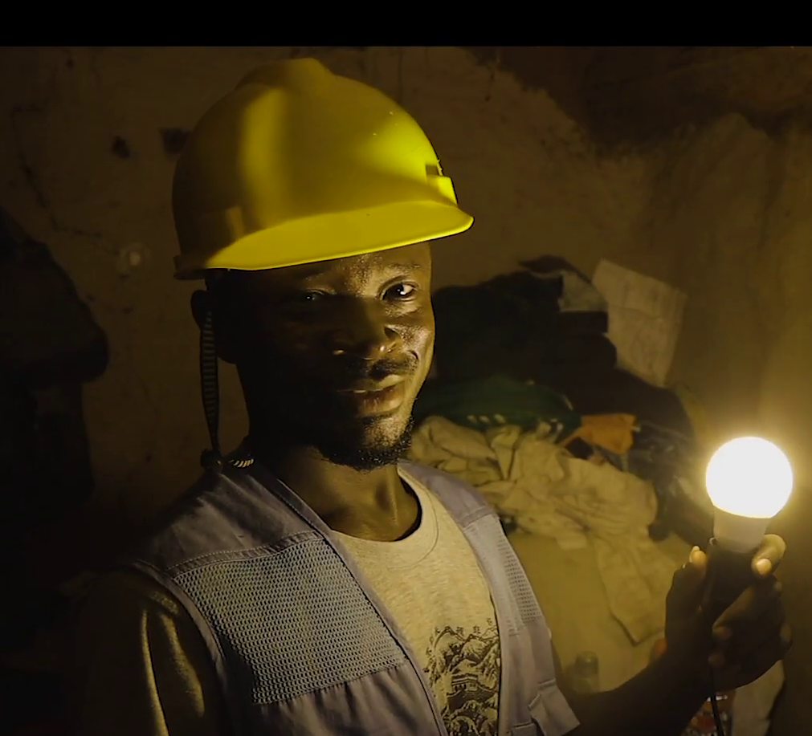
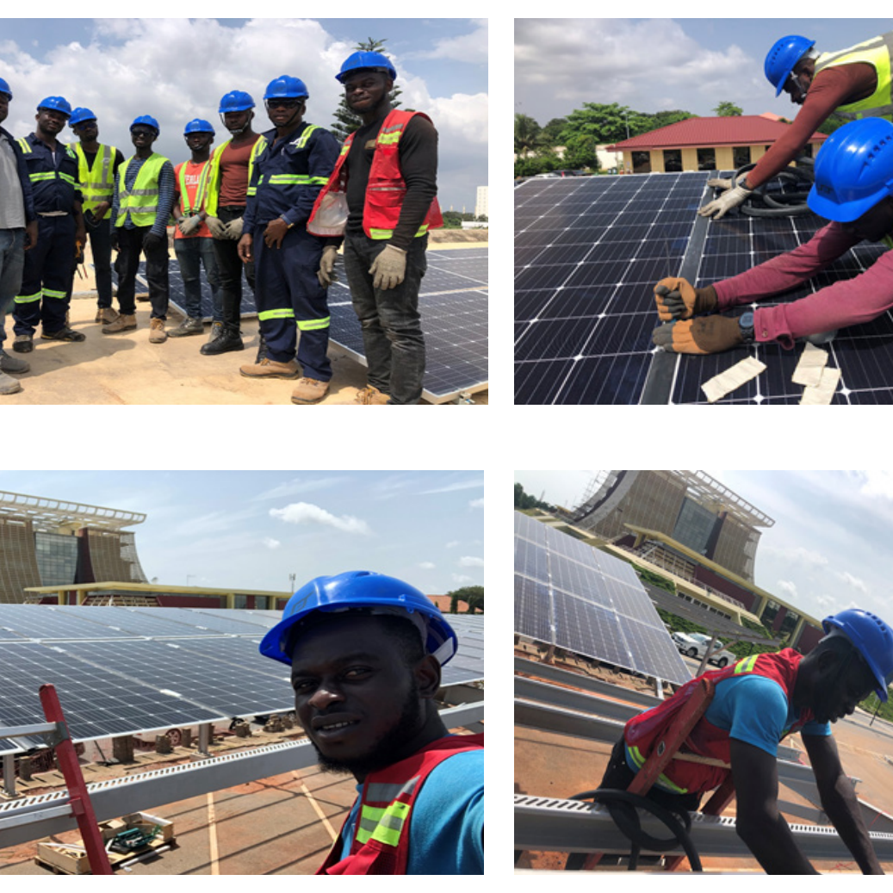
OUR PROGRAMS
We currently run the following postgraduate programs and short courses:
PhD
MSc
SHORT COURSES
Sustainable Energy Management
Environmental Engineering Management
Solar PV Design and Installation
Biogas Design
Energy Audit
Energy Management
Solar Irrigation System
Occupational Health and Safety
Sustainable Energy Management
Environmental Engineering Management
The following postgraduate programs are undergoing National accreditation from GTEC:
PhD
Mphil/MSc
Energy Policy and Sustainability
Energy Economics
Energy Policy and Sustainability
Energy Economics

Slide 13


ACCREDITATIONS
We have National accreditation for all our Programs from GTEC.
We have recently received international accreditation from ASIIN, Germany for our current Programmes.

Slide 14
OUR STUDENTS FROM ACROSS AFRICA (2019-2022)
BURKIKNA FASO
GAMBIA
NIGERIA
SENEGAL
CHAD
SIERRA LEONE
1
13
6
2
4
2
1
IVORY COAST
3
182
2
GHANA
39
CAMEROON
Regional Students
224
TOGO
184
BENIN
1
National Students
50
Female Students
ZIMBABWE
173
Male Students

Slide 15
OUR STUDENTS FROM ACROSS AFRICA (2019-2022)
BURKIKNA FASO
39
Regional Students
GAMBIA
NIGERIA
CHAD
184
SENEGAL
National Students
1
50
SIERRA LEONE
2
Female Students
13
6
4
2
1
IVORY COAST
3
110
2
173
Male Students
GHANA
CAMEROON
69
TOGO
PhD Students
BENIN
1
154
Masters Students
ZIMBABWE
223
TOTAL STUDENTS

Slide 16
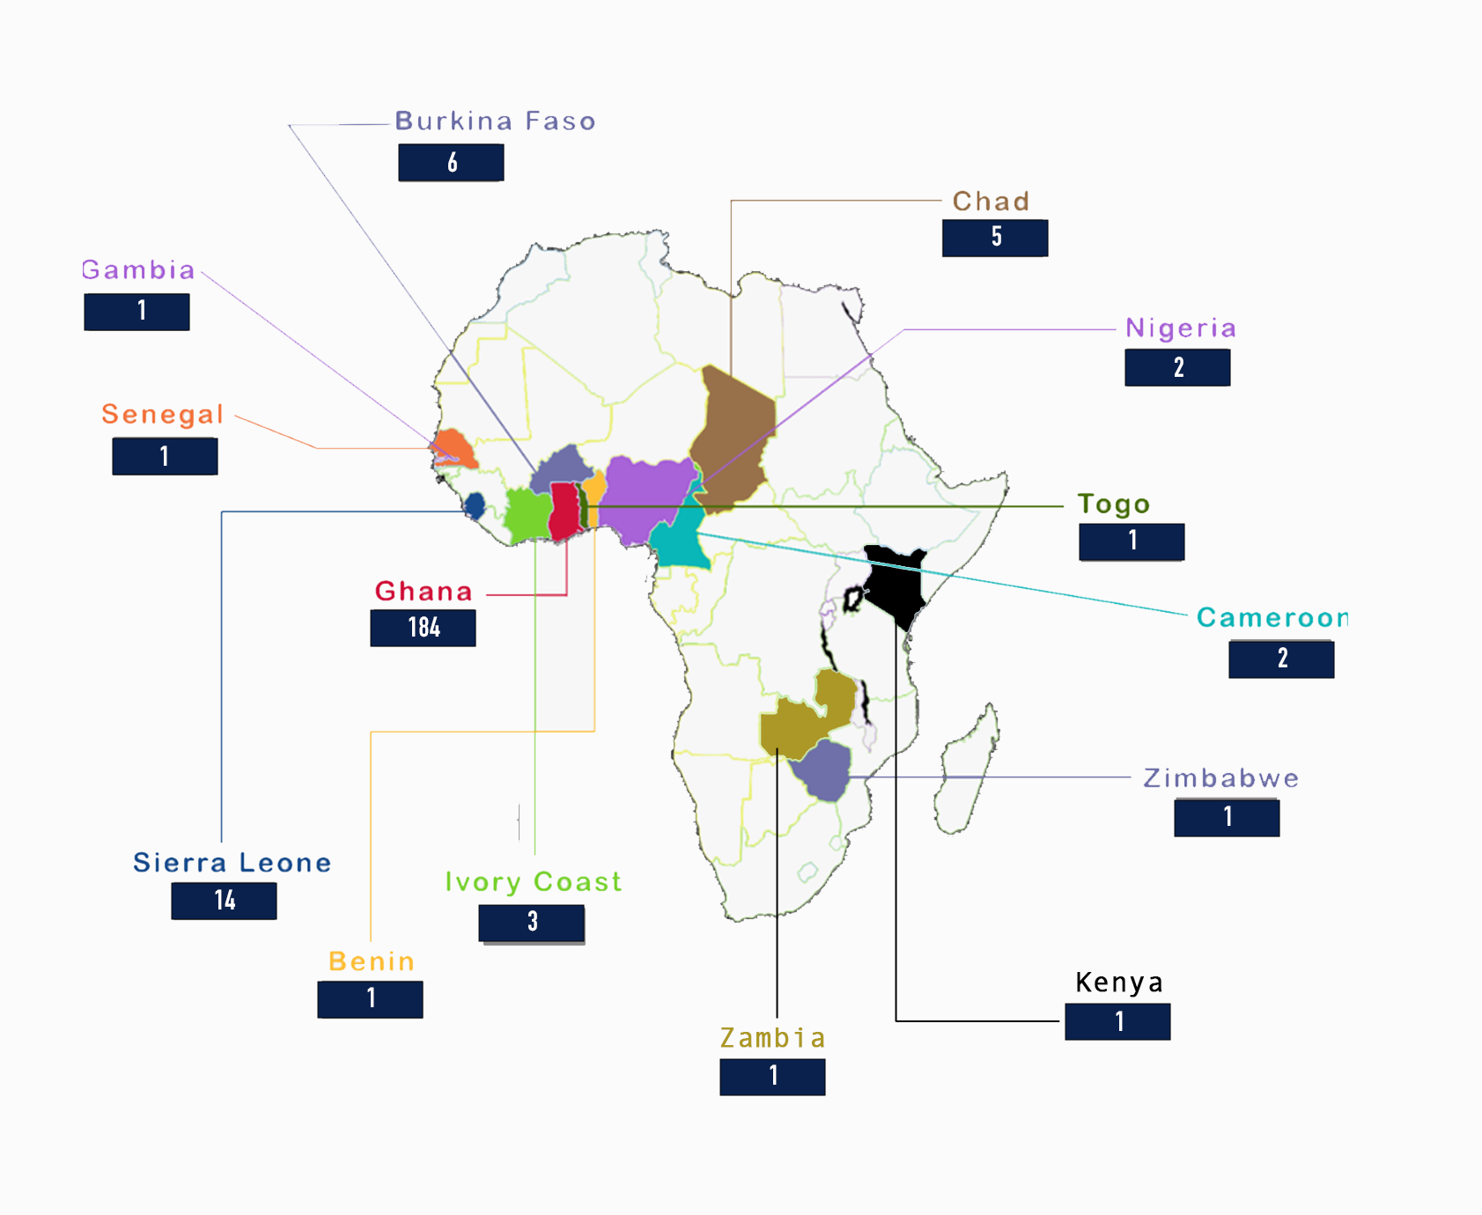
NATIONAL AND REGIONAL DISTRIBUTION
Distribution of our students from across the continent

Slide 17
Short Courses (2019 – 2024)
Cohort | National | Regional | Grand Total
2019/2020 | 23 | 7 | 30
2020/2021 | 144 | 74 | 218
2021/2022 | 34 | NIL | 34
2022 /2023 | 139 | 23 | 162
2023/2024 | 59 | NIL | 59
Grand Total | 201 | 81 | 282
104
Regional
399
National
98
Female
253
Male
TOTAL
PARTICIPANTS
405

Slide 18



















Where Our Students and Alumni Work

Slide 19
RESEARCH

Slide 20
OUR RESEARCH THEMES
Energy Transitions
  Energy Demand-side Management and Energy Efficiency
  Renewable Energy (Solar, Wind, Biomass, Hydro)
  Clean Technologies (Cookstoves, Nuclear, Natural gas, CCSU, etc)
  Sustainable low-cost technologies
  Smart Energy Technologies
  Smart Cities
Energy Storage
  Energy Storage Materials
  Energy Storage Systems
  E-mobility
Environmental Management
  Faecal Sludge Management
  Solid Waste Engineering and Management
  Water and Wastewater Treatment
  Waste-to-Energy
  Resource Recovery
  Environmental Remediation
  Water Resource Management
  Land reclamation (Mining, oil and gas decommissioning
Environment and Climate
  Carbon Capture and Storage
  Floods and droughts Management
  Adaptation and Mitigation measures
  Land-use Land-cover assessment
Energy, Society and Environment
  Sustainable Assessment of Energy systems
  Energy Use Behaviour
  Energy Communities
  Energy Economics, Policy and Finance (Climate Financing and green economy)
  Climate change
  Energy-Water-Food Nexus
  Energy and transportation systems
  Energy and Built Environment
Environment and Health
  Environmental and Social Impact Assessment
  Environmental Risk Assessment
  Pollution Control
  Hazardous Waste and e-waste management

Slide 21
OUR RESEARCH THEMES
Environmental Management
Environment and Climate
Energy, Society and Environment
Environment and Health
Energy Transitions
Energy Storage

Slide 22

PUBLICATIONS UNDER RESEARCH THEMES (2019-2023)
Year | Number of Publications
2019 | 18
2020 | 54
2021 | 61
2022 | 56
2023 | 67
TOTAL | 256

Slide 23
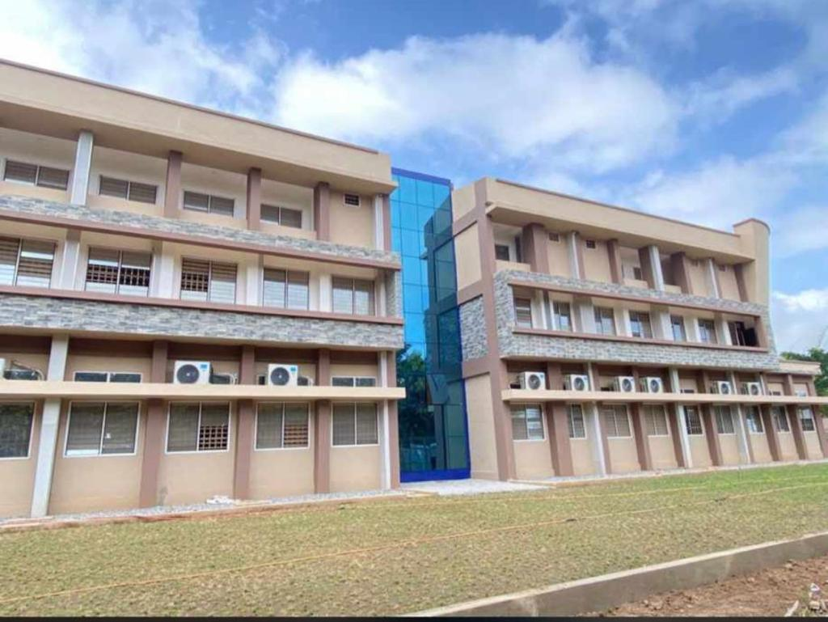
INFRASTRUCTURE

Slide 24
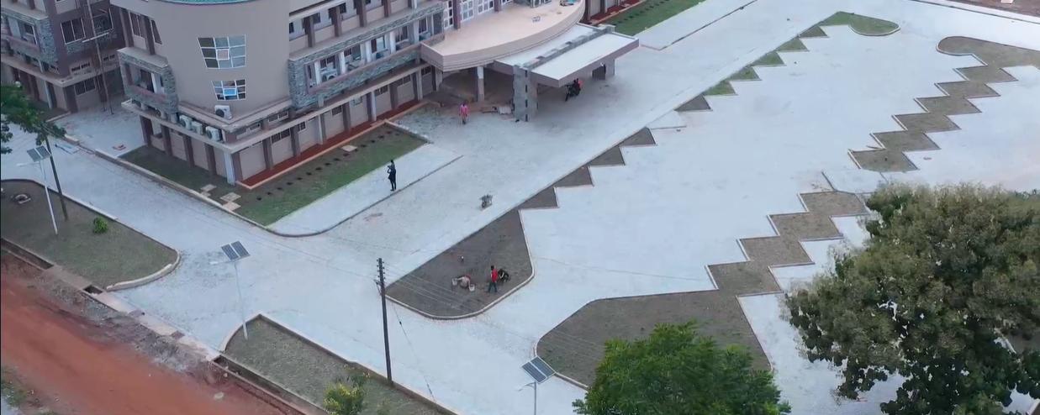
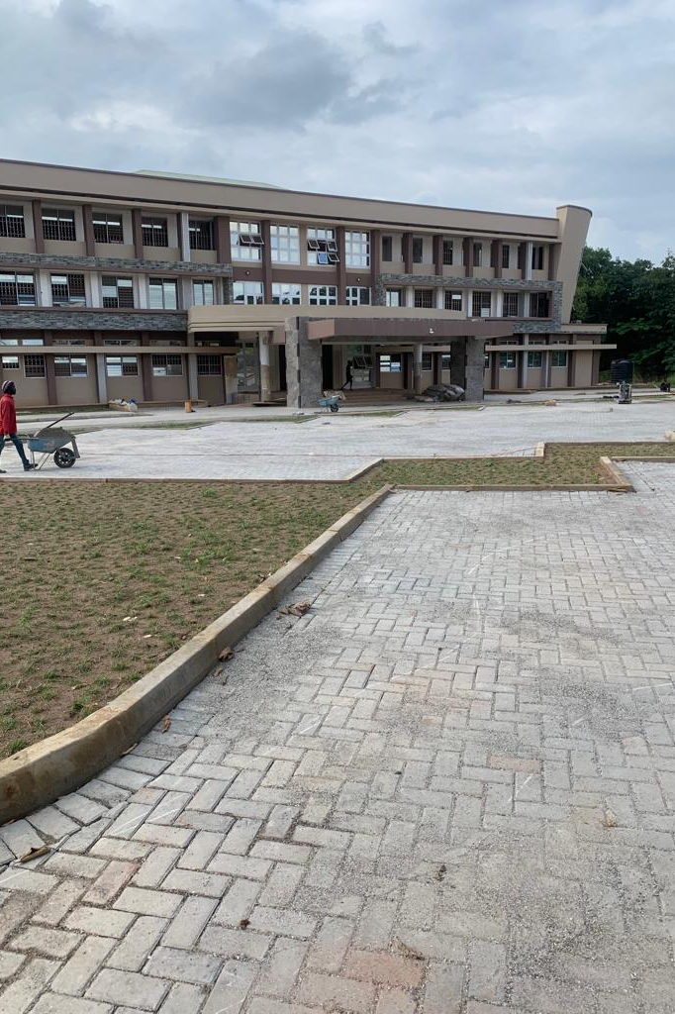
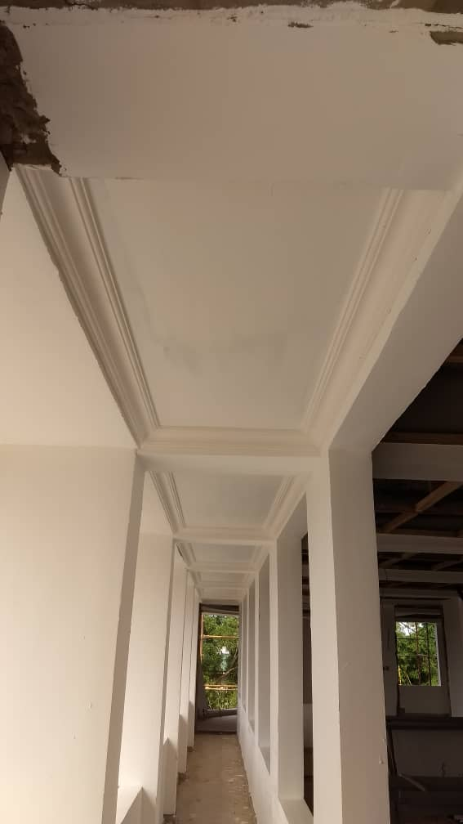
Centre Building
Less than 2 months of work remaining
Expected Completion in April 2024.

Slide 25
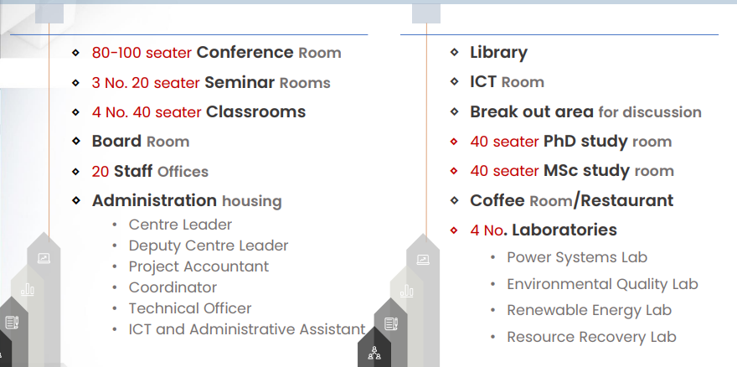
Facilities in the Building

Slide 26
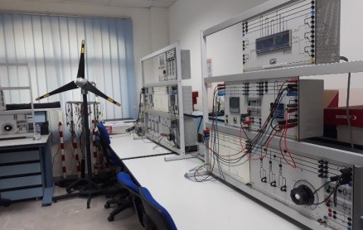
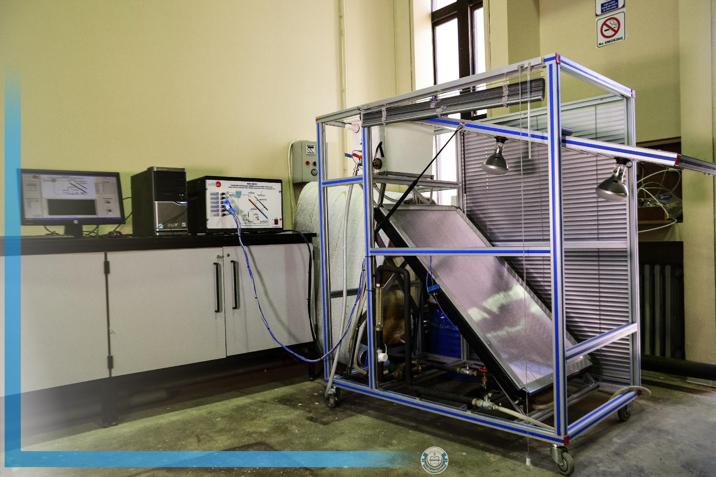
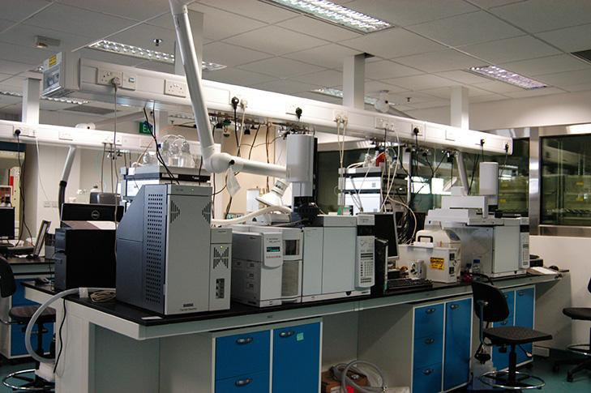

Laboratories to be Installed
Power Systems Lab
Resource Recovery Lab
Renewable Energy Lab
Environmental Quality Lab
Be Part of the RCEES Success Story…Partner with us to install these Laboratories!

Slide 27
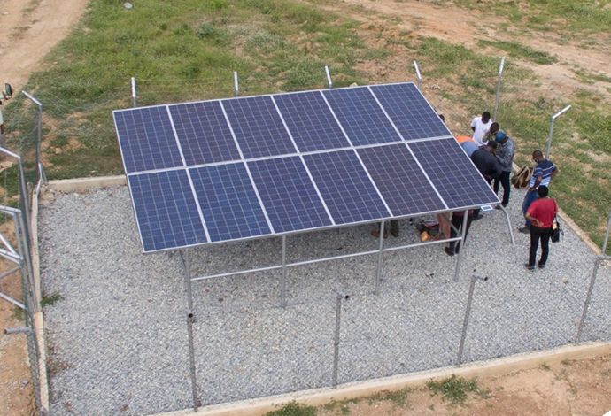

Other Infrastructure
3 acres of Solar PV Irrigation Demonstration and training Site. Drip,
Sprinkler, and tube irrigation application systems present at the site
Sustainable Energy Service Centres under the Millennium
Challenge Compact (MCC).
  a. Energy Audit Equipment worth $50,000.00
Centre of Competence in Digital Education
(C-CODE) project; to design, produce and distribute massive
open online courses, or MOOCs.
EXAF-EPFL (Excellence in Africa ‒ EXAF ‐ EPFL)

Slide 28
GRANTS AND PROJECTS

Slide 29












TOTAL SUM OF GRANTS AND
FUNDING SOURCES
Together with our partners …
Funding Sources…
1,041,177
2,499,675
206,560
Approximately USD 3,988,698 in total

Slide 30
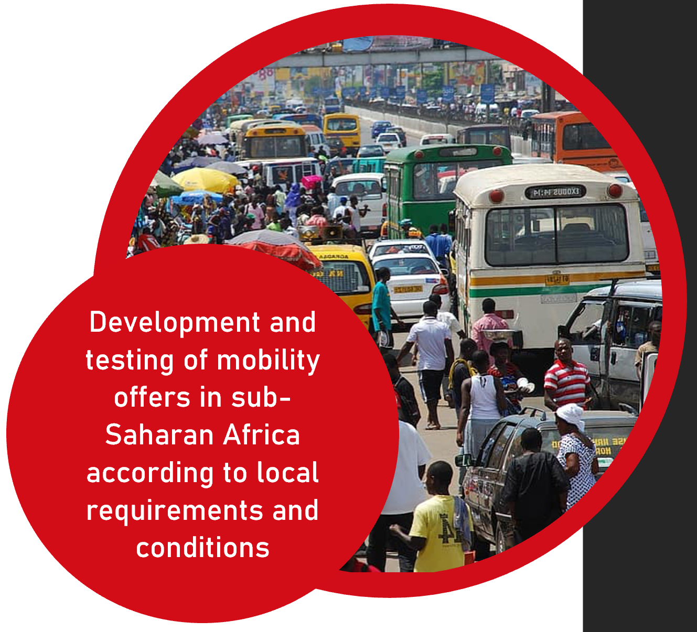

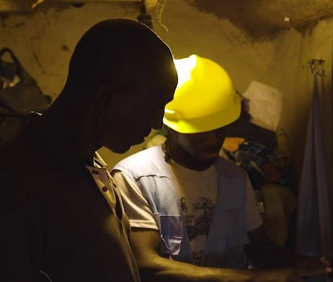
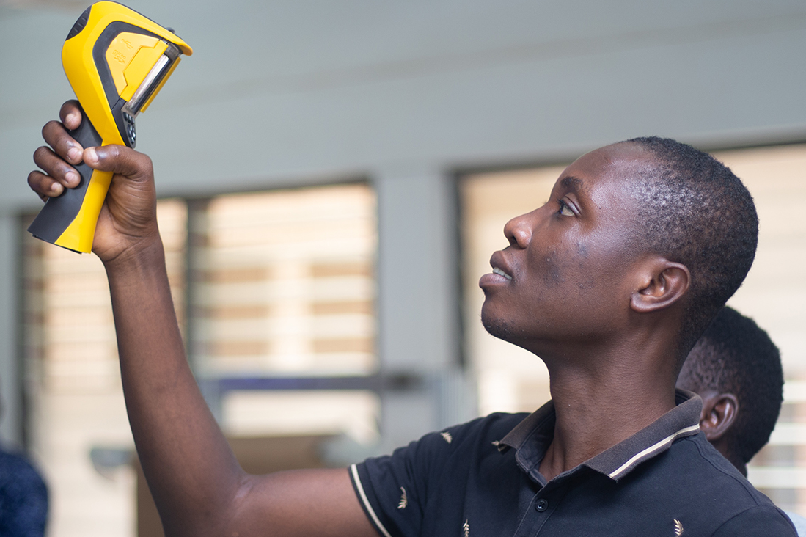
Our Projects
Mobility for Sub-Sahara Africa – Sustainability thought through the Lifecycle
Sustainable Energy Service Centre
RCEES in Consortium with some of our partners including Sunyani Technical University, Kumasi Technical University and the Energy Foundation has been selected to host one of the three Sustainable Energy Service Centres (SECS) the Millennium Development Authority (MiDA) under the Millennium Challenge Compact (MCC).
The MoNaL project is tested the use of e-mopeds and e-cargo bikes in sub-Saharan Africa using a sharing model.
Add Text
Simple PowerPoint Presentation
GenDesign (STEAM)
Energy Service Centre
Energy access strategy for disadvantaged communities in Ghana Sub-award from Carleton University, Canada
provide hands-on-training to commercial and industrial electricity consumers and service providers in renewable energy (RE) and energy efficiency (EE) under the auspices of the GIZ Market Entry into Renewable Energy (RE) and Energy Efficiency (EE) for the Productive Sector in Ghana project

Slide 31
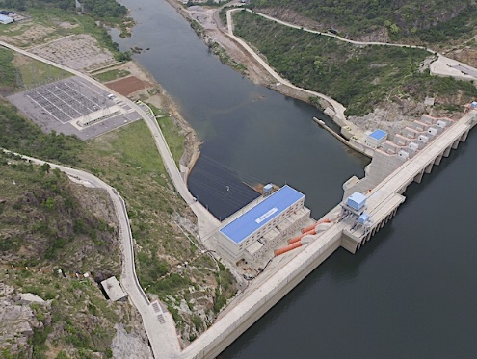
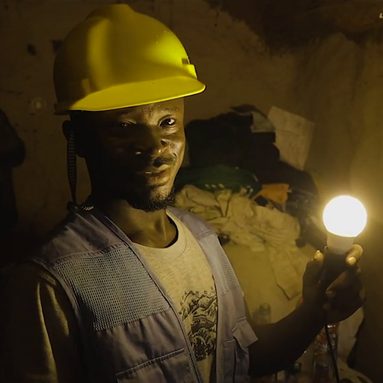
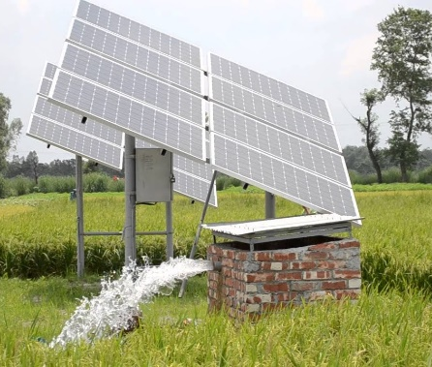

Our Projects
Erasmus+ Project -Enhancing Entrepreneurship, Innovation and Sustainability in Higher Education in Africa (EEISHEA)
China South-South Cooperation on Climate Change
The program focusses on provision of RE equipment to mitigate the harsh effect of climate change on underserved rural Poor Island and inland communities that will not have access to electricity in foreseeable future and energy efficiency goods to reduce electricity consumptions in public facilities
This project has trained faculty members to able to redesign curriculum that will create future game-changers in energy, innovative and entrepreneurial graduates. And include sustainability and SDGs into the curriculum
Add Text
Simple PowerPoint Presentation
Sustainable Dams Project
SOLAR PUMP AND IRRIGATION PROJECT
The project seeks to investigate the management and planning of hydropower generation in West Africa under climate change and land use/land
The centre is to train 50 (installers, technicians and extension officers) and 20 credit officers

Slide 32


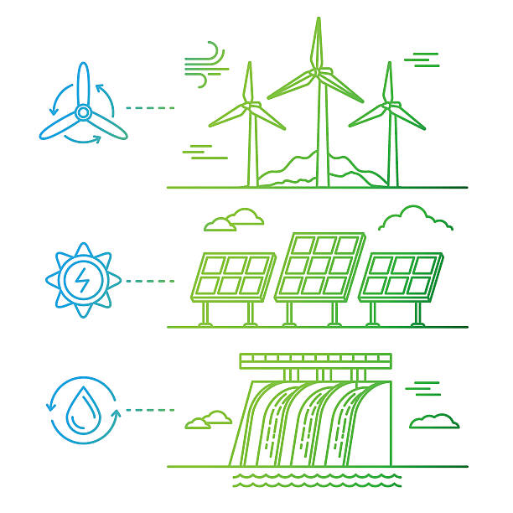

Our Projects
Professional Education for Renewable Energy in Ghana – (ProREG)
Transforming Energy Access – Learning Partnership (TEA-LP)
In the ProREG project , the Technische UniversitätBerlin is working with the universities Kwame Nkrumah University of Science and Technology (KNUST) and the University for Energy and Natural Resources (UENR) as well as six corporate partners to address the lack of labour market relevance of education in the field of renewable energy in Ghana.
The TEA-LP project aims to support the development of postgraduate academic curricula at African higher education institutions to bridge the skills gap in Africa’s rapidly-growing energy access sector.
Add Text
Simple PowerPoint Presentation
Integrating machine learning, Surveys and qualitative approaches for Context-relevant and disaggregated demand modelling in Planning clean Energy for Ghana and Zambia - SCOPE
Energy Planning and Modelling through integrated Assesment of Climate-Land-Energy Nexus in SSA (EPIC-Africa)
In this project, we will continue to develop storage functionalities to enable the assessment of battery- assisted microgrids, pumped hydro energy storage (PHES), and large scale hydrogen production in the specific case applications
SCOPE will contribute outputs in both “Research” and “Partnerships” areas. By developing machine learning tools, generating insightful contextualised user data through surveys and stakeholder engagement, we will identify drivers of demand for electricity and clean fuels across multiple user groups.

Slide 33


OUR PROJECTS CONT.
NDC action in Ghana (UNEP Grant): Establishing a baseline of NDC implementation investments gaps and investment areas to build on in line with the prioritized Agriculture sector (climate smart agriculture - SPIS)

Slide 34
Institutional Impact
The centre championed and supported the Vice Chancellor of the University to set up 3 key Centres to facilitate academic and research excellence in the university. The centres are:
  Centre for Grants, Research and Innovation (CeGRI)
  Centre for Entrepreneurship and Business Incubation (CEBI)
  Centre for Professional Development (CePDeV)
Capacity building for faculty in the areas of Research Supervision, Grantsmanship, the Research Cycle etc.

Slide 35
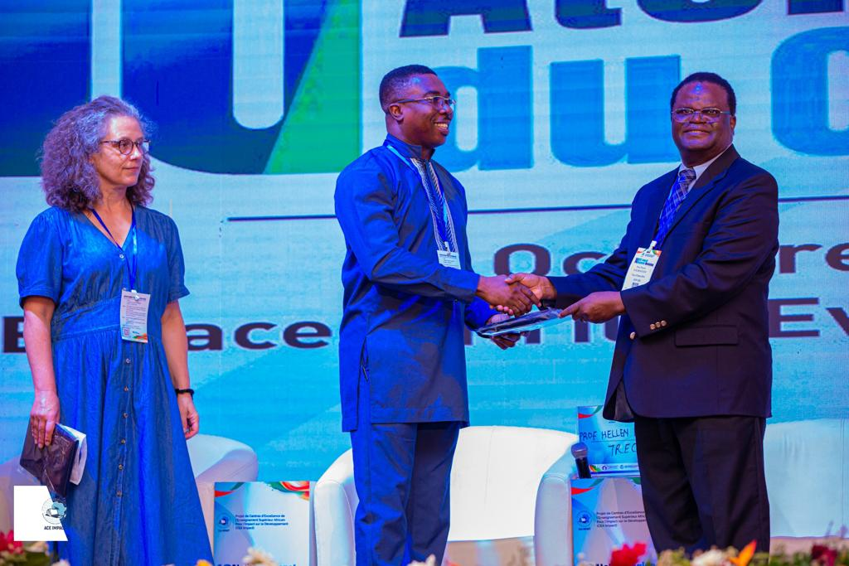
OTHER SUCCESS STORIES
Hosting of the West African Centres of Excellence in Energy Network (WACEENET) Secretariat and Organizing first mobility exercise.
Amongst the best performing Centre’s of excellence of all the 44 across the region. In view of this, the Centre Director was honored by the World Bank.

Slide 36
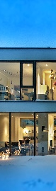
Challenges
Attracting external funding.
Infrastructure – Laboratories.
Attracting self-funding students (especially from the region).

Slide 39


Networking and Partnerships
CAPACITY BUILDING
Trainings and Certifications
Year | No. of Staff Trained | Types of Training Received
2019 | 3 | Project management, Training of trainers in Solar Thermal, Biogas Promotion and Management for Developing Countries
2020
2021
2022 | 7 | SPIS, Energy Management and Audit, Flood Monitoring
2023 | 2 | Machine Learning, Financial Management
MSc & PhD
Year | No. of Staff Trained | Types of Training Received
2019-Present | 2 | PhD Environmental Engineering Management, PhD Sustainable Energy Management

Slide 40

PARTNERSHIPS
In line with our objective of facilitating cooperation between our centre and academic institutions in Ghana, Africa and the international community, as well as industry partners.
Key amongst them is the KAFUE GORGE REGIONAL TRAINING CENTRE (KGRTC) in Zambia.
Establishing of Renewable Energy Institute with
BPA and AfDB to become a Bui Campus of UENR
Collaborated on the Sustainable Energy Service Centres project with
  KsTU, STU and Energy Foundation
Worked with our academic partners in Liberia in organizing 2 successful short courses in their country
  80 participants in total took part in those short courses
  Had foreign students enrol in our programs from some of the companies that took part in the training

Slide 41
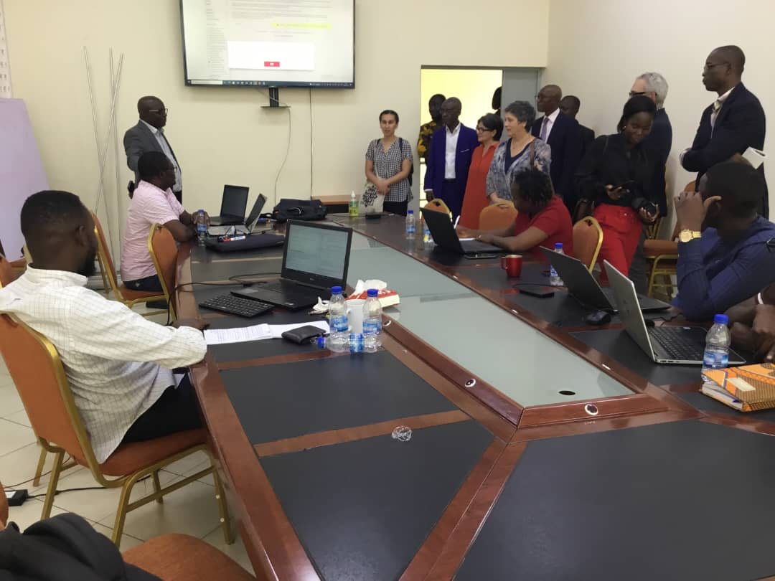
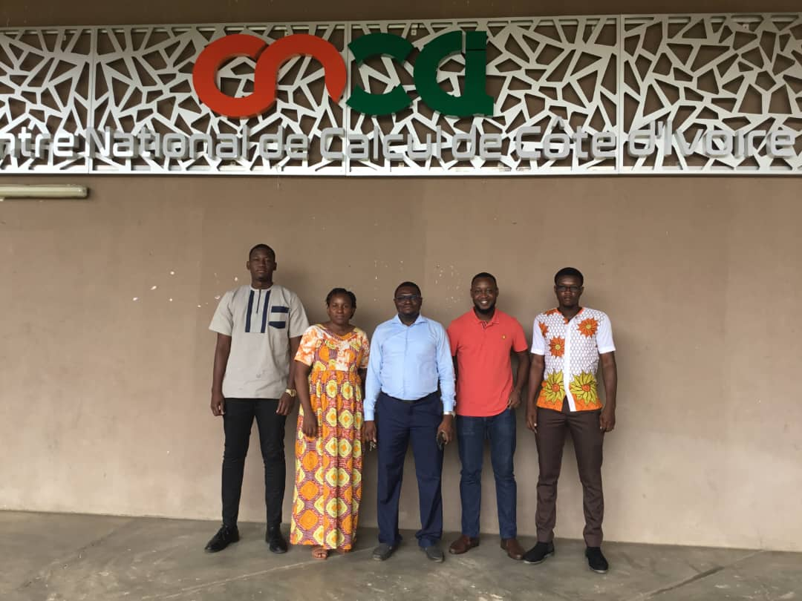

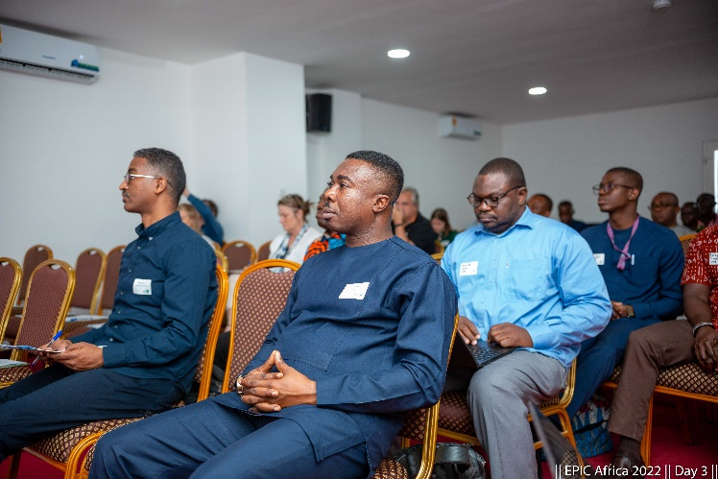
Networking and Partnerships
PARTNERSHIPS Cont’d
Collaboration with academic partners in Ivory Coast, Senegal, Burkina Faso, Germany and France on the SustainDam project.
Collaboration with academic and research partners across Europe and Ghana on the EPIC Africa project
Partnership with a NEBOSH accredited Learning partner (Millennium Health and Safety Consult) to certify interested students and staff in Health and Safety.

Slide 42
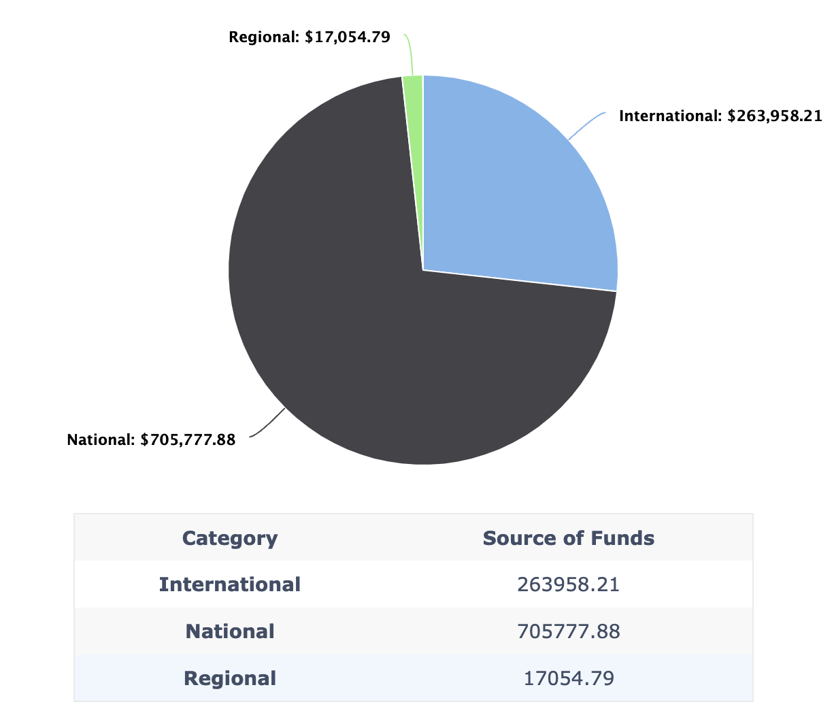
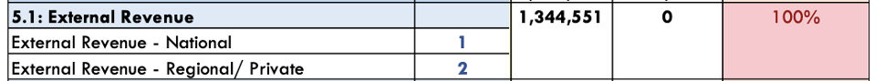
EXTERNAL FUNDS
International: $263,958.21
International: $263,958.21
National: $705,777.88

Slide 43
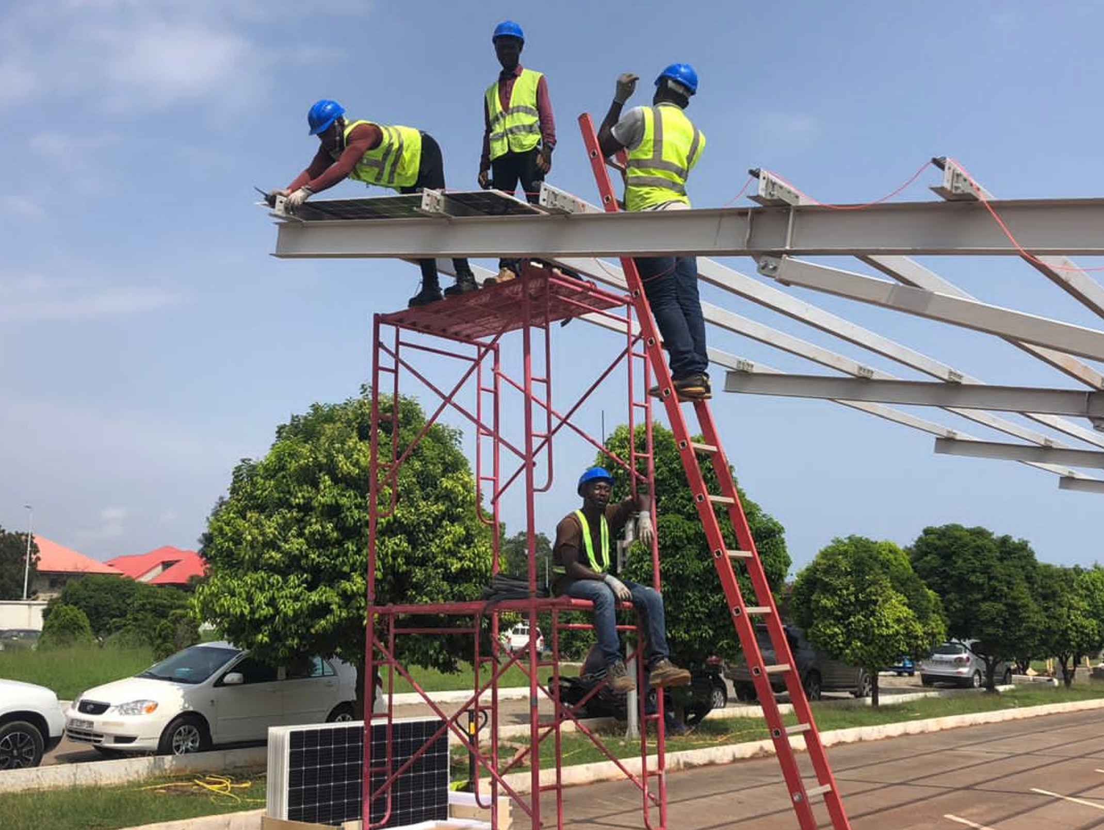
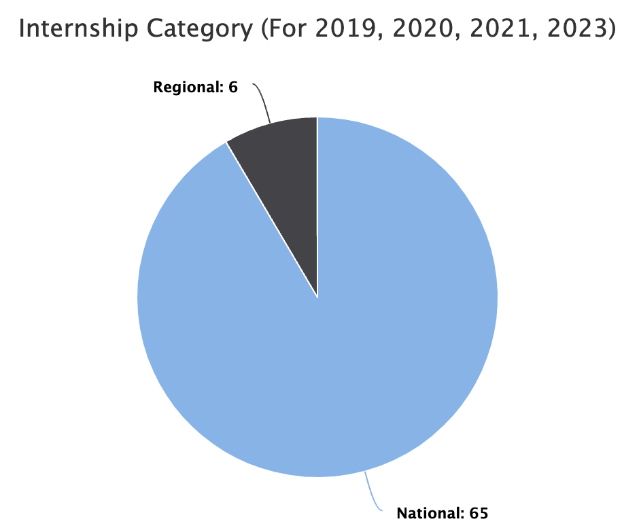
INTERNSHIPS
The target for student internship is 140 and staff internship is 08
110 students have completed internships of 1 month or more (1st and 2nd cohort)
3rd cohort to go for internships before the end of the year
Staff internships is to start next academic year
National: 65
National: 65

Slide 44
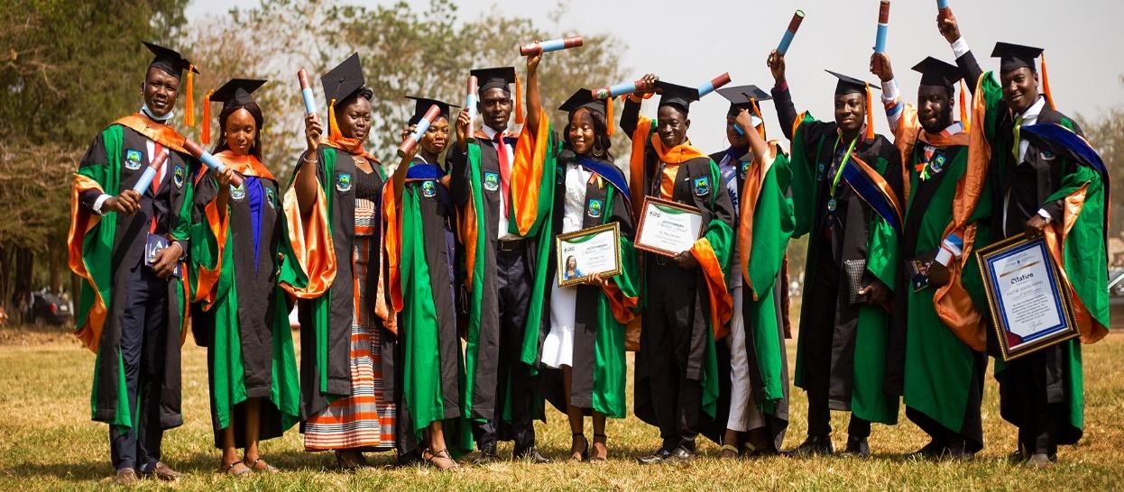
Graduation
The 1st cohort of MSc students who were graduated during the university’s 6th Congregation held in December 2021.
A total of 40 students (26 in Environment, 14 in Energy) have successfully graduated from their Master program
The remaining students are scheduled to be graduated in a special graduation ceremony.
2nd group of Master Students and 1st PhD students under RCEES to graduate this year

Slide 45
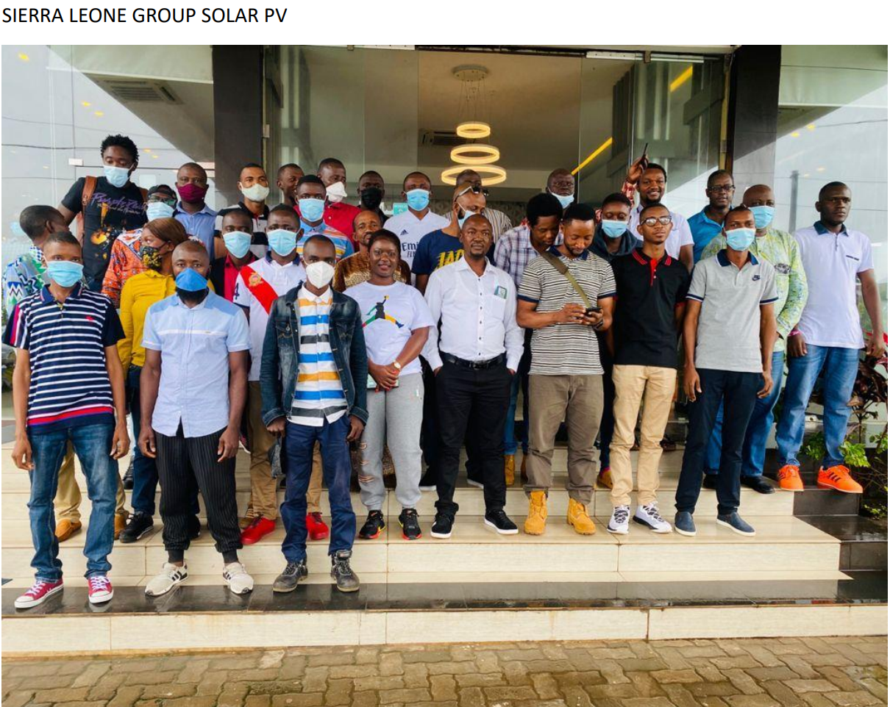
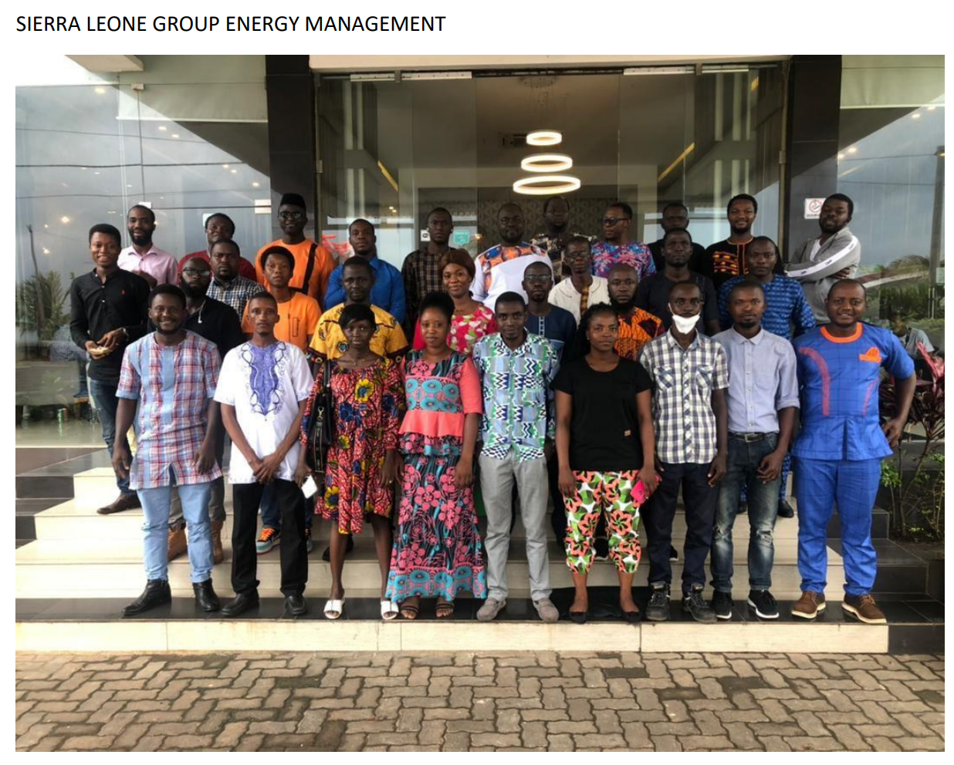
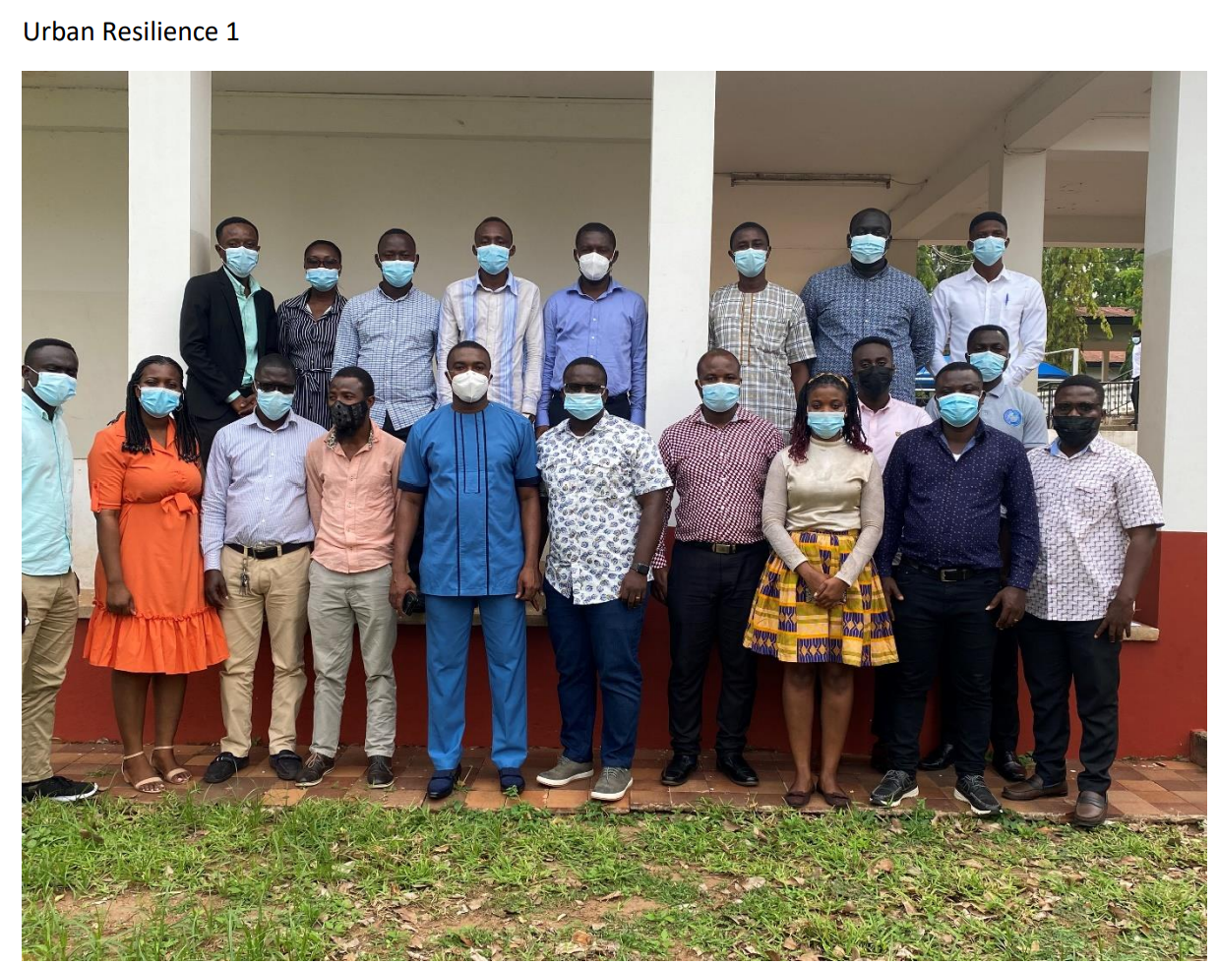
Short Courses

