Slide 1

The German concept of competence and a relevant theoretical background
Workshop: Training of Trainers, within the ProREG-Project at KNUST, March 2024
PD Dr. Stefan Wolf | s.wolf@tu-berlin.de

Slide 2
Definitions of competence
Definition of competence according to - Heinrich Roth
Subject-related „skills“
(professional and specialised knowledge) and process-related skills and methods (heurism)
„Technical“*
Competence
Quoted: Heinrich Roth:
Educational psychology of teaching and learning. 1957
Roth became known for his call for a "realistic turn" in German educational science.
Personal
Competence
Self-related „skills“ such as motivation, interests, metacognition
etc.
Social „skills“ such as communication “skills”, ability to work in teams etc.
Social
Competence
Workshop: Training of Trainers, within the ProREG-Project at KNUST, March 2024 | PD Dr. Stefan Wolf
Dr H.-J. Lindemann & PD Dr Stefan Wolf | CC-BY-NC 4.0
Notes:
Technical Competence means the German term of Sachkompetenz

Slide 3
Definitions of competence
Competencies are "dispositions of self-organised action" (Erpenbeck, Rosenstiehl 2007, XIX), which "ultimately mean the person as such with his versatility, his knowledge, his ability, his will, in short: his personality" (Vonken 2005, 39) and which are self-organised towards "self-imposed goals (...)" (Erpenbeck, Scharnhorst 2005, 2).
Workshop: Training of Trainers, within the ProREG-Project at KNUST, March 2024 | PD Dr. Stefan Wolf
Dr H.-J. Lindemann & PD Dr Stefan Wolf | CC-BY-NC 4.0

Slide 4
Competence concept of professional education and training
Definitions of competence in German professional education
The company
The Vocational school (dual)
The (...) named skills, knowledge and abilities (professional ability to act) are to be taught in a process-related manner.
The qualifications must be taught in such a way that the trainees are able to carry out a qualified professional activity (...) which includes, in particular, independent planning, implementation and control as well as acting within the overall operational context.
The (...) objectives [of the vocational school] are focussed on the development of action competence.
This is understood as the willingness and ability of the individual to behave appropriately, considerately and in an individually and socially responsible manner in social, professional and private situations.
Competence to act develops in the dimensions of professional competence, personal competence and social competence.
Quoted from: Training framework plan for vocational training
in the industrial metalworking trades
Quoted from: FRAMEWORK CURRICULUM for the training occupation of industrial mechanic
Workshop: Training of Trainers, within the ProREG-Project at KNUST, March 2024 | PD Dr. Stefan Wolf
Dr H.-J. Lindemann & PD Dr Stefan Wolf | CC-BY-NC 4.0

Slide 5
Demarcations ^{I}
Demarcations of the competence concept
Competence should not be confused with qualification* (German)
*
Proficiency for a specific [professional] activity acquired through training, experience, etc.
  Competence is an inner disposition of human beings
  Qualification means usability and usefulness in a specific context
The existing tension between competence and qualification is cancelled out by the pedagogical construct of competent action!
Workshop: Training of Trainers, within the ProREG-Project at KNUST, March 2024 | PD Dr. Stefan Wolf
Dr H.-J. Lindemann & PD Dr Stefan Wolf | CC-BY-NC 4.0

Slide 6
Demarcations ^{II}
Demarcations of the competence concept
CBET aims to teach simple work skills
No connection with complex work tasks and problem-solving skills
No work process orientation
Professional competence should not be confused with competence-based education and training (CBET).
Workshop: Training of Trainers, within the ProREG-Project at KNUST, March 2024 | PD Dr. Stefan Wolf
Dr H.-J. Lindemann & PD Dr Stefan Wolf | CC-BY-NC 4.0

Slide 7
Summary of competences in education in Germany
(Professional)
Competence
Specialist*
Competence
Methodological competence
Learning competence
Language competence
...
Human
Competence
Methodological competence
Learning competence
Language competence
Self-reliance
...
Social
Competence
Methodological competence
Learning competence
Language competence
Co-operation
...
Domain
Person
Group
Workshop: Training of Trainers, within the ProREG-Project at KNUST, March 2024 | PD Dr. Stefan Wolf
Dr H.-J. Lindemann & PD Dr Stefan Wolf | CC-BY-NC 4.0
Notes:
*Sachkompetenz

Slide 8
Standards: German Qualifications Framework (DQR)
Four-pillar model:
 | Requirement structure
Professional Competence |  | Personal competence
Knowledge | Skills | Social competence | Self-competence
Depth and width | Instrumental and systemic skills, Assessment capability | Team/leadership skills, Co-design and communication | Independence/responsibility, Reflexivity and learning competence
Dr Lindemann
Competence concepts
8
Workshop: Training of Trainers, within the ProREG-Project at KNUST, March 2024 | PD Dr. Stefan Wolf
Dr H.-J. Lindemann & PD Dr Stefan Wolf | CC-BY-NC 4.0

Slide 9

Der Standard der dualen BB - Kompetenzkonzept
Kompetenzverständnis im DQR (Deutscher Qualifikationsrahmen)
"In the DQR, competence refers to the ability and willingness of the individual to use knowledge and skills as well as personal, social and methodological abilities and to behave in a thoughtful and individually and socially responsible manner. In this sense, competence is understood as a comprehensive competence to act". (BIBB) translated by deepl.com
Einheitliche Struktur bei der Beschreibung der acht Niveaus des DQR:
Niveauindikator Anforderungsstruktur
Fachkompetenz |  | Personale Kompetenz
Wissen | Fertigkeiten | Sozialkompetenz | Selbständigkeit
Tiefe und Breite | Instrumentale und systemische Fertigkeiten, Beurteilungsfähigkeit | Team/ Führungsfähigkeit, Mitgestaltung und Kommunikation | Eigenständigkeit/ Verantwortung, Reflexivität und Lernkompetenz
Workshop: Training of Trainers, within the ProREG-Project at KNUST, March 2024 | PD Dr. Stefan Wolf
Dr H.-J. Lindemann & PD Dr Stefan Wolf | CC-BY-NC 4.0

Slide 10
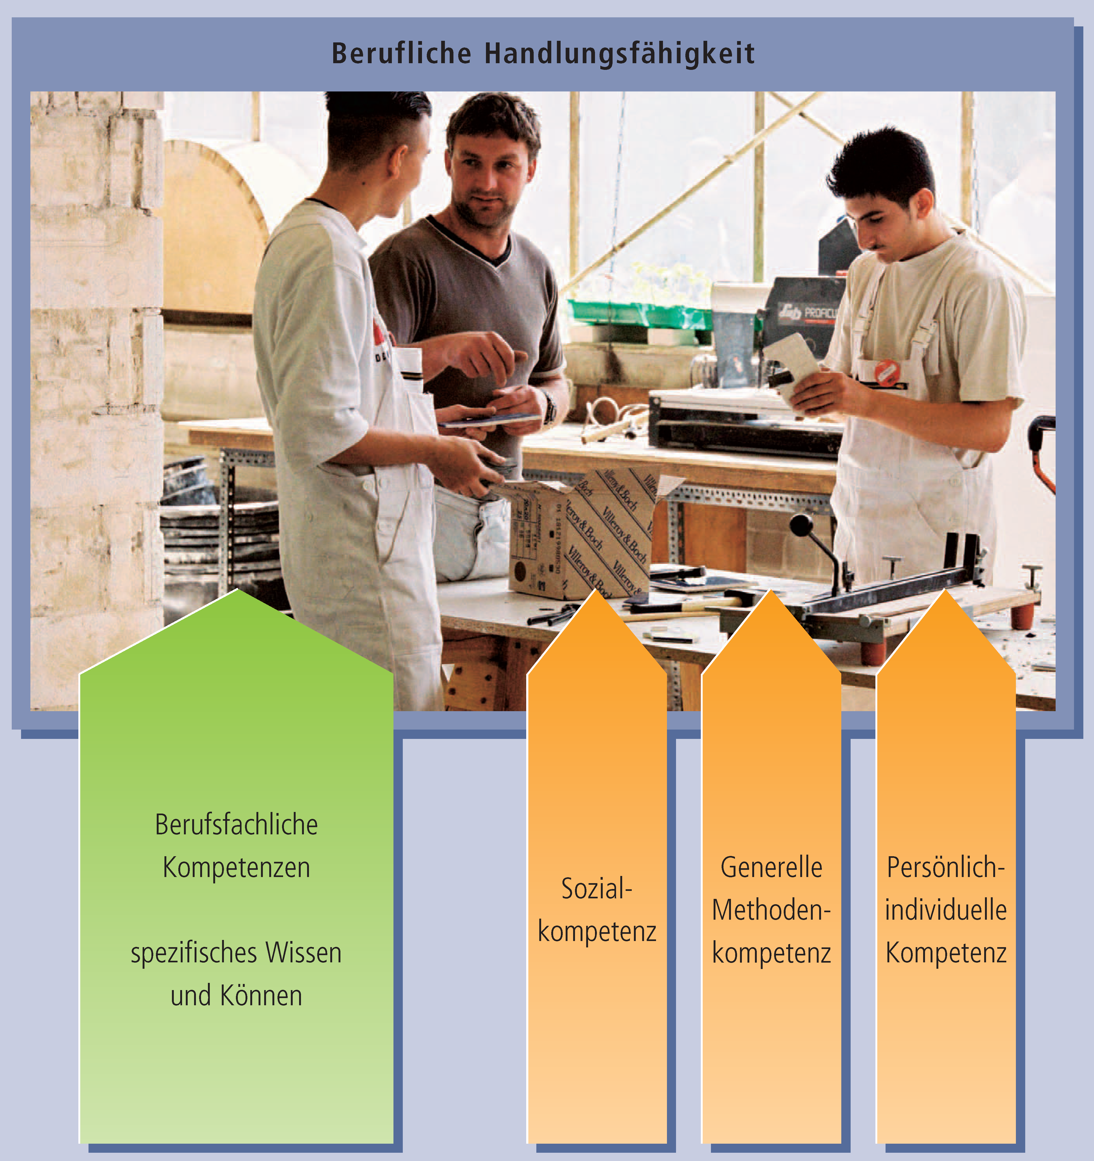
Summary of competences in professional education and training
Ability to Act Professionally
Professional competence is the prerequisite for the ability to act professionally* as the goal of professional training
It is constituted by the combination of occupation-related competence with social, personal and methodological competence
Professional Competence
Test
occupation-related competence
Social competence
General Methodological Competence
Personal competence
Specific knowledge and skills
*In contrast to a competence, the ability to act is open to assessment
occupation-specific
Supra-disciplinary / transversal
Workshop: Training of Trainers, within the ProREG-Project at KNUST, March 2024 | PD Dr. Stefan Wolf
Dr H.-J. Lindemann & PD Dr Stefan Wolf | CC-BY-NC 4.0

Slide 11
Competences in professional education and training
Comprehensive professional competence
Main Competences
Technical
Competence
Social competence
Human Competence
Complete action
Problem-solving ability
Economic efficiency
Project management
Presentation skills
Time management
Documentation
Foreign language (e.g. English)
Working in a team
Communication skills
Dealing with conflict
Critical faculties
Fairness
Tolerance
Customer orientation
Helpfulness
Innovation ability
Sense of responsibility
Independence
Reliability
Creativity
Flexibility
Decision-making ability
Reflexivity
Partial competences
e.g. bricklayers / Civil Engineer:
Stone formats
Occupational safety; Health / Hygiene ...
Mortar groups; Tools; Materials; Constructions
ecological rules; etc.
more basic specialised knowledge and skills
Workshop: Training of Trainers, within the ProREG-Project at KNUST, March 2024 | PD Dr. Stefan Wolf
Dr H.-J. Lindemann & PD Dr Stefan Wolf | CC-BY-NC 4.0

Slide 12
Theoretical background
Workshop: Training of Trainers, within the ProREG-Project at KNUST, March 2024 | PD Dr. Stefan Wolf
Dr H.-J. Lindemann & PD Dr Stefan Wolf | CC-BY-NC 4.0

Slide 13
Theoretical background
A few comments on this:
However, some other conceptual approaches are also important:
- Action regulation theory (Volpert, Hacker)
- Experiential learning for engineering education (Kolb)
- Situated learning (Lave, Wenger)
Learning theories of constructivism
Theories of activity-based learning, in particular the Soviet school of cultural-historical activity theory (Vygotsky, Leontiev, Galparin)
Workshop: Training of Trainers, within the ProREG-Project at KNUST, March 2024 | PD Dr. Stefan Wolf
Dr H.-J. Lindemann & PD Dr Stefan Wolf | CC-BY-NC 4.0

Slide 14
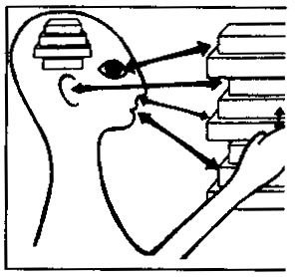
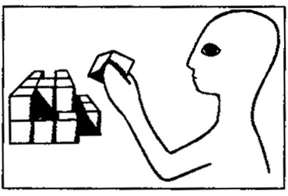
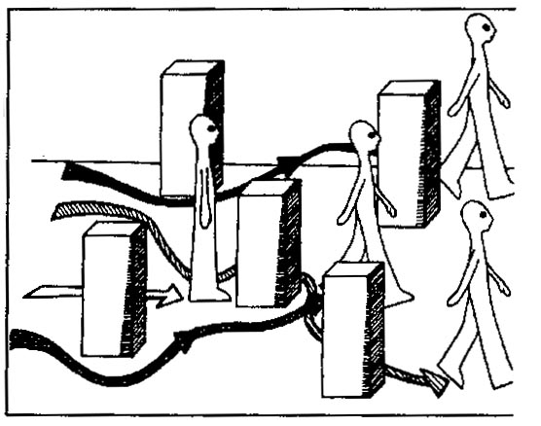
Constructivist theory of learning
Theoretical background
            The human being is a closed system that perceives its world through sensory channels
            Everyone constructs their own view of the world
            The construction of the world is practicable (useful), not right or wrong
Workshop: Training of Trainers, within the ProREG-Project at KNUST, March 2024 | PD Dr. Stefan Wolf
Dr H.-J. Lindemann & PD Dr Stefan Wolf | CC-BY-NC 4.0

Slide 15
Consequences for didactics
Theoretical background
From the guiding difference right/wrong to the guiding difference relevance and usefulness
From the normative to the interpretative and reflexive approach
From imparting knowledge and truth to penetrating the world
From the didactics of instruction to the didactics of facilitation
Active action for the creation of "reality"
Perception of difference and plurality
Source: Siebert; 1998; in: Berner; 2001
Workshop: Training of Trainers, within the ProREG-Project at KNUST, March 2024 | PD Dr. Stefan Wolf
Dr H.-J. Lindemann & PD Dr Stefan Wolf | CC-BY-NC 4.0

Slide 16
Theories of action-orientated learning
The cultural-historical school
Theoretical background
From a socio-cultural-historical perspective, all learning and development processes are conditioned by social interaction
Wykotsky: internalisation and objective action; the development of the individual develops sequentially (zone of proximal development)
Leontjew: "All human knowledge reflects the world in human beings, however refracted through the prism of the concrete particularity of the individual, ".
Workshop: Training of Trainers, within the ProREG-Project at KNUST, March 2024 | PD Dr. Stefan Wolf
Dr H.-J. Lindemann & PD Dr Stefan Wolf | CC-BY-NC 4.0

Slide 17
Theories of activity-based learning
Theoretical background
                e.g. Miller, Galanter, Pribram (1960), Hacker (1974), Volpert (1974), Kolb (1984)
                e.g. Holzkamp (1995), Engeström (2001)
                e.g. John Dewey
                e.g. Pestalozzi (18th century), Comenius (17th century) - head, heart and hand - unity of learning, German reform pedagogy
Theories of regulation
Theories of appropriation
Pragmatism
(learning by doing)
European philosophy of education
(a link between activity and learning)
Workshop: Training of Trainers, within the ProREG-Project at KNUST, March 2024 | PD Dr. Stefan Wolf
Dr H.-J. Lindemann & PD Dr Stefan Wolf | CC-BY-NC 4.0
Notes:
TOTE-Modell: Plans and the Structure of Behavior; Miller, Galanter, Pribram (1960),
Holzkamp 1995, Lernen: Subjektwissenschaftliche Grundlegung, defensives und expansives Lernen;
Engeström 2001, Expansive Learning at Work: Toward an activity theoretical reconceptualization, expansives Lernen und Tätigkeitstheorie, For Engeström, learning takes place not only in the form of people absorbing knowledge, but also in the active transformation of their environment and their relationships to life.

Slide 18



Pragmatism and contextualism according to John Dewey
Theoretical background
Learning is essentially based on experience.
Knowledge and meanings as the result of social constructivist processes (group work, practical experience, etc.)
Learning as a process of active construction that generates qualitative changes in knowledge.
Workshop: Training of Trainers, within the ProREG-Project at KNUST, March 2024 | PD Dr. Stefan Wolf
Dr H.-J. Lindemann & PD Dr Stefan Wolf | CC-BY-NC 4.0

Slide 19
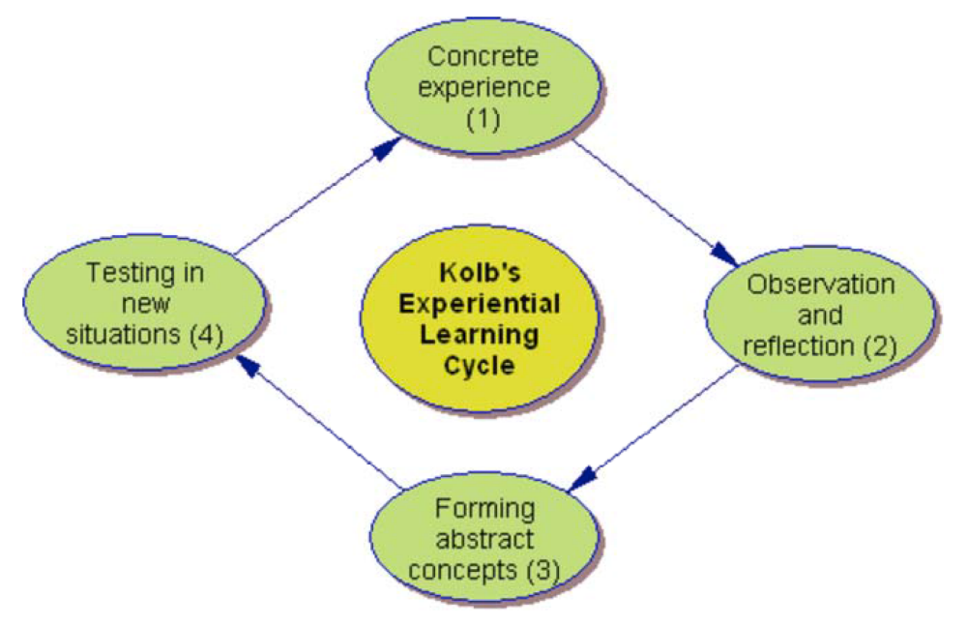
Experiential Learning - a widespread concept of engineering education -
Theoretical background
“Learning is the process
whereby knowledge is created through the transformation of
experience” (Kolb, 1984, p.3)
More?
Novice to master paradigm in professional education
Workshop: Training of Trainers, within the ProREG-Project at KNUST, March 2024 | PD Dr. Stefan Wolf
Dr H.-J. Lindemann & PD Dr Stefan Wolf | CC-BY-NC 4.0

Slide 20
Theoretical background
The development logic approach
From novice to expert
Novice
Advanced
Competent expert
Based on "A Five-Stage Model of the Mental Activities Involved in Directed Skill Acquisition", Dreyfus and Dreyfus 1980
Need for clear rules is decreasing
Implicit knowledge is increasing
Behavioural safety increases
Perception sharpens
Alternative courses of action are increasing
end
Danger:
Willingness to reflect and criticise can decrease
Dr H.-J. Lindemann & PD Dr Stefan Wolf | CC-BY-NC 4.0
Workshop: Training of Trainers, within the ProREG-Project at KNUST, March 2024 | PD Dr. Stefan Wolf
Notes:
5 stages: novice, competence, proficiency, expertise and mastery

Slide 21

Thank you very much for your participation
Priv. Doz. (Associate Professor) Dr. Stefan Wolf | s.wolf@tu-berlin.de
Senior Researcher at TU Berlin
International Consultant
Workshop: Training of Trainers, within the ProREG-Project at KNUST, March 2024 | PD Dr. Stefan Wolf

