Slide 1

Project Learning and Learn- and Work-Assignments
Workshop: Training of Trainers, within the ProREG-Project at KNUST, March 2024
PD Dr. Stefan Wolf | s.wolf@tu-berlin.de

Slide 2

Summary of competences in professional education and training
Ability to Act Professionally
Professional competence is the prerequisite for the ability to act professionally* as the goal of vocational training
It is constituted by the combination of occupation-related competence with social, personal and methodological competence
Professional Competence
Test
occupation-related competence
General Methodological Competence
Personal competence
Social competence
Specific knowledge and skills
*In contrast to a competence, the ability to act is open to assessment
occupation-specific
Supra-disciplinary / transversal
Workshop: Training of Trainers, within the ProREG-Project at KNUST, March 2024 | PD Dr. Stefan Wolf
Dr H.-J. Lindemann & PD Dr Stefan Wolf | CC-BY-NC 4.0

Slide 3
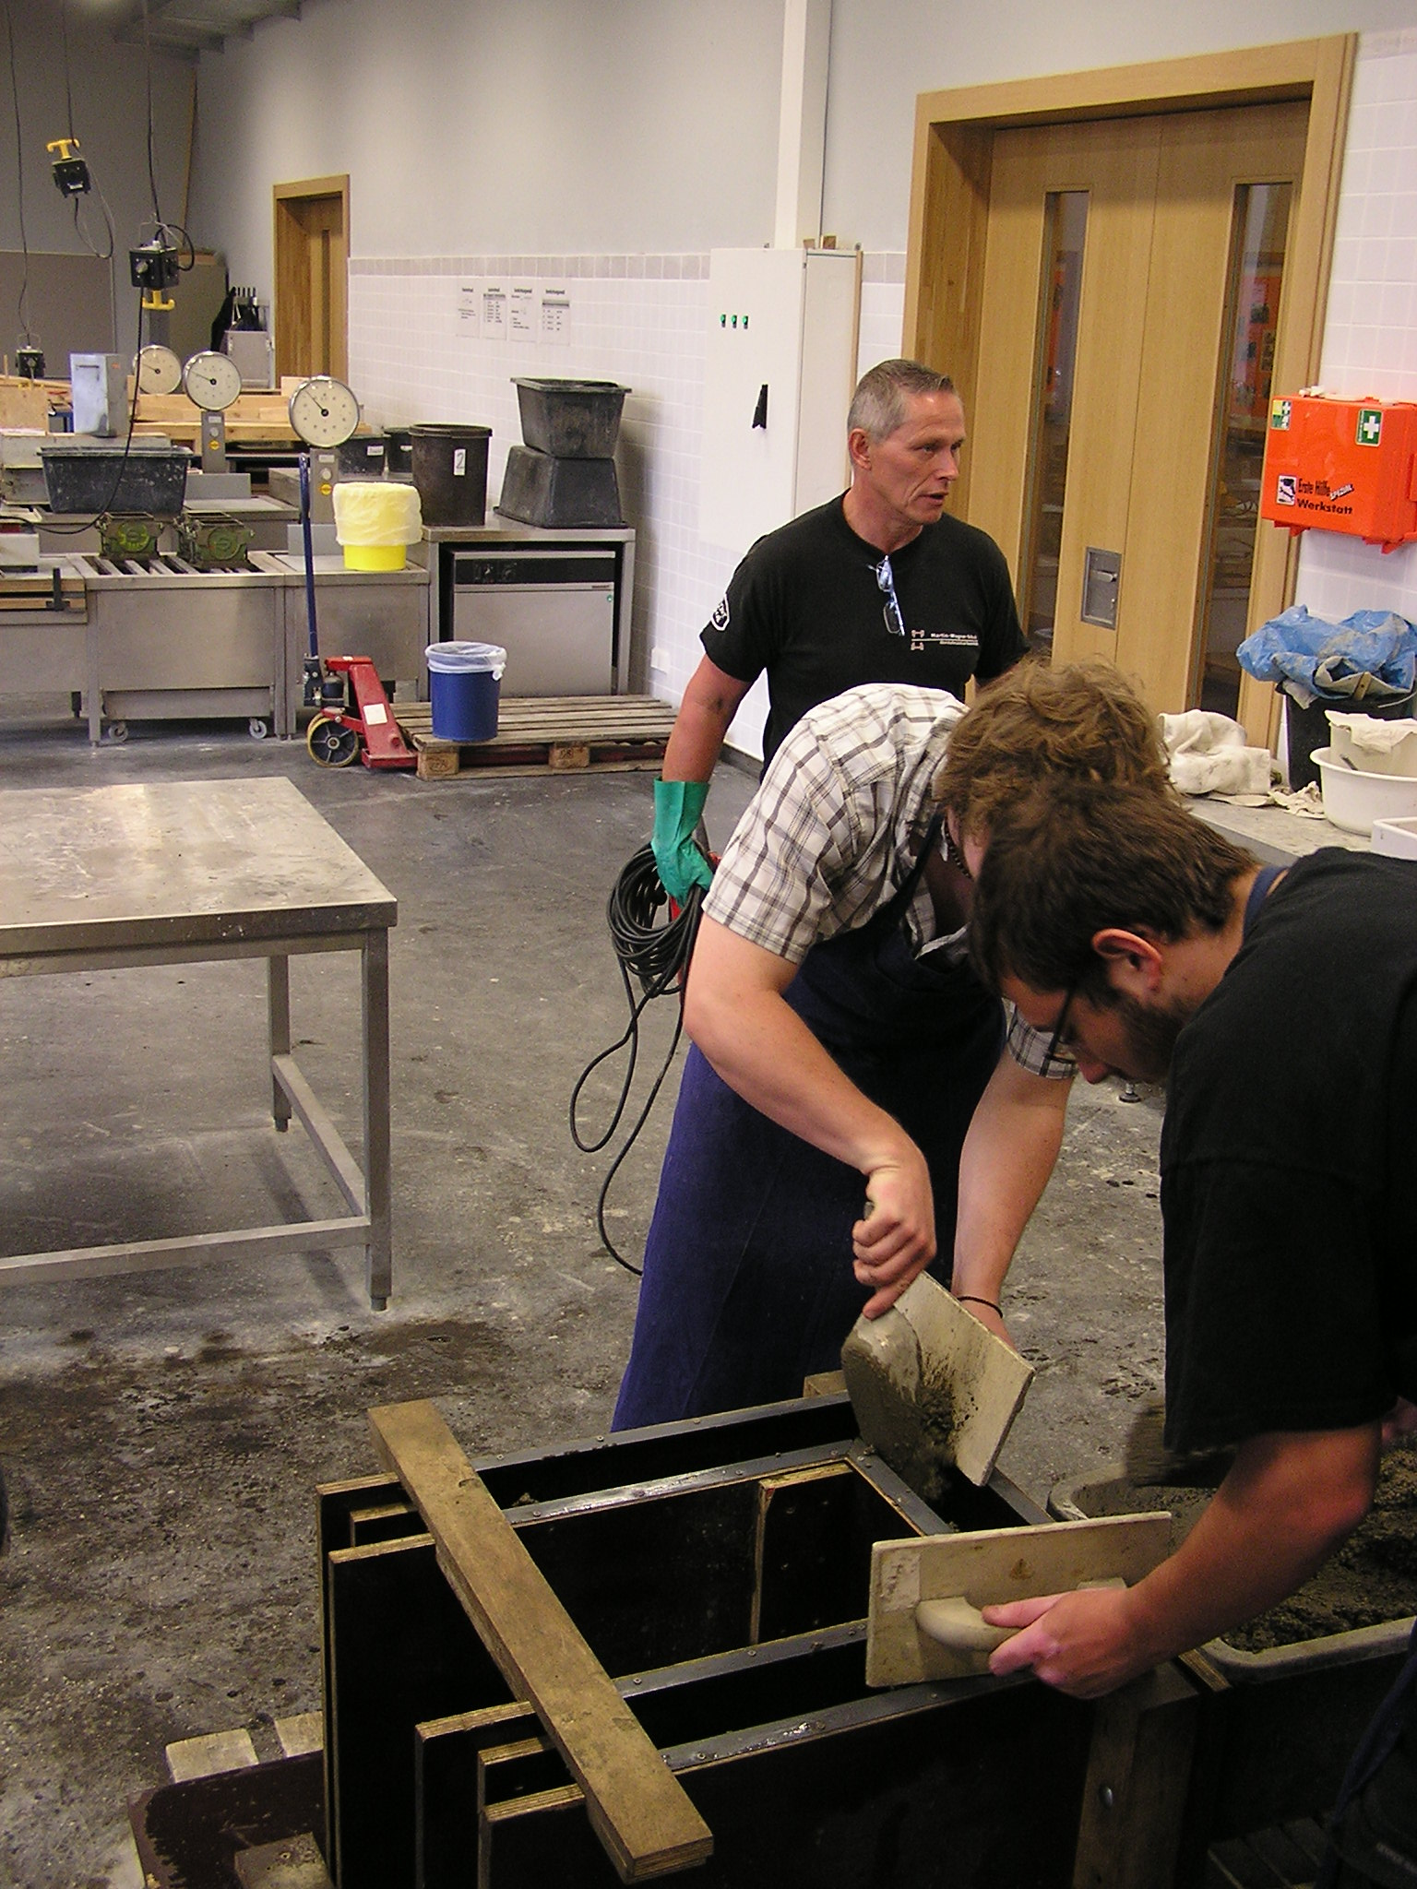
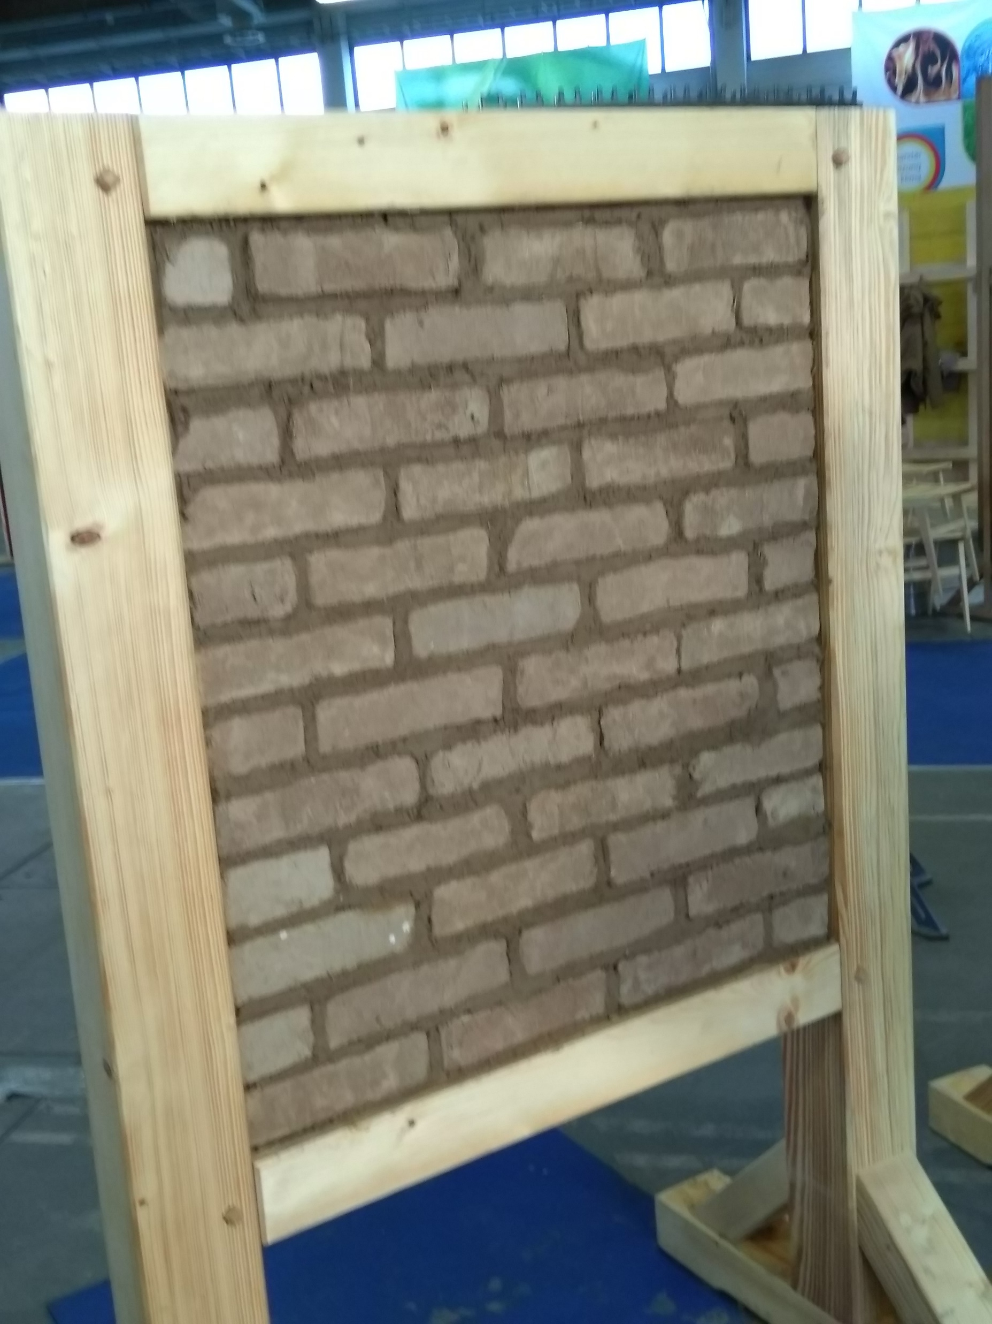
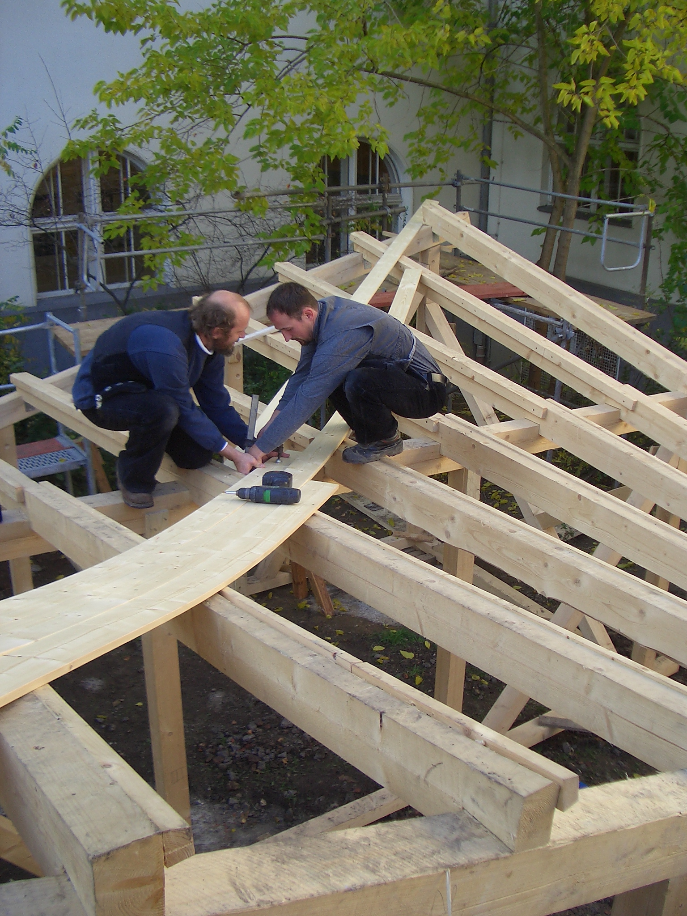
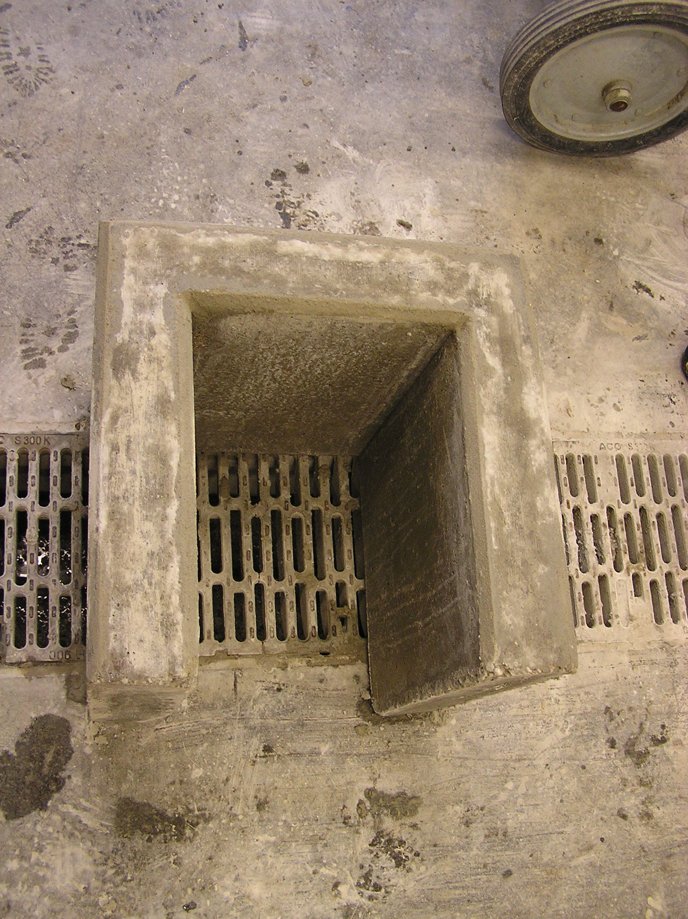
Action- and problem-oriented learning
Teaching should be designed as an active construction process by the learners.
In this understanding, concepts, theories, models, strategies or techniques are to be introduced as solutions to specific problems of action or orientation.
Practically relevant action or orientation problems (also e.g. in the form of concrete work tasks) should be the starting point of the learning process.
Situated learning:
The central didactic-curricular challenge is to (re)integrate learning objects into meaningful situational contexts,
that they offer learners opportunities for problem-solving learning,
that they become relevant for orientation and action in the course of this problem-solving action
and can thus be appropriated by the learners
Dr H.-J. Lindemann & PD Dr Stefan Wolf | CC-BY-NC 4.0
Workshop: Training of Trainers, within the ProREG-Project at KNUST, March 2024 | PD Dr. Stefan Wolf

Slide 4
Holistic learning - complexity of operational tasks
Complex teaching-learning situations as starting points for situated, problem-solving learning
Representation of the meaning of the subject content and the essential structural relationships of the respective learning object
Didactic management - recourse to operational problems, allocation and integration of factual content (systematics)
Student-appropriate progression in complexity of situation and task
Disruptions in operational processes as a design element of operational learning
Core concepts should refer to:
Which concepts (terms, models, procedures, attitudes) should the learners acquire and
How these concepts are to be represented situationally by which problems or tasks, operational processes?
Workshop: Training of Trainers, within the ProREG-Project at KNUST, March 2024 | PD Dr. Stefan Wolf
Dr H.-J. Lindemann & PD Dr Stefan Wolf | CC-BY-NC 4.0

Slide 5
Learning within projects
We need to separate strictly between Educational Projects and Operational ones
Educational projects
Operational projects
Participant-orientation - open design (goals - content)
Projects at school: negotiation between
teachers and learners
Holistic learning:
cognitive, psychomotor, affective skills
Reference to real (work) situations
Problem content - practical significance
Product orientation: process - product - process
Action orientation: planning - implementation - monitoring and evaluation
Self-control - starts with the goals
Teamwork: learners work together on the project task
Interdisciplinary character
Form a project team (different professional profiles)
Team leader, team roles
Client, project order (specifications)
The client's concern: What does he want to achieve? What is his problem?
Project profile (P.-Name ...)
Clarify stakeholders / parties involved
Target, target matrix
Phase planning, phase plan
Project order - Project contract
Work breakdown structure
Subtasks, work packages
Project schedule / milestones
Risk analysis
Project realisation - control
Project completion
Workshop: Training of Trainers, within the ProREG-Project at KNUST, March 2024 | PD Dr. Stefan Wolf
Dr H.-J. Lindemann & PD Dr Stefan Wolf | CC-BY-NC 4.0
Notes:
Projects for learning and teaching within engineering education request a mixture between pure educational and operational projects

Slide 6
Constructivist view of teaching and learning
Learning as a constructive, social,
situated process
(project method, learning tasks, team method ...)
Active position of the learner
Construction
Designing situated learning environments
Teaching: Lecturing, teaching dialogue
Accompanying, moderating, ...
Active and reactive
Role of the teacher
Workshop: Training of Trainers, within the ProREG-Project at KNUST, March 2024 | PD Dr. Stefan Wolf
© Dr. H.-J. Lindemann & PD Dr. Stefan Wolf | CC-BY-NC 4.0

Slide 7
Construction of competences - instruction / teaching
Instruction
Teachings e.g.
Lecture, Presentation
Instruction, presentation CAD
Support, advise
explaining, discussing
The teachers :
Situation-specific alternation between active and receptive forms (lecture - exercise – project etc. )
Project
Task
Construction
Learning is an active, self-directed, constructive,
social and
situational process
Learners:
Individually and as a team,
actively receptive
Workshop: Training of Trainers, within the ProREG-Project at KNUST, March 2024 | PD Dr. Stefan Wolf
© Dr. H.-J. Lindemann & PD Dr. Stefan Wolf | CC-BY-NC 4.0

Slide 8
How to realise this holistic learning and teaching approach?
Workshop: Training of Trainers, within the ProREG-Project at KNUST, March 2024 | PD Dr. Stefan Wolf

Slide 9
Principles for the development of complex teaching-learning arrangements
When developing and formulating complex and holistic learning situations, the following aspects must be taken into account:
They should be realistic and draw on the trainees' experience wherever possible (working environment, work processes)
Make clear the possibilities of linking previous knowledge or own experiences, reflection and exchange of experiences in the learning group
Enable a consideration of the different points of view,
Recognising design and application possibilities in related situations (transfer) and .
Communicate various solutions to problems in different operational work processes.
Enable categorisation in knowledge concepts, expand the trainees' knowledge structure (knowledge orientation - problem, work process, subject)
Workshop: Training of Trainers, within the ProREG-Project at KNUST, March 2024 | PD Dr. Stefan Wolf
Dr H.-J. Lindemann & PD Dr Stefan Wolf | CC-BY-NC 4.0

Slide 10

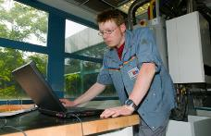
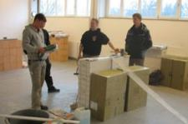
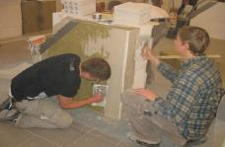
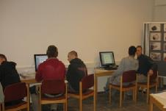
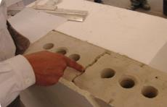
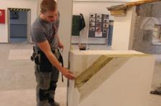
How to realise holistic learning and teaching approach ?
The model of the complete action in modern training concepts
!
take over assignment
(from the coach),
obtain relevant information
Evaluation of the results of the assessment + feedback to avoid future errors
Step with a specific duty to the trainer
1. inform
Preparation of a written work plan
!
6. evaluate
2. plan
Decide how to get the job done based on the work plan.
Step with a specific duty to the trainer
5. control
3. decide
!
Self-assessment and external assessment with the aid of test sheets
4. execute
Carry out the work order
Step with a specific duty to the trainer
Workshop: Training of Trainers, within the ProREG-Project at KNUST, March 2024 | PD Dr. Stefan Wolf
Dr H.-J. Lindemann & PD Dr Stefan Wolf | CC-BY-NC 4.0
Notes:
Source : https://www.foraus.de/images/content/Berufsbildung_4_0_276093827_443x290.jpg
Symbol for the special activity of the teacher or trainer

Slide 11
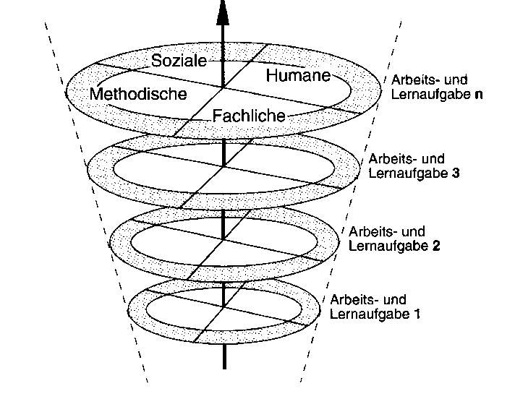
Realisation of professional competence
Structure of learning tasks/learning and work tasks
How to realise holistic learning and teaching approach ?
Competences
Social
Learn & Work Assignment n
Personal
Methodological
Professional
Requirements
from operational
Work tasks
Learn & Work
Assignment 3
Learn & Work Assignment 2
Learn & Work Assignment 1
Requirements
from the didactic
analysis
Workshop: Training of Trainers, within the ProREG-Project at KNUST, March 2024 | PD Dr. Stefan Wolf
Dr H.-J. Lindemann & PD Dr Stefan Wolf | CC-BY-NC 4.0

Slide 12
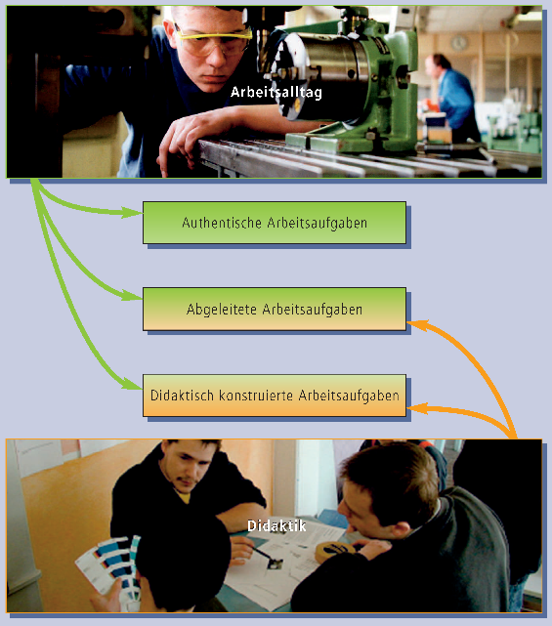
Realisation of professional action competence
How to realise holistic learning and teaching approach ?
Problem based work tasks results from:
directly from operational processes
working processes, but elaborated
didactically constructed tasks
Daily Work Experiences
Authentic work tasks
Derived work tasks
Didactically constructed work tasks
Learn and Work Assignments (LWA)
Didactics
Workshop: Training of Trainers, within the ProREG-Project at KNUST, March 2024 | PD Dr. Stefan Wolf
Dr H.-J. Lindemann & PD Dr Stefan Wolf | CC-BY-NC 4.0

Slide 13
How to realise … – the Learn and Work Assignments
In-Company learning
In-Edu-Institutional learning
Work and learning tasks are didactically and methodically prepared professional work tasks, during the execution of which the professional, social and personal competences of the actors are expanded.
The constitution and implementation are primarily dependent on the following factors:
work and organisational concepts; customer and business processes; learning potential and opportunities in the work process; qualification and competence requirements
Learning and work task - definition:
A learning task sets goals in the form of a professional task,
the realisation and solution of which requires the application of new knowledge and skills, whereby the learning success results from the correct and complete execution of the task. (according to Elmar Witzgall)
Workshop: Training of Trainers, within the ProREG-Project at KNUST, March 2024 | PD Dr. Stefan Wolf
© Dr. H.-J. Lindemann & PD Dr. Stefan Wolf | CC-BY-NC 4.0

Slide 14
How to realise … – the Learn and Work Assignments
Selection criteria
Criteria for identifying professional work tasks for teaching and learning
Professional work tasks must include typical content and methods of specialised work that correspond to occupational profiles or job descriptions.
Professional work tasks represent a complete work action, whereby the individual action phases are usually weighted differently.
When working on a professional task, its integration into the operational process and organisational structure as well as into the operational business processes should be recognisable.
Occupational tasks contain learning potential that is reflected in characteristics such as room for manoeuvre, holism and problem solving.
Workshop: Training of Trainers, within the ProREG-Project at KNUST, March 2024 | PD Dr. Stefan Wolf
© Dr. H.-J. Lindemann & PD Dr. Stefan Wolf | CC-BY-NC 4.0

Slide 15
How to realise … – the Learn and Work Assignments
Work steps for the creation of learning and work tasks by the educational expert
Criteria for the didactic design of learning and work tasks:
Flowchart for creating learning and work tasks
Reference to real (work) situations
Practical significance, use significant work tasks
Orientation towards the level of training and the needs of the trainees
Product orientation: process - product - process
Enable active learning
Holistic learning: with head, heart and hand
Self-direction: trainees take responsibility for their learning path
Selecting a work task;
Listing activities;
Structuring activities
Selecting a topic (curriculum);
Determining Competences;
Defining subject content
Procurement of necessary information
Developing the learning and work task;
Determining the operational context - Defining the task;
Determining the product - Designing the learning process
Carrying out the learning and work task
Success control and follow-up
Workshop: Training of Trainers, within the ProREG-Project at KNUST, March 2024 | PD Dr. Stefan Wolf
Dr H.-J. Lindemann & PD Dr Stefan Wolf | CC-BY-NC 4.0

Slide 16
Example* of a complete workflow
How to realise … – the Learn and Work Assignments
Customer
enquiry
e.g. installing
thermal
insulation
Work
preparation
e.g.
check
substrate
Production,
Installation
of
component
e.g. corner
formation
Assembly
e.g.
Installing
insulation
Applying
plaster
Inspection, snagging
Quality control,
Documentation of inspection
Invoicing
Create
invoice
Processing a customer order as the basis for learning at educational institutions
* An example from the professional education in the Dual Training in Germany
Workshop: Training of Trainers, within the ProREG-Project at KNUST, March 2024 | PD Dr. Stefan Wolf
© Dr. H.-J. Lindemann & PD Dr. Stefan Wolf | CC-BY-NC 4.0

Slide 17

How to realise … – the Learn and Work Assignments
An Example for project learning in the professional education for journeyman in electrician and electronics
end
Workshop: Training of Trainers, within the ProREG-Project at KNUST, March 2024 | PD Dr. Stefan Wolf
© Dr. H.-J. Lindemann & PD Dr. Stefan Wolf | CC-BY-NC 4.0

Slide 18

Examples from German‘s professional education
Thank you very much for your participation
Priv. Doz. (Associate Professor) Dr. Stefan Wolf | s.wolf@tu-berlin.de
Senior Researcher at TU Berlin
International Consultant
Workshop: Training of Trainers, within the ProREG-Project at KNUST, March 2024 | PD Dr. Stefan Wolf

